Slide 1
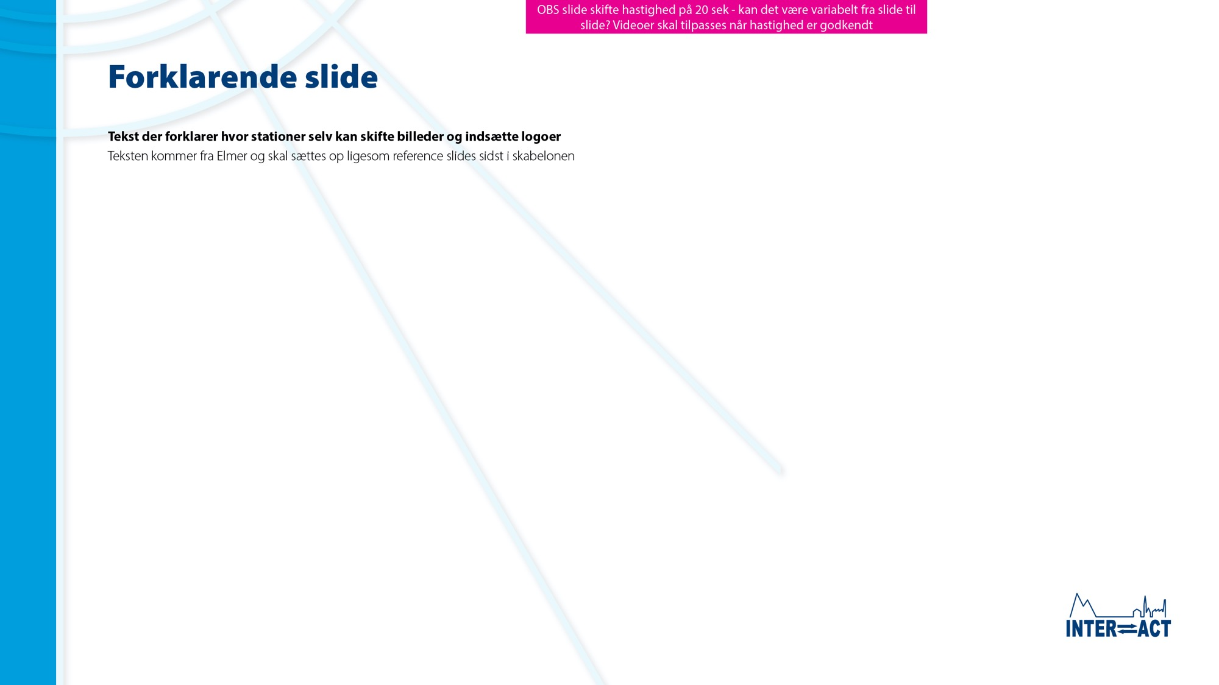

Slideshow explanation for stations
This slideshow has been made by the INTERACT Station Managers’ Forum and is intended for use at open station events.
The slideshow can be shown as a stand-alone slideshow or presented by station staff.
Stations can insert station/institution logo(s) on Slide 2.
Stations can insert photos of the station and surroundings on Slides 2, 3, to make the slideshow locally relevant. Remember to insert new photo credits.
The last two slides provide links to relevant INTERACT educational ressources and references to the slides.
Make sure to hide or delete Slide 1, 7, 8 before showing the slideshow.
Let’s INTERACT!

Slide 2
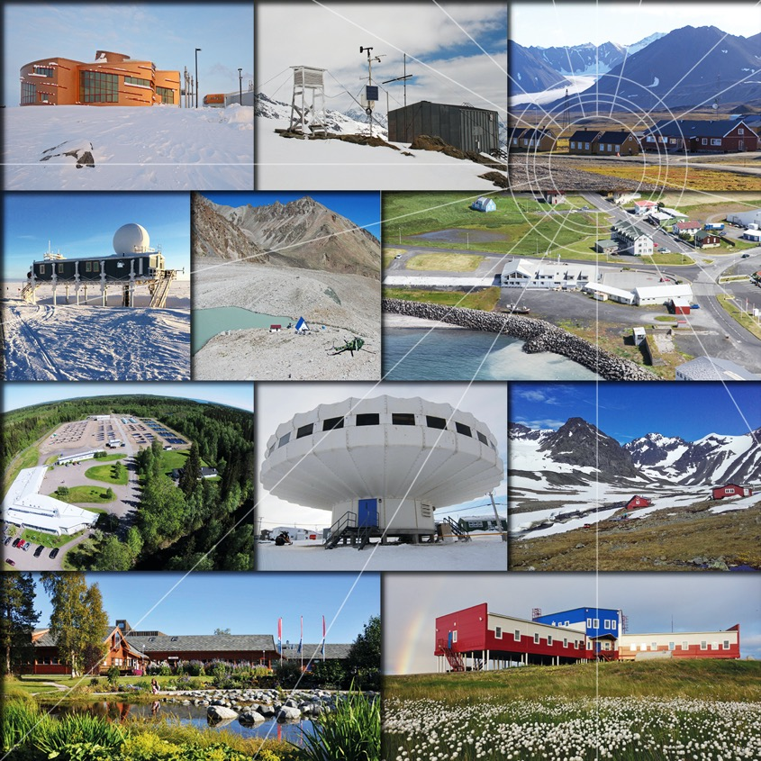

Photo: INTERACT stations
INTERACT
Open Station Event
Happening at research stations all over the Arctic

Slide 3
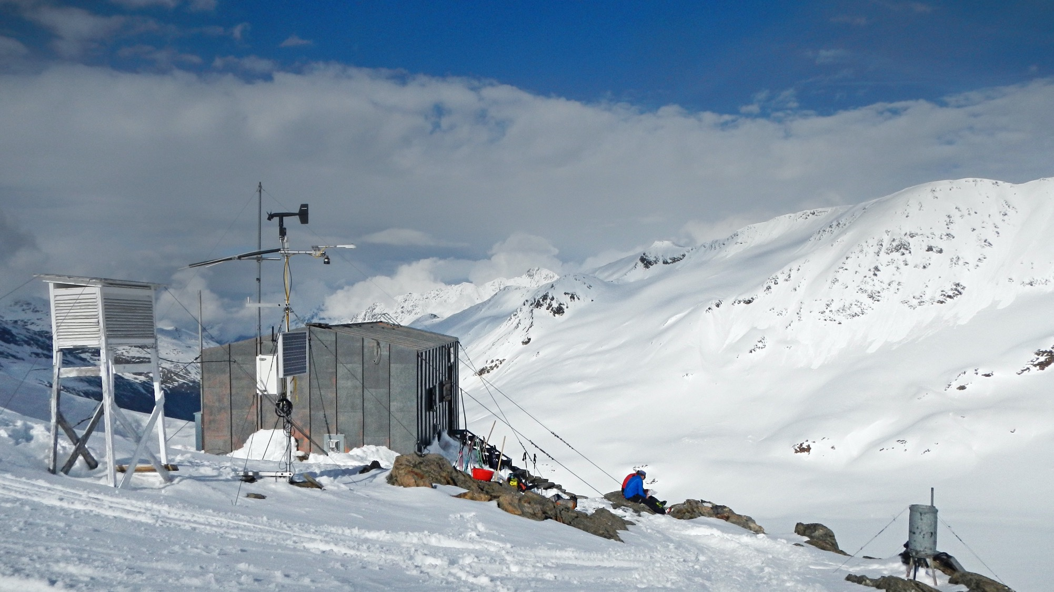
Photo: Christin Wild
The science that we do at our station is important for understanding local changes
PAGE 2 of 27

Slide 4
Our station is part of a circum-arctic network of research stations
called INTERACT
INTERACT brings together
managers of arctic, northern boreal and alpine research stations to exchange knowledge and improve the services offered to the scientific community
Russian station participation currently on pause
PAGE 3 of 27

Slide 5
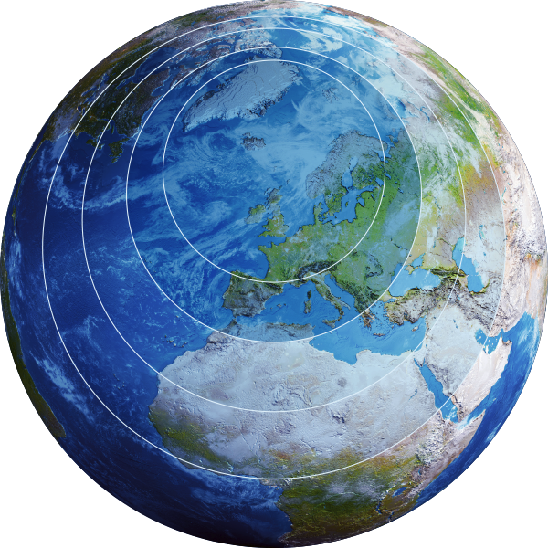
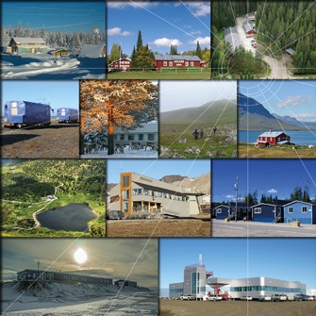
By providing our local data to international scientific networks and organisations, data from our area is used to assess climate and ecosystem change on a local to global scale
Photo: INTERACT stations
Local
Landscape
National
Regional
Local scale
Global
Arctic scale
Landscape scale
Global scale
PAGE 4 of 27

Slide 6



INTERACT stations contribute to an improved understanding of
climate and ecosystem change
Data from INTERACT stations are
used by science organisations to
address societal challenges
and make future predictions
for decision makers - locally, nationally and globally
Global
Arctic
Science and Policy
for People and Nature
Intergovernmental Panel on Biodiversity and Ecosystem Services
Intergovernmental Panel on Climate Change
Arctic
Council
PAGE 5 of 27

Slide 7
Educational resources
Station movie links
INTERACT educational resources:
Abisko Scientific Research Station:
https://interactsciencestories.org
https://eu-interact.org/arctic-awareness/interact-educational-resources
- Patterned ground (relevant for slides 11, 15 and 21)
- Permafrost dynamics (relevant for slides 11, 15 and 21)
- Analysis and importance of peatlands (relevant for slides 11, 15 and 21)
- Secret of dead plants (relevant for slides 11, 15 and 21)
- Glacier dynamics (relevant for slide 13)
- Glaciation and hanging valleys formation (relevant for slide 13)
Aktru Research Station :
https://youtu.be/AGhGoWxOMKU
Polish Polar Station Hornsund:
https://youtu.be/UZIoAmy3r8w
INTERACTive edition of the Science stories book II
Pallas-Sodankylä Research Station :
https://youtu.be/7L54vrsroQc
https://interactsciencestories.org
Global temperatures:
Villum Research Station :
https://youtu.be/o6Ghk2ourW0
Historic (relevant for slide 8): https://climate.nasa.gov/climate_resources/139/video-global-warming-from-1880-to-2021
Projection towards (relevant for slides 9 and 10)
https://zacklabe.com/climate-model-projections
GEM (Arctic Station, GINR, Zackenberg – in danish):
https://youtu.be/VNgLJLPxL10
Minimum sea ice extent:
Mukhrino Field Station:
https://youtu.be/PtPsjl-yD5A
1975-2020 (relevant for 12, 22 and 23): https://www.youtube.com/
watch?v=Vphz0HbbQVo
Projection towards 2100 (relevant for slides 12, 22 and 23): https://zacklabe.com/
climate-model-projections
Uapishka Research Station :
https://youtu.be/fyqu1bZb8Fw
PAGE 26 of 27

Slide 8
References
Slide 8, Global temperatures
Slide 16, Species composition
Statement: Rantanen, M., et al. (2022). The Arctic has warmed nearly four times faster than the globe since 1979. https://doi.org/10.1038/s43247-022-00498-3
Figure: Adapted from the National Aeronautics and Space Administration Goddard Institute for Space Studies: https://data.giss.nasa.gov/gistemp/maps/index_v4.html
Animation: NASA’s Scientific Visualization Studio. Data provided by Robert B. Schmunk (NASA/
GSFC GISS).
Statement: https://doi.org/10.1002/lno.11380
Statement: https://hdl.handle.net/10037/6807
Slide 17, Invasive species
Statement: https://www.pame.is/images/03_Projects/MPA/ARIAS/Arctic_Invasive_Alien_
Species_Strategy_and_Action_Plan_ARIAS.pdf
Slide 9, Global climate projection
Slide 18, Ecological mismatch
Projection by IPCC (Intergovernmental Panel on Climate Change). Source: https://www.ipcc.ch
Statement: https://onlinelibrary.wiley.com/doi/epdf/10.1111/ecog.02261
Slide 10, Arctic amplification
Slide 19-20, Extreme events
Animation: https://zacklabe.com/climate-model-projections
Statement: https://www.usgs.gov/science/science-explorer/climate/coasts-storms-and-sea-
level-rise
Statement: https://link.springer.com/article/10.1007/s13280-011-0213-x
Statement: https://arctic-council.org/explore/topics/climate/wildland-fire
Slide 11, Permafrost thaw
Animation: Permafrost CCI, Obu et al, 2019 via the CEDA archive, https://youtu.be/yTFt6rh0uVg
Statement: https://www.esa.int/Applications/Observing_the_Earth/FutureEO/Permafrost_thaw_it_s_complicated
Slide 21, Permafrost thaw
Slide 12, Sea-ice disappering
Statement: www.nunataryuk.org
Statement: https://doi.org/10.1038/s41558-022-01455-w
Statement: https://climate.nasa.gov/vital-signs/arctic-sea-ice
Statement: https://climate.esa.int/en/projects/sea-ice/news-and-events/news/simulations-suggest-ice-free-arctic-summers-2050
Animation: NASA/Goddard Space Flight Center’s Scientific Visualization Studio. And The Blue Marble data is courtesy of Reto Stockli (NASA/GSFC). https://svs.gsfc.nasa.gov/5036
Slide 22-23, Arctic sea-ice change
Statement: https://sciencenordic.com/cultural-history-culture-denmark/greenlands-sled-dog-population-is-decreasing-rapidly/1448029
Statement: https://nsidc.org/learn/parts-cryosphere/sea-ice/why-sea-ice-matters
Statement: https://aaca.amap.no
Slide 11, Glacier and ice cap melt, and sea level rise
Illustration: Steiger et al. (2018). Simulated retreat of Jakobshavn Isbræ since the Little Ice Age controlled by geometry. https://doi.org/10.5194/tc-12-2249-2018
Figure: http://www.columbia.edu/~mhs119/SeaLevel
PAGE 27 of 27

