Slide 1
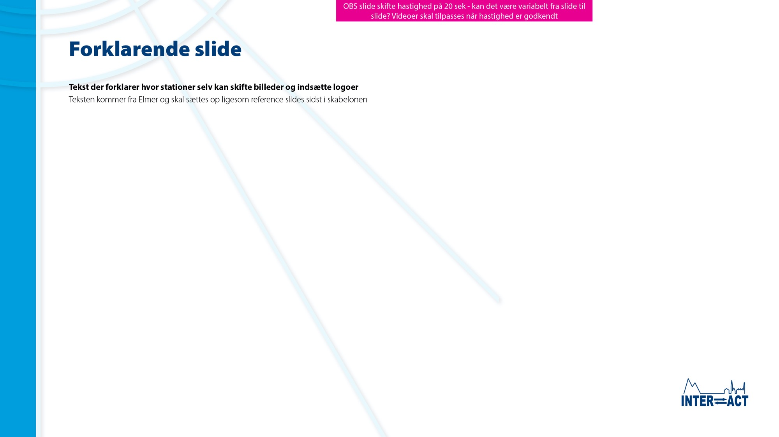

Slideshow explanation for stations
This slideshow has been made by the INTERACT Station Managers’ Forum and is intended for use at open station events.
The slideshow can be shown as a stand-alone slideshow or presented by station staff.
Stations can insert station/institution logo(s) on Slide 2.
Stations can insert photos of the station and surroundings on Slides 2, 10, 17 to make the slideshow locally relevant. Remember to insert new photo credits.
There are also slide paradigms, where stations can make their own slides about invasive species (8), plastic pollution (15) and local Climate Change (22) – simply duplicate slides if you need more slides. Remember to unhide slides before starting the slideshow.
Make sure to hide or delete Slide 1 (this slide) before showing the slideshow.
Let’s INTERACT!

Slide 2

An
invasive species
is an introduced, non-native organism able to spread in the natural environment
Invasive species
- What can you do?

Slide 3
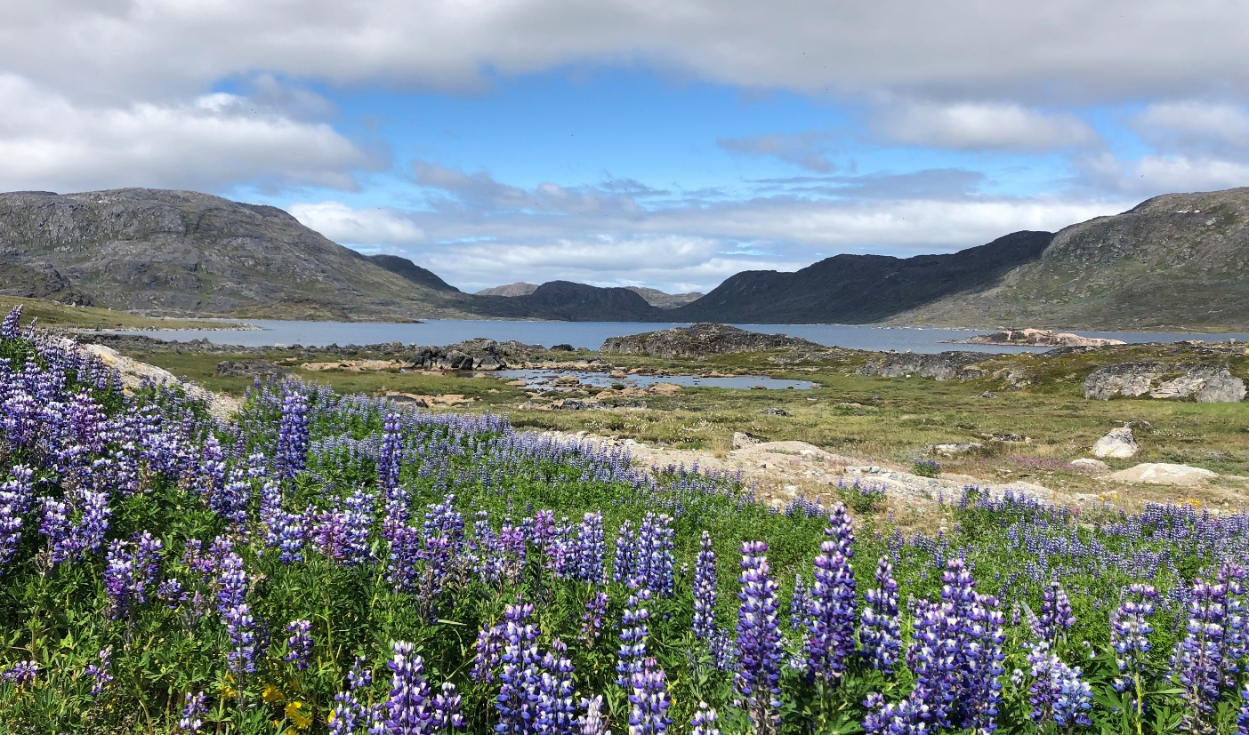
Invasive species
are one of the top drivers of global biodiversity loss
The invasive
Nootka lupin
in Greenland
Katrine Raundrup

Slide 4
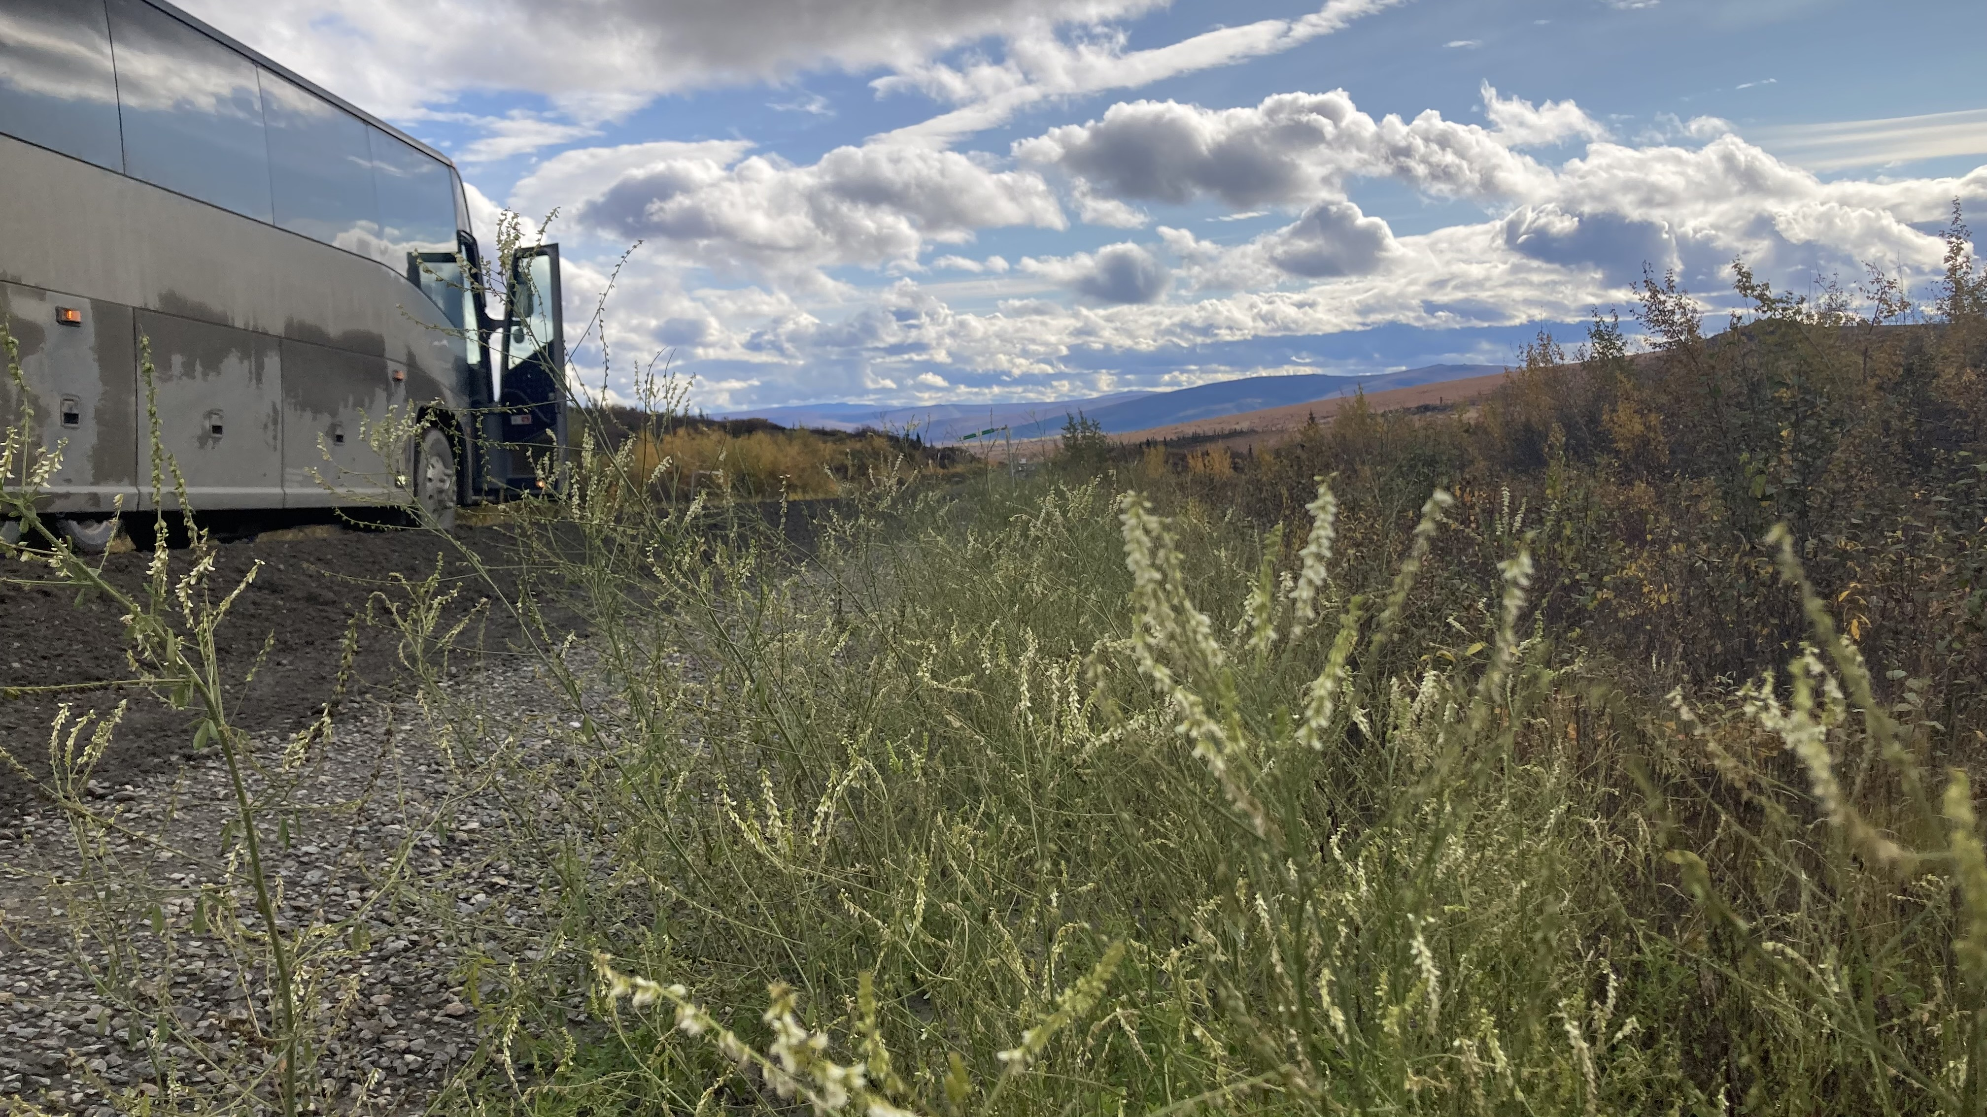
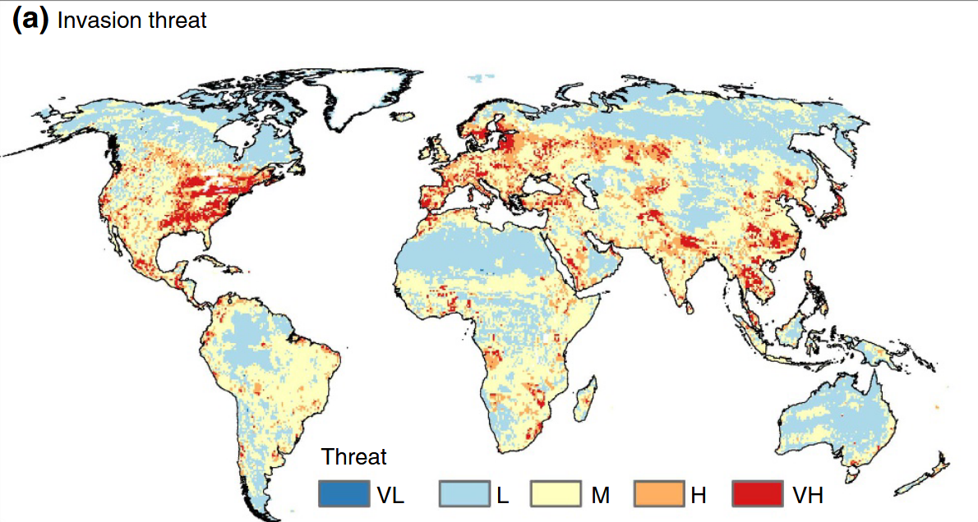
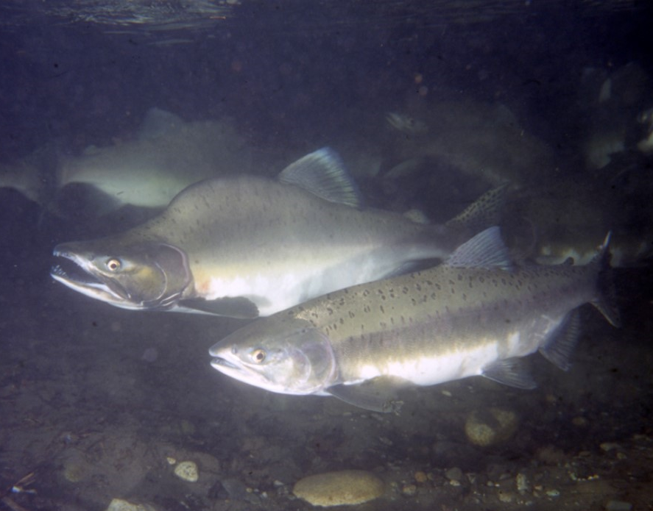
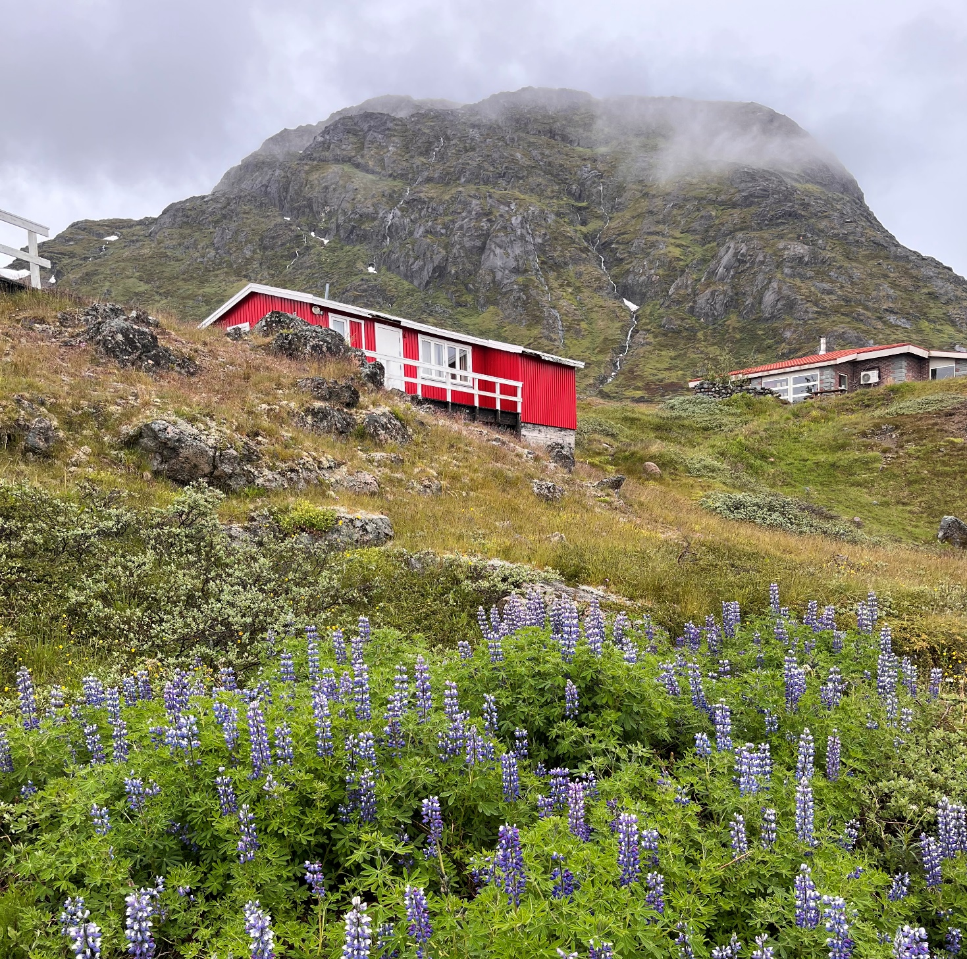
Invasive species
- What is the problem?
Affect local
natural resource availability and crop production with implications for local livelihoods and economies
Nootka lupin, Greenland, Katrine Raundrup
White sweet clower, Alaska, Elmer Topp-Jørgensen
Pink salmon, invasive to Norway/Greenland, ER Keeley
Directly affect
human health through introduction of diseases and parasites
Spread in their
new environment and potentially become a
threat to the local biodiversity
Invasion threat from invasive species.
VL=very low, L=low, M=medium, H=high, VH=very high

Slide 5
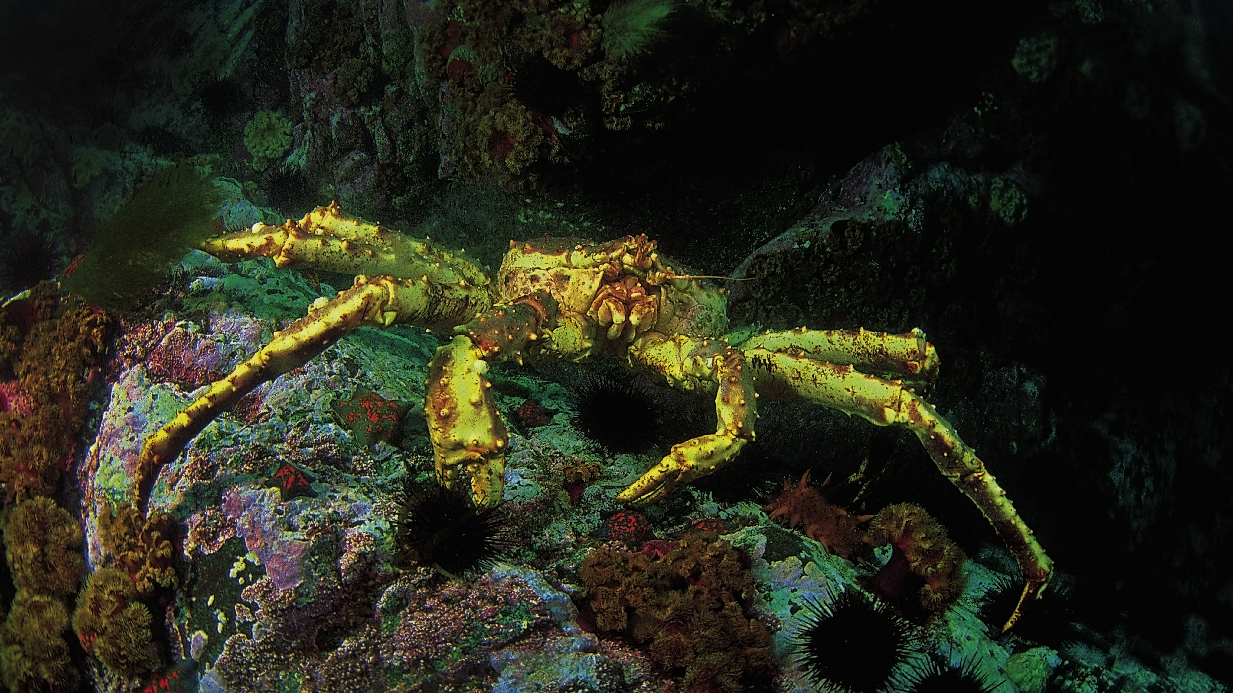
Red king crab
Introduced from the Pacific ocean to diversify fisheries in northwest Russia
… now spreading along the Norwegian coast reaching the British Isles
Sasha Isachenko

Slide 6
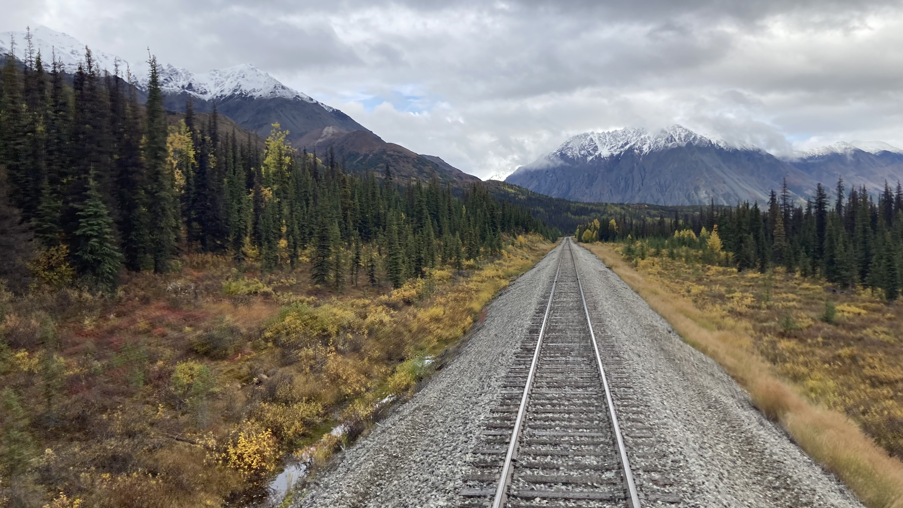
Invasive species
- How do they get here?
Intentional or unintentional escape, release or placement of species into the natural environment by people
Organisms become “hitchhikers”
when goods, equipment
or people relocate
- in ballast water, on ships’ hulls,
on drifting marine plastic/waste,
seeds in a tourist’s shoe or
insects in soils of
imported plants
The globalisation
of trade, travel and transport greatly increase the number
and types of species moving around
the World
Elmer Topp-Jørgensen

Slide 7
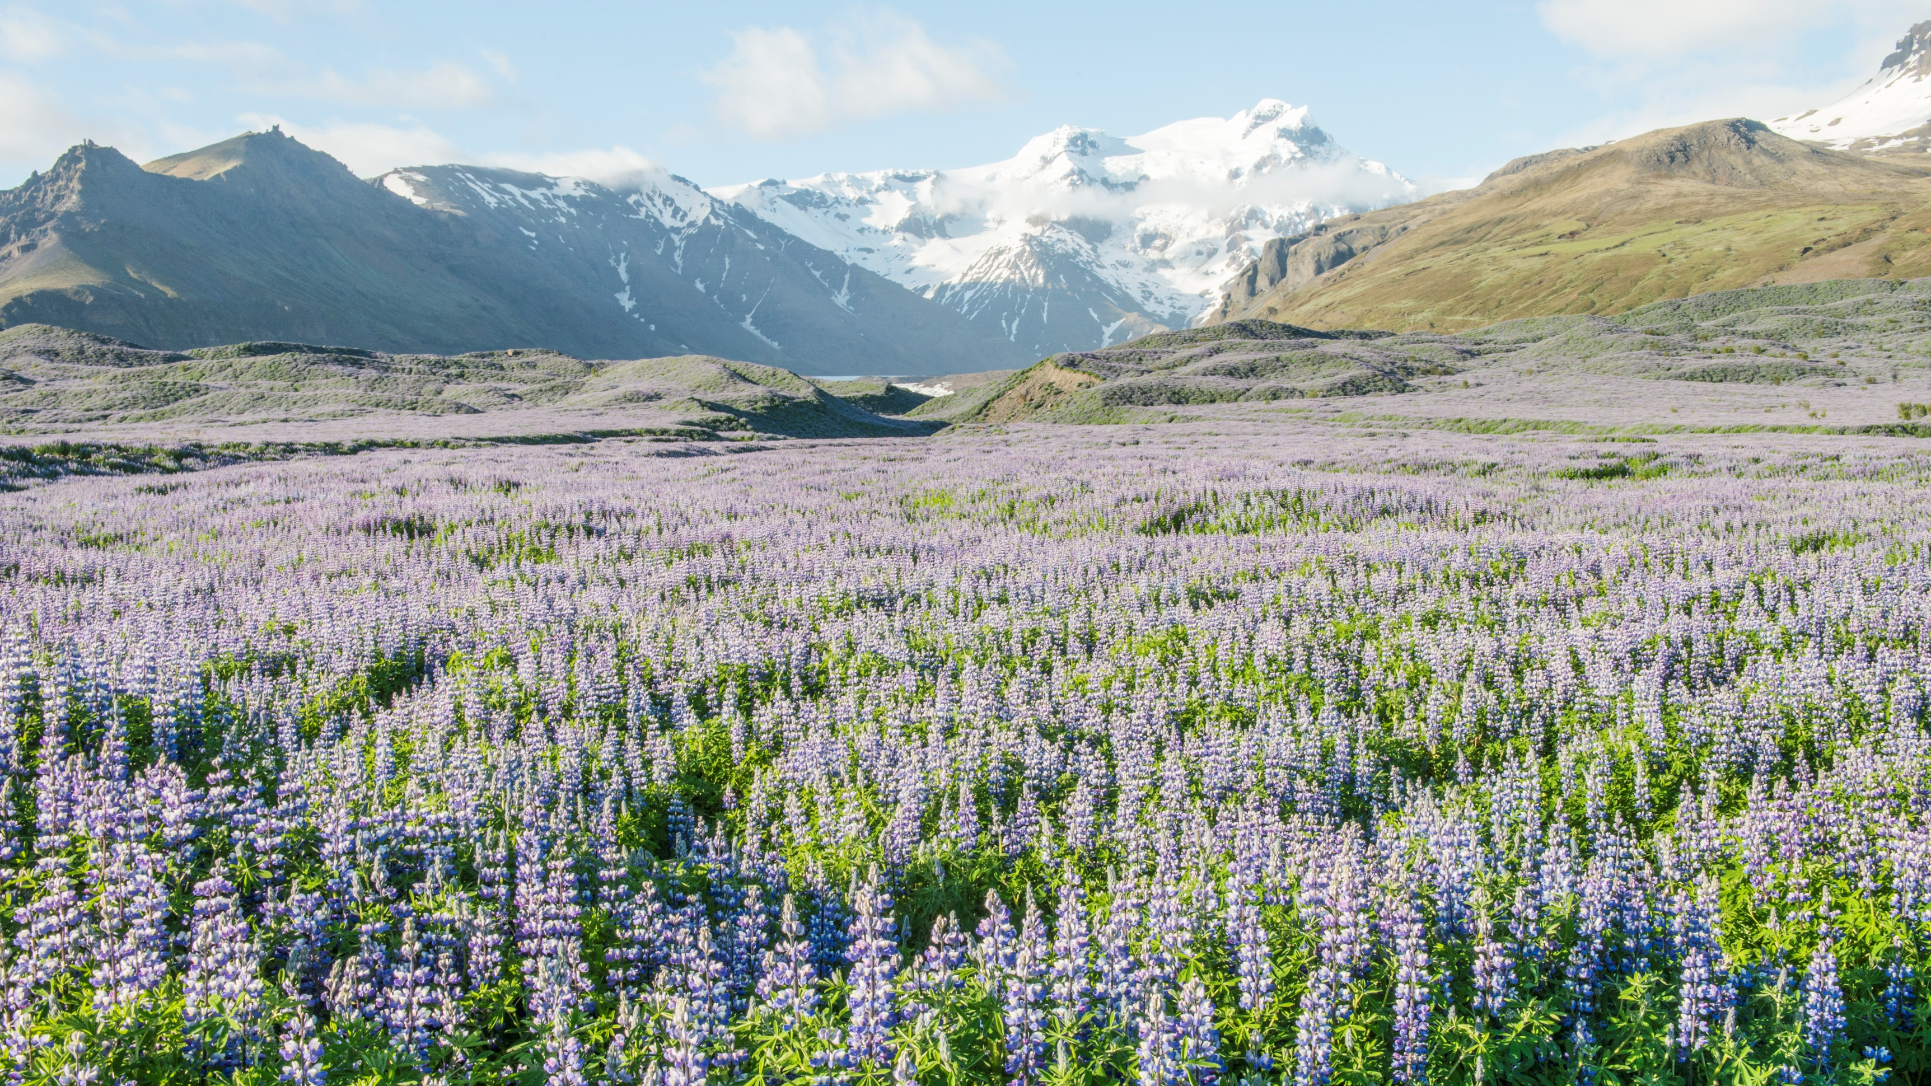
Nootka lupin
Introduced to Iceland and Greenland from Alaska as ornamental plant and to prevent erosion
… now spreading into
the wilderness
Anjali Kiggal

Slide 8
Invasive species
- observed at [your station name]
Photo: Insert name
Insert short text and photos on current or potential invasive species risks in your area.
You decide the number of slides :o)
PAGE 25 of 27

Slide 9
The Convention on Biological Diversity have called on governments to take action to minimize the spread of invasive species
Invasive species
- What can you do?
1. Prevent the spread of invasive species by ‘traveling alone’, i.e. brush, hoover and wash
Make sure that you bring clean shoes, clothes and equipment, when traveling.
2. Help governments detect invasive species
Early detection increases likelihood of eradicating unwanted species or prevent spread.
3. Help eradicate or control the spread of invasive species
Collect, pluck, catch, harvest or hunt invasive species
(but be aware not to violate local legislation).
Anjali Kiggal
www.StopArcticAliens.com

Slide 10
Plastic has
a number of beneficial
properties making it widely
used for many different
purposes across the World,
e.g. light-weight, durable,
easily cleaned
and cheap
Plastic pollution
- What can you do?

Slide 11
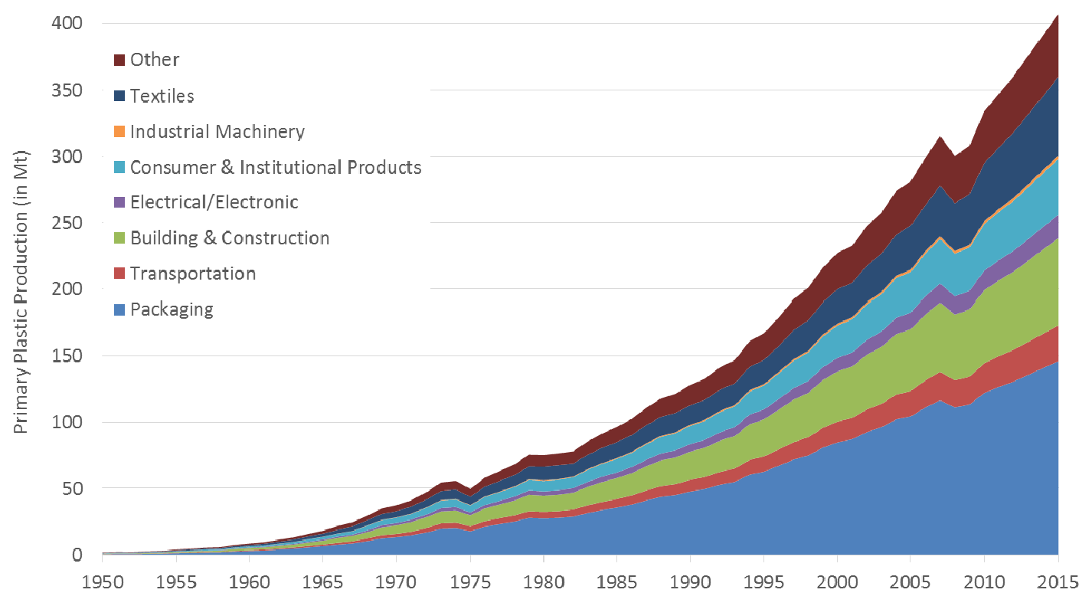
Plastic pollution
- What is the problem?
Globally less than
10% is recycled,
50% ends up in landfills,
19% is incinerated and
22% does not reach public waste handling systems
Global plastic waste production 1950-2015
Around 40% of
plastic products are garbage after less than a month
(i.e. single use plastics)
Worldwide we produce more than 350 million tons of plastic waste per year (>40 kg per person/year)

Slide 12
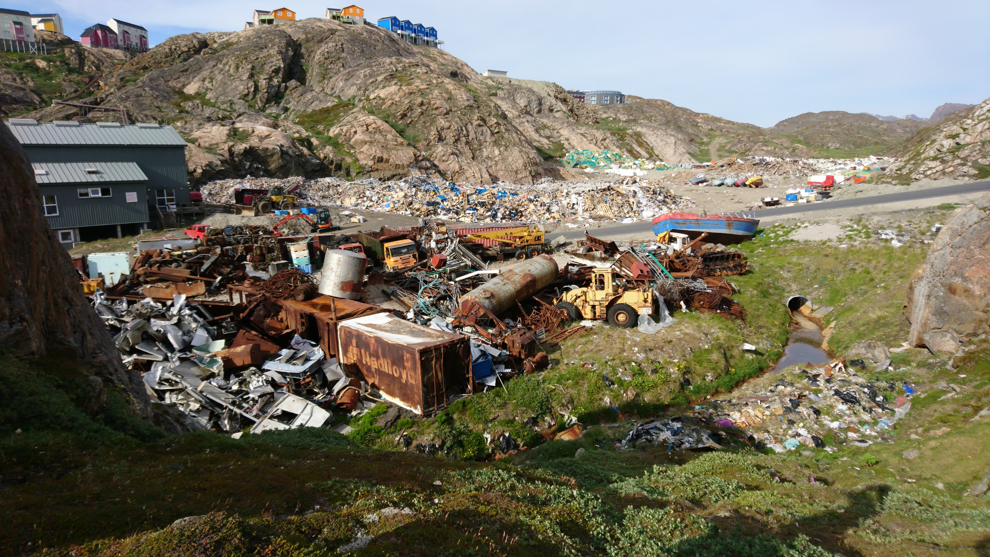
Dump site from where plastic can spread to the natural environment
Maria Granberg

Slide 13
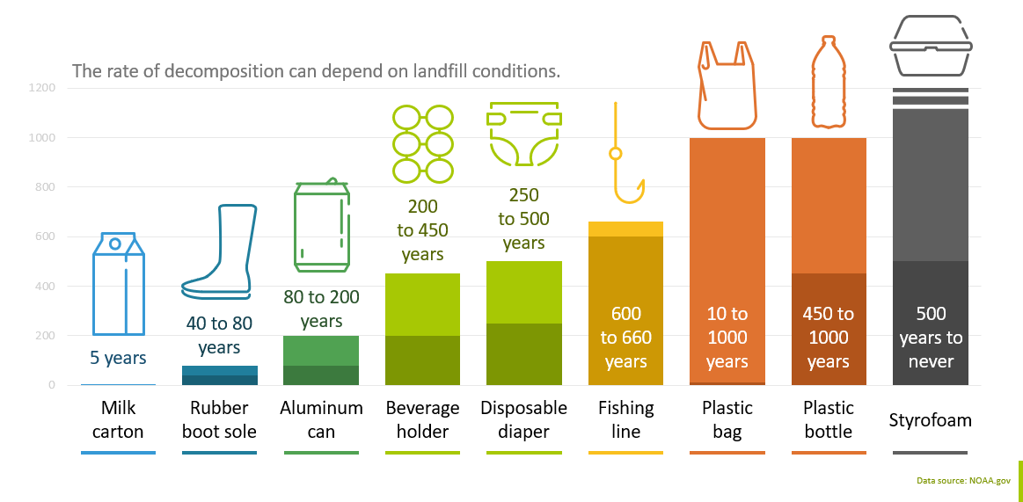
Most plastic types do not decompose,
but will break down over time into smaller and smaller particles:
Macro (> 5 mm) Micro (< 5 mm) Nano (< 1 μm)
Plastic degradation times
Once it
degrades into micro or nano particles, it is virtually impossible to remove from the natural environment and could stay there for decades to millennia

Slide 14
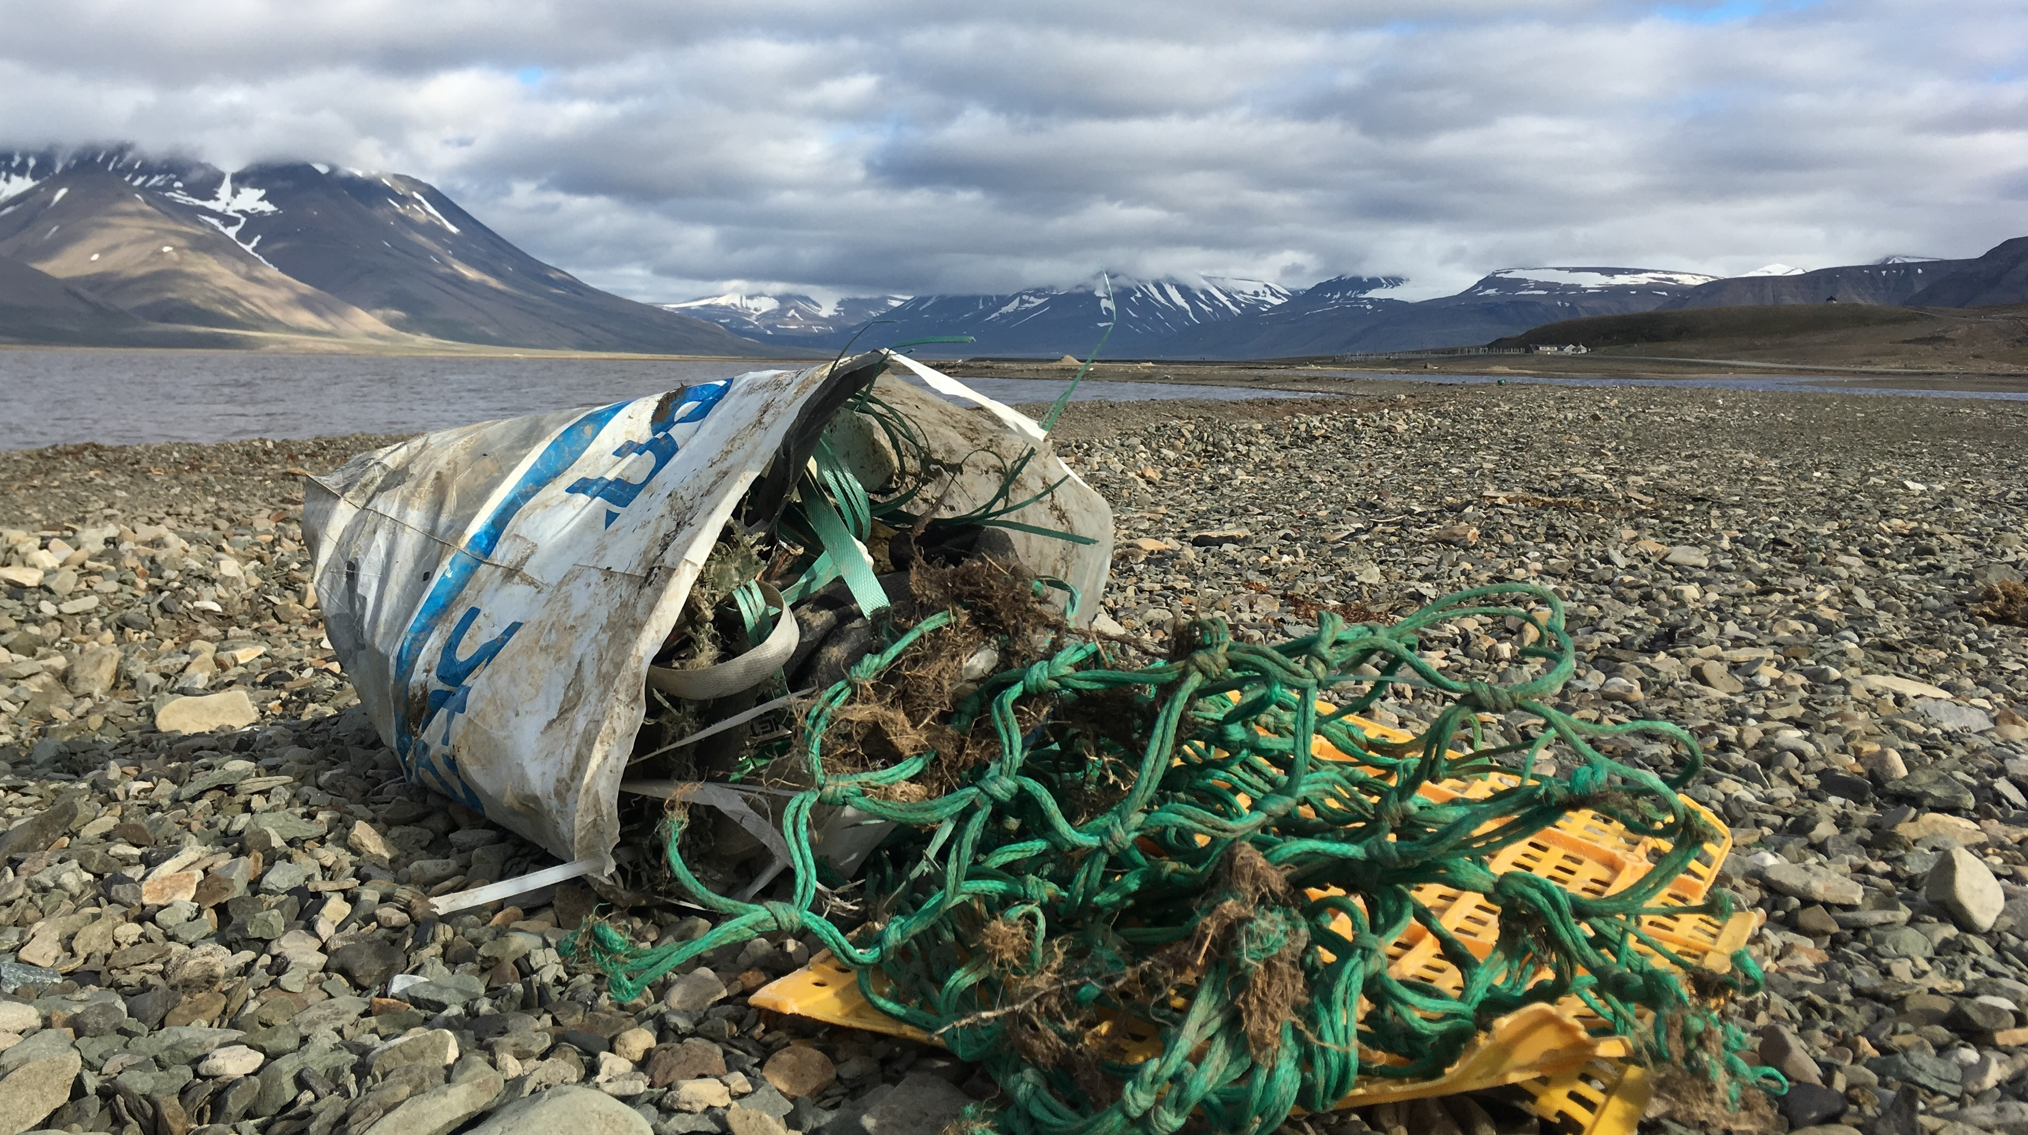
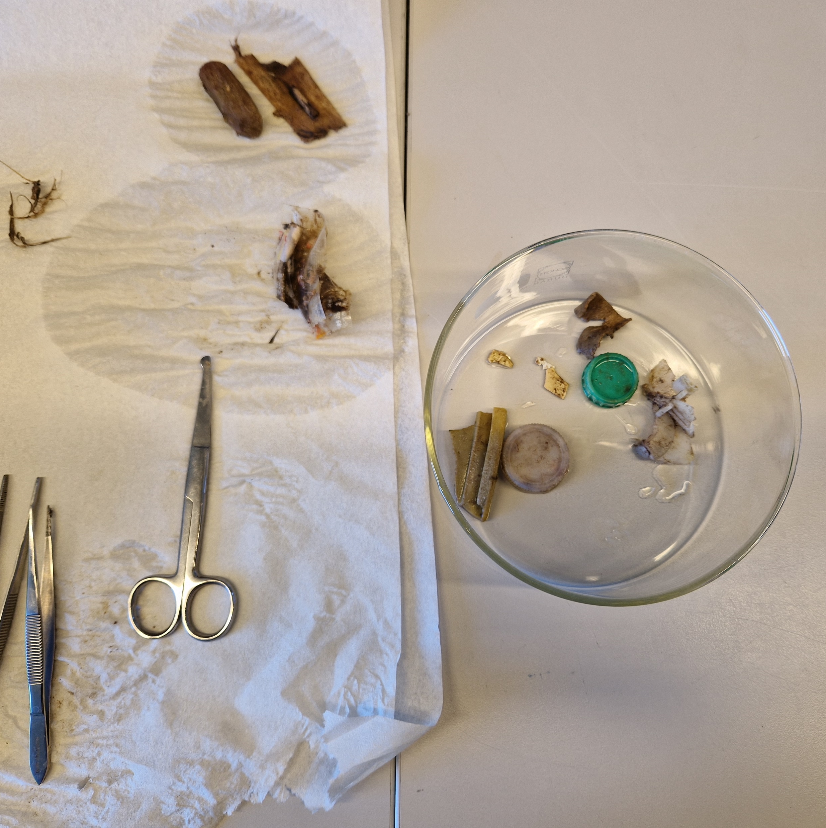
Plastics
affect ecosystems
and human health by spreading hazardous chemical additives with implications for, e.g. reproduction and early development
Plastic found
in stomach of
Northern Fulmar
Plastic impacts
Climate Change through the extraction of oil and gas for plastic and
the energy used in the transport, production and waste handling phases (recycling and disposal)
Plastics
physically
affect species by entanglement or ingestion,
e.g. blocking airways and digestive tracts or filling stomachs
Marie F. Arndal (inserted), Maria Granberg (large)

Slide 15
Plastic pollution
- observed at [your station name]
Photo: Insert name
Insert short text and photos on local plastic pollution concerns in your area.
You decide the number of slides :o)
PAGE 25 of 27

Slide 16
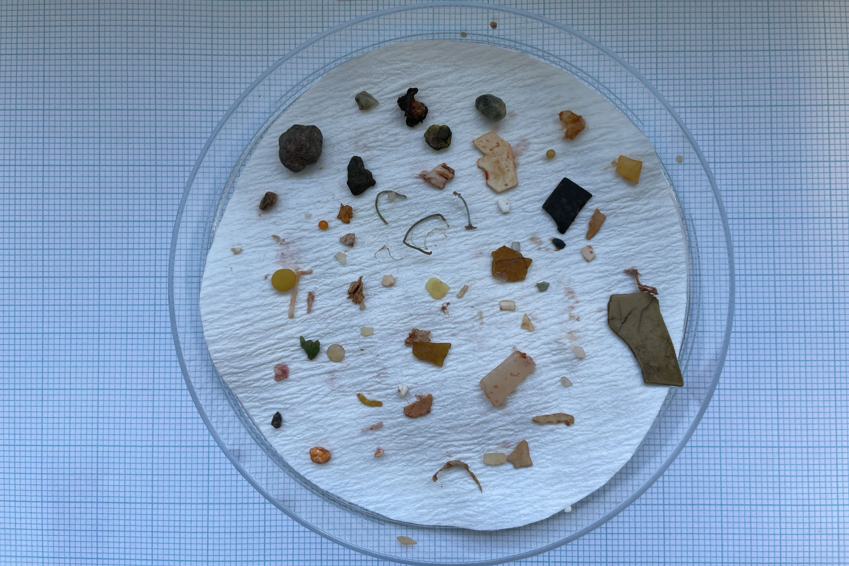
Plastic pollution
- What can you do?
We all have a share
in the increasing plastic pollution problem affecting ecosystems and humans across the Globe
1. Refrain from using unnecessary, harmful, low-quality and un-recyclable plastics.
2. Replace plastics with sustainable alternatives (bio-based and biodegradable plastics).
3. Reduce and minimize the use of plastics whenever possible.
4. Reuse plastic products for the same or different purposes.
5. Repair and extend the lifespan of plastic items.
6. Recycle through proper sorting and disposal to recycling facility.
7. Remember to keep the environment clean and engage in clean-ups.
8. React by speaking up and advocate for change among friends, family, colleagues, institutions and politicians.
Promote above principles and argue for a move towards a more circular plastic economy
with limited production, no harmful additives, long durability and significant increase in recycling.
Jannie Friis Linnebjerg

Slide 17
The effects of
Climate Change is
visible all over the World.
Temperatures are increasing and extreme weather events occur more frequently impacting societies and
local livelihoods
Climate Change
- What can you do?

Slide 18
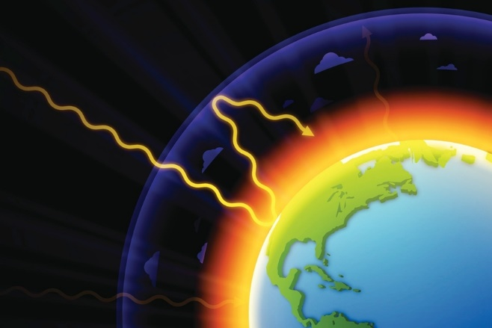
Greenhouse effect
Without the greenhouse effect, the avreage temperture on Earth would be -18 ºC
Human increases in greenhouse gas concentrations led to increasing temperatures
What is the problem?
2. Energy is absorbed and long wave radiation emitted
Incoming short wave solar radiation
Temperatures
are now increasing
3-4 times faster in the Arctic than for the entire Globe
3. Greenhouse gas absorb and reflect energy back into the atmosphere

Slide 19
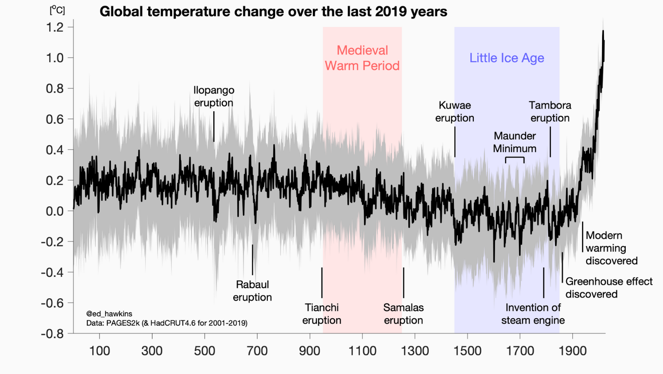
Increasing greenhouse gas in the atmosphere lead to global warming
Global temperature change
year 0 to year 2020
ºC

Slide 20
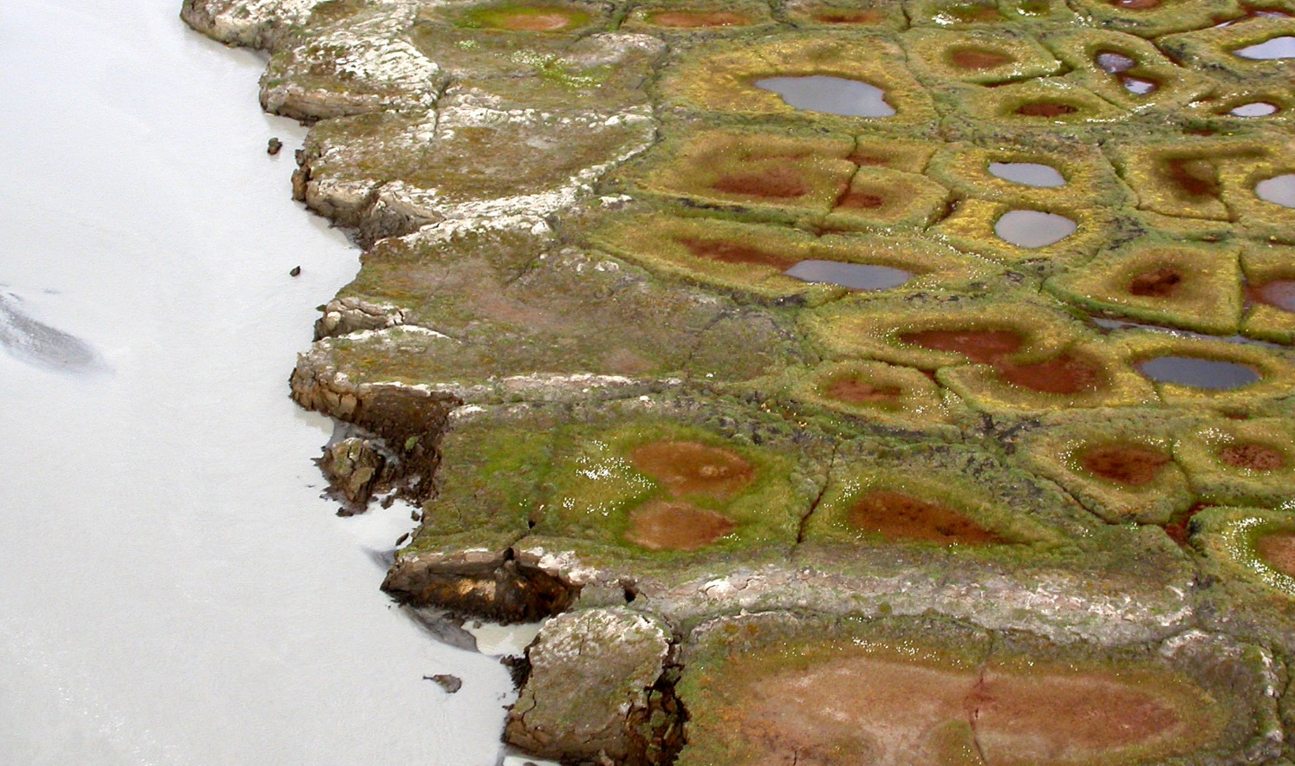
Temperatures
are now increasing
3-4 times faster
in the Arctic than for the entire Globe

Slide 21
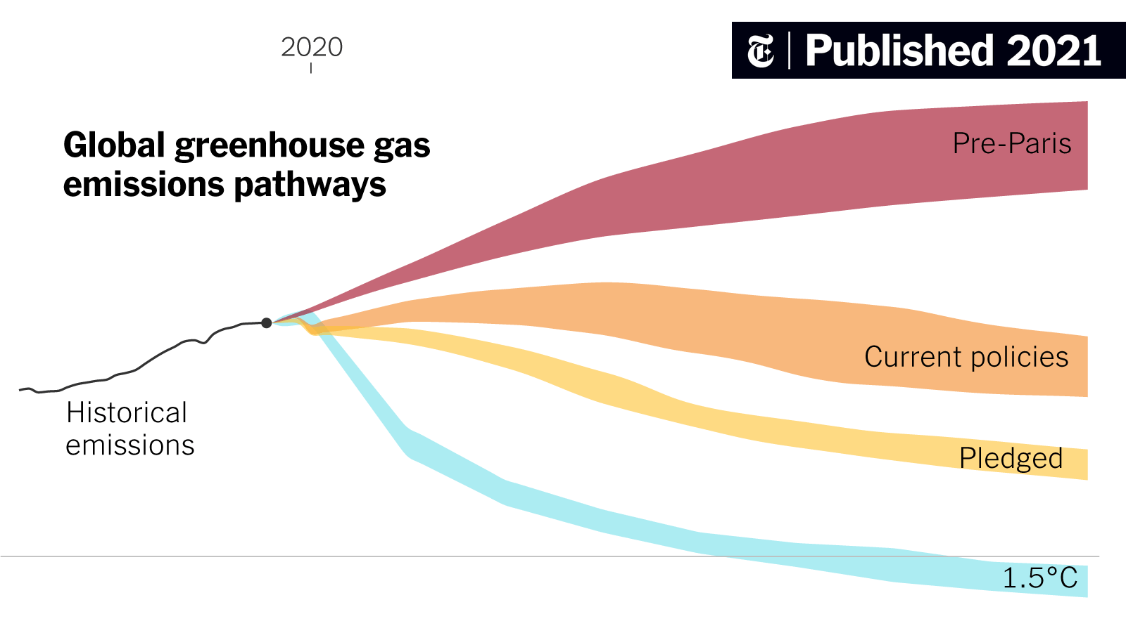
Greenhouse Gas concentrations
from year 1990 to year 2100
It is time to
ACT
If we want to reach
the red goal line
Policies before the
Paris Agreement
+ 4.2°C to 3.6°C
Current government policies
+3.1°C to 2.7°C
Reduction targets
promised by governments
+2.4°C to 2.1°C
1990
2020
Paris Agreement
2100
Goal line set in the Paris Agreement 2015
Keep temperature increase < 1,5ºC above pre-industrial levels
< 1.5°C
https://www.nytimes.com/interactive/2021/10/25/climate/world-climate-pledges-cop26.html

Slide 22
Local Climate Change
- observed at [your station name]
Photo: Insert name
Insert short text and photos on what your station do to study climate change, the results and international collaboration. Include photos (e.g. of scientists in the field, science instrumentation, observed effects of Climate Change, etc.).
You decide the number of slides :o)
Local Climate Change projection
Local studies
Local results
International collaborations
Opportunities for local engagement (e.g. Citizen Science)
PAGE 25 of 27

Slide 23
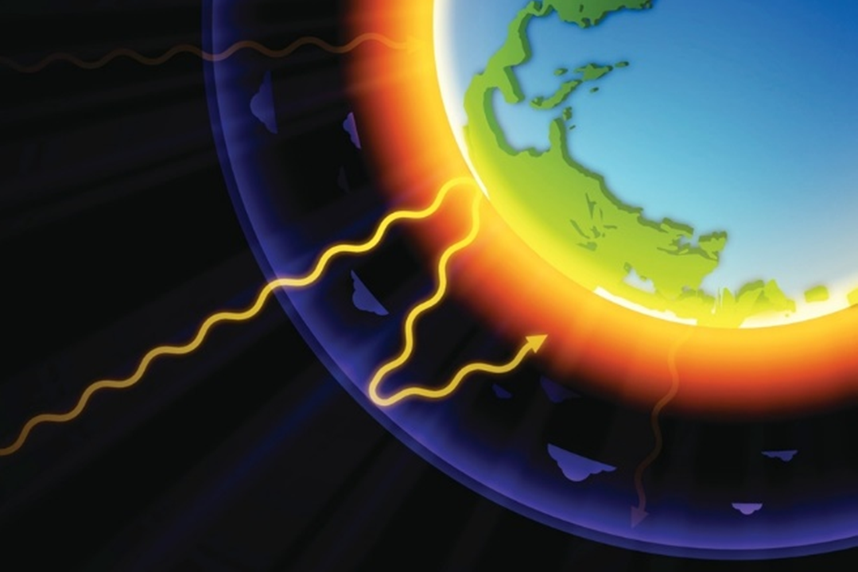

UN
Climate Change
- What can you do?
recommendations
Reduce your own contributions, i.e.:
Save energy at home - energy efficient houses and electronics (turn them off, when not in use).
Use sustainable energy sources at home – switch to solar, hydro, wind or geothermal energy.
Make your money count – buy local, durable, used, recycled, and environmental friendly products.
Reduce consumption - share or borrow things, repair, reuse and sort waste for recycling.
Eat local food and reduce consumption of meat and dairy products.
Minimise food waste.
Walk, bike or use public transport.
Switch to an electric vehicle.
Consider your long-distance travels – reduce and take train when possible.
Speak up
Encourage your friends and workplace to be more sustainable and put pressure on governments to find political solutions to minimise human caused Climate Change.
https://www.un.org/en/actnow/ten-actions

