Slide 1
An update on Kilpisjärvi bilberry monitoring data
Tanja Lindholm, Kilpisjärvi biological station, University of Helsinki, Finland
0000-0001-6115-3359

Slide 2
University of Helsinki Research Stations (RESTAT UHEL)
Several decades of data on birds, mammals, vegetation, phenology, forestry, hydrology, marine invertebrates etc. (covering roughly 1000 variables) excluding atmospheric data
Data are collected by the station personnel and are the responsibility of the stations themselves.
Datasets are unique and the observations cannot be repeated.

Slide 3
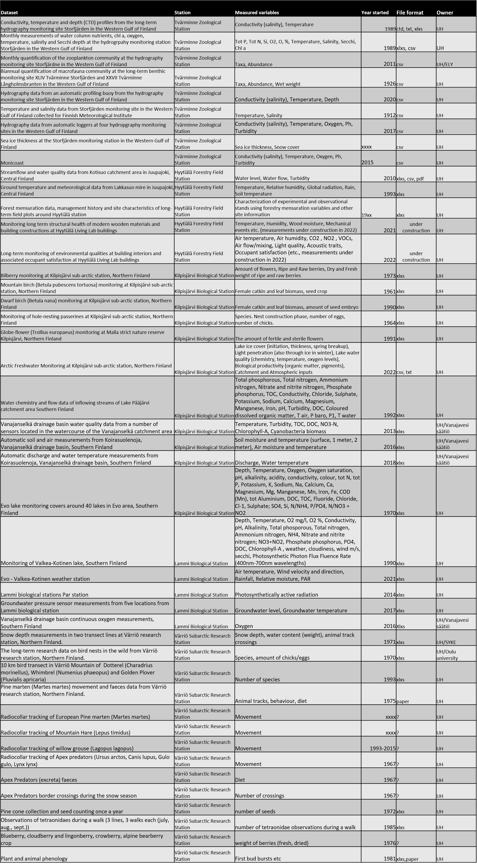
University of Helsinki Research Stations (RESTAT UHEL)
Proper method and metadata is missing.
Data collectors retired.
Data is scattered
Unclear ownership
Less than 20% are currently shared openly and to some extent follow FAIR principles.

Slide 4
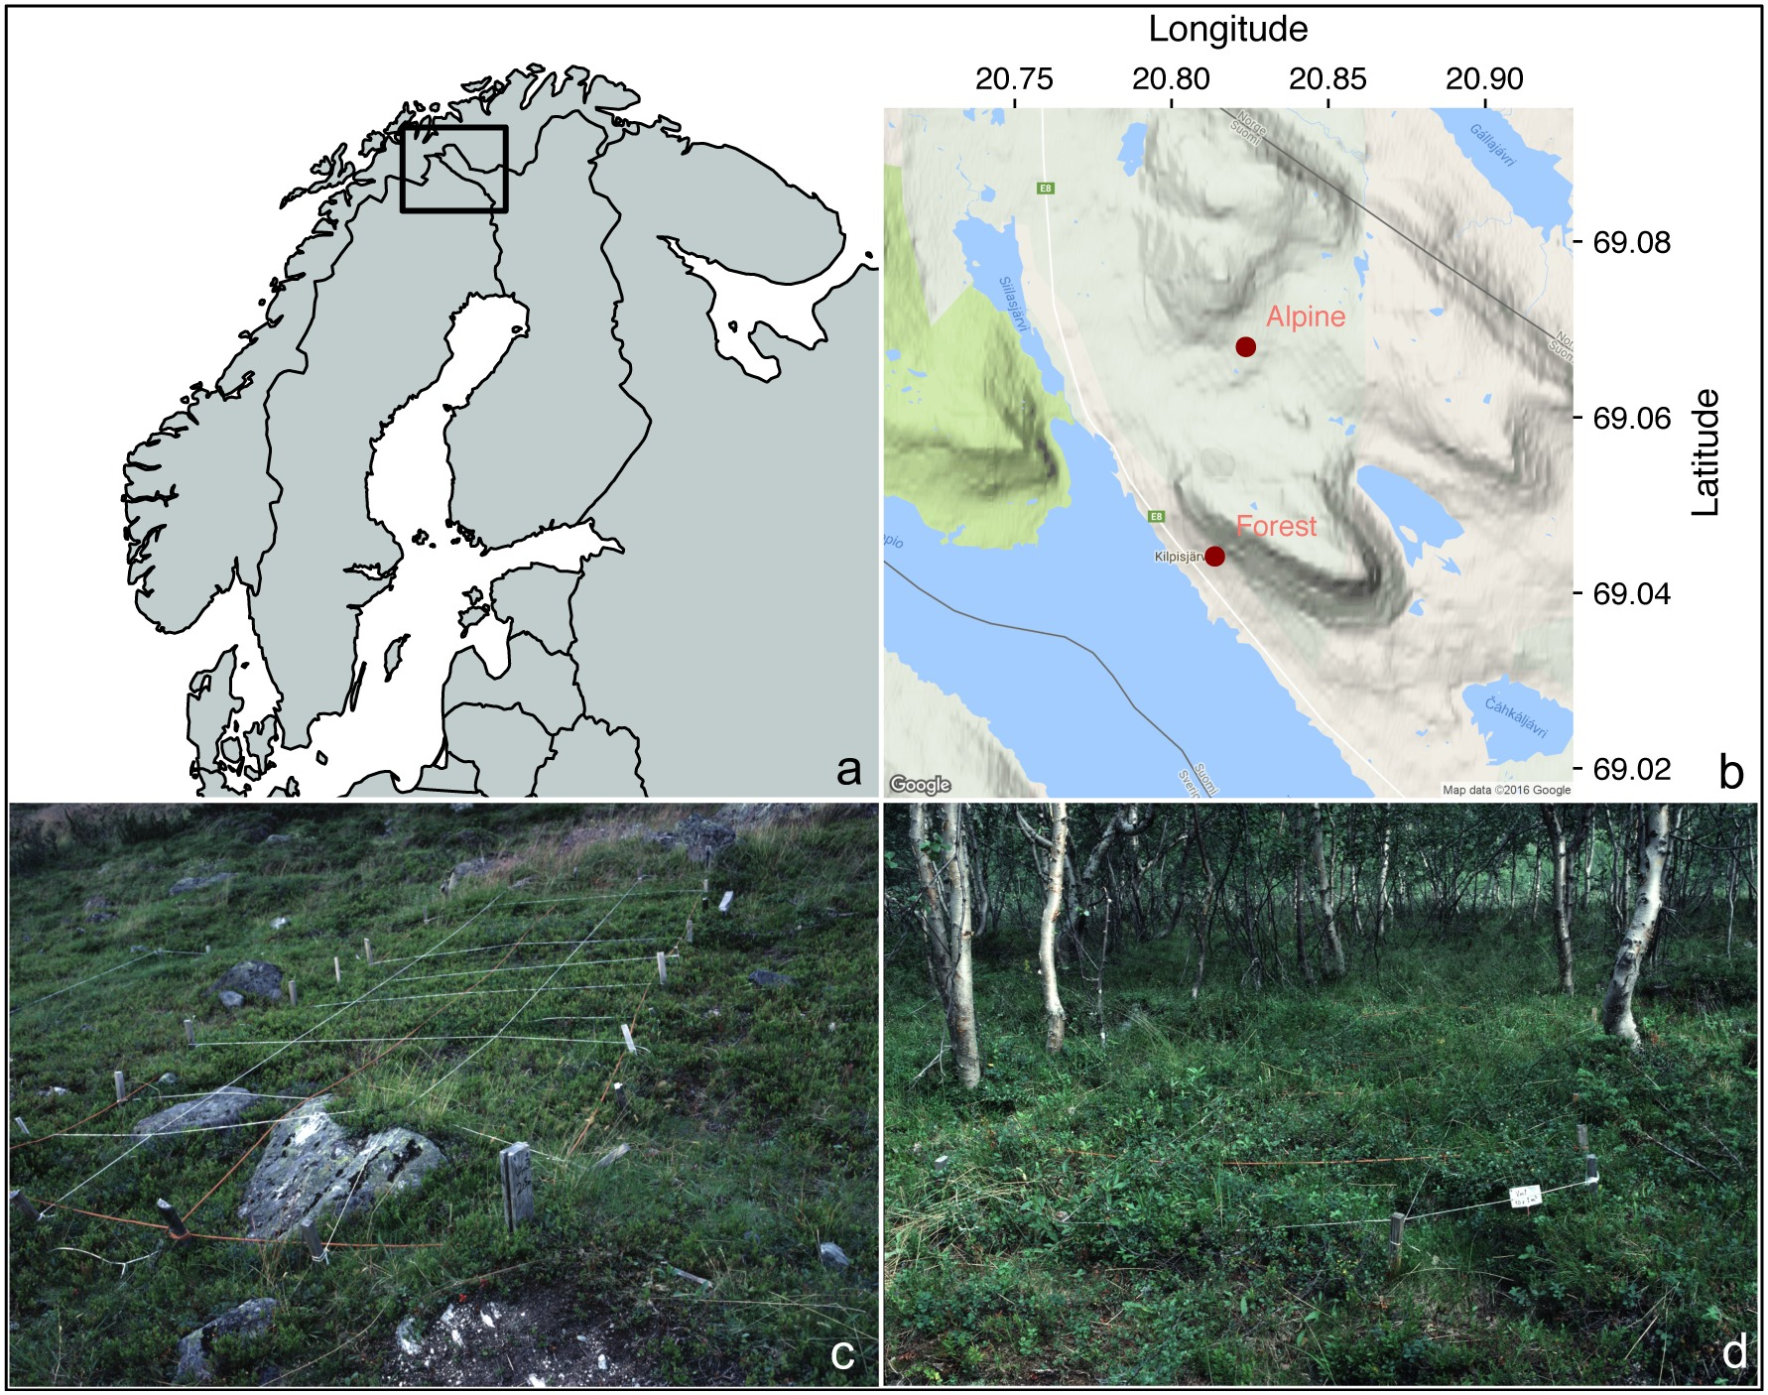
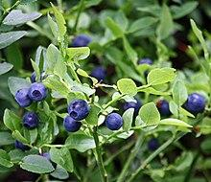
Kilpisjärvi bilberry monitoring data
Time series from 1973 to 2021 (ongoing)
Bilberry yield and flowering variables
No. of flowers
Raw & ripe berries
Fresh & dry weight
Boulanger‐Lapointe, Noémie & Jarvinen, Antero & Partanen, Rauni & Herrmann, Thora. (2017). Climate and herbivore influence on Vaccinium myrtillus over the last 40 years in northwest Lapland, Finland. Ecosphere. 8. 10.1002/ecs2.1654.

Slide 5
Kilpisjärvi bilberry monitoring data
What would you do?
F
Where to open
Where to open
A
I
Method
R
Format
Resources (time, competence, money)

Slide 6
Identification
Method
Resources
Identification of available databases (Pangaea, Polar data catalog, FinBif, etc.)
Identification of FAIR data formats (csv, txt, etc.)
Inform on data structure and metadata protocols
Define all metadata: Manual investigation and detailed description of excel files
Cleaning the files and make it machine readable: Quality check and codes to bring data together
Conduct a database or at least clear structure for the data
Publish the data
Involve persons who has collected the data
Data science students to organize the data
Researchers to publish the results and analyse the data
IT / data scientists to build a database.
Data manager for maintaining the database (2 months/year).
The 17th International Digital Curation Conference, 13-16 June 2022, Edinburgh, Scotland

Slide 7
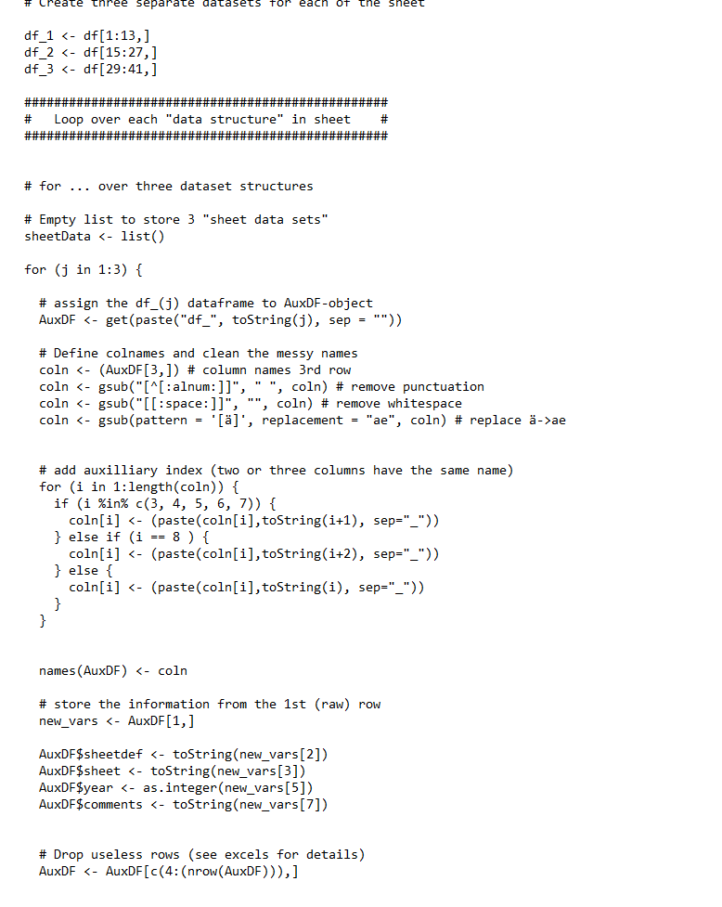
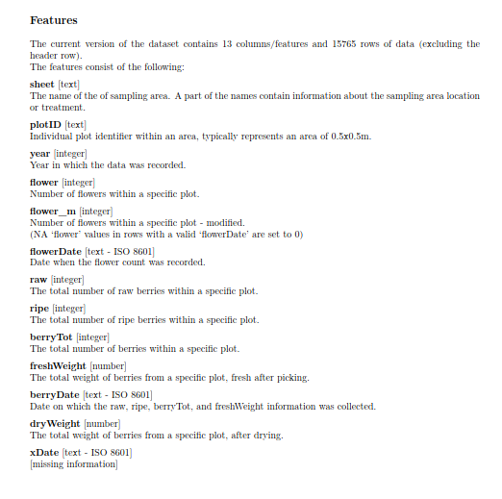
Data processing
Identification of what was there
The structure was somewhat consistent over the files and sheets
Inconsistent variable formats
Missing data
Some corrupted files
Columns with same name but different substance
0 vs NA
Deliverables
A clear structure for the data
Metadata
Scripts (R and Python)

Slide 8
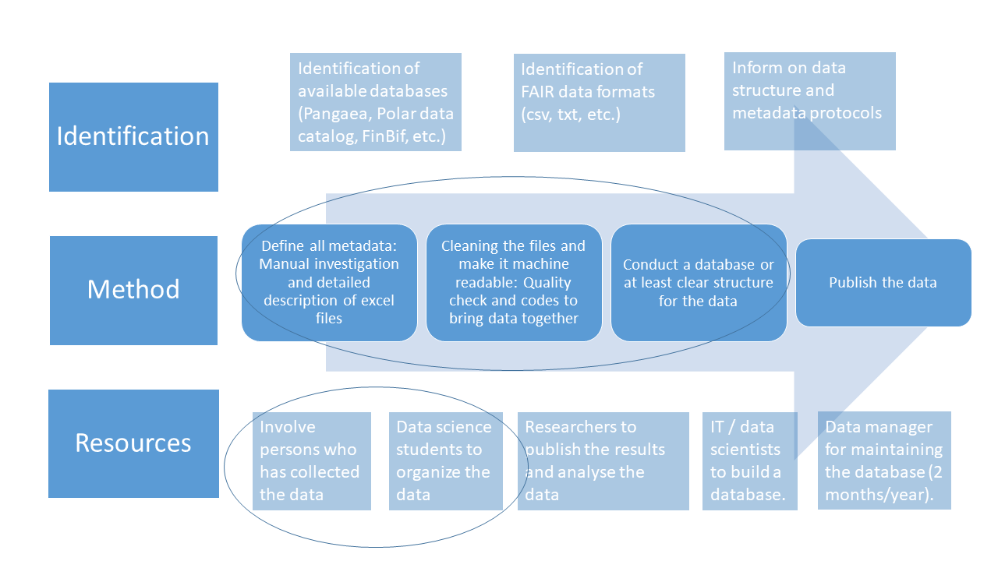
3 ½ month work
Competence
4 Data Science Master students
Data Manager
Person who has collected the data
50 datasets, 1000 variables
-> 14,5 years

Slide 9
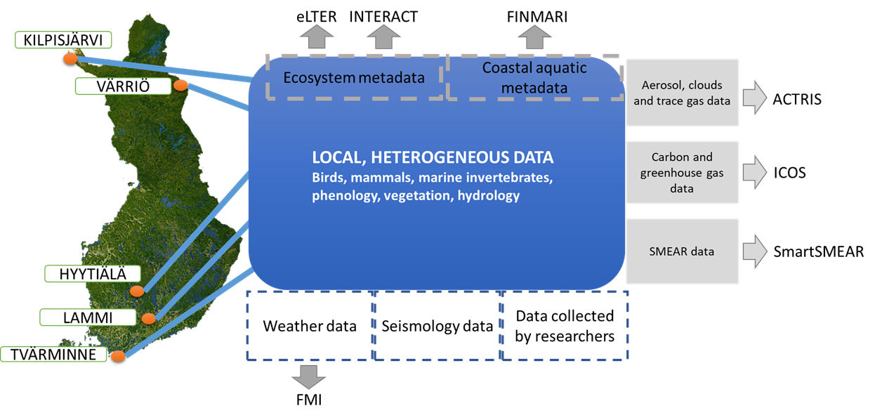
Funding opportunities

Slide 10
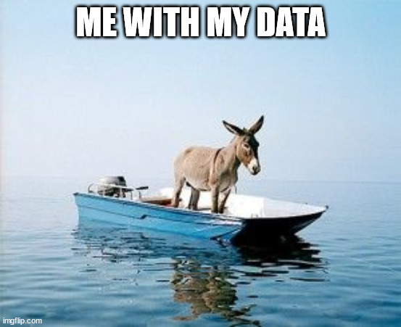
Thank you!
It’s a Long Way to the Top (if you wanna be FAIR)

