Slide 1
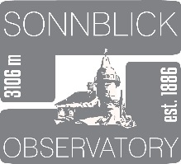
INTERACT-3 SMF
Sonnblick Observatory
Elke Ludewig
elke.ludewig@zamg.ac.at
28.09.22 Keflavik, Iceland

Slide 2
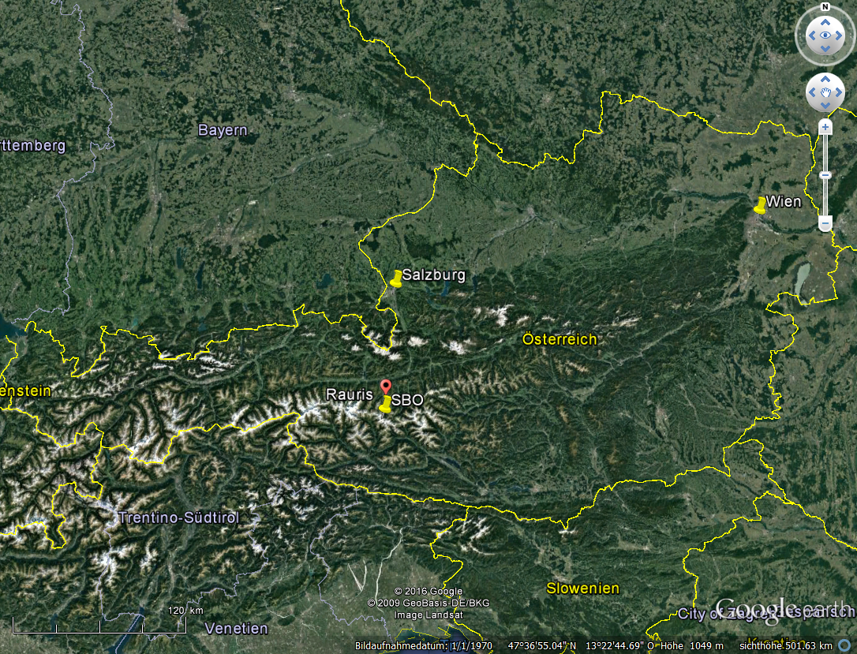
Sonnblick Observatory
Location
borders:
Land Salzburg
Carinthia
villages:
Rauris
Heiligenblut

Slide 3
Die Gründung des Sonnblick Observatoriums (SBO)
Sonnblick Observatory, established 1886
@SV, Stich von Heilmann
Original Archive Salzburg Museum

Slide 4
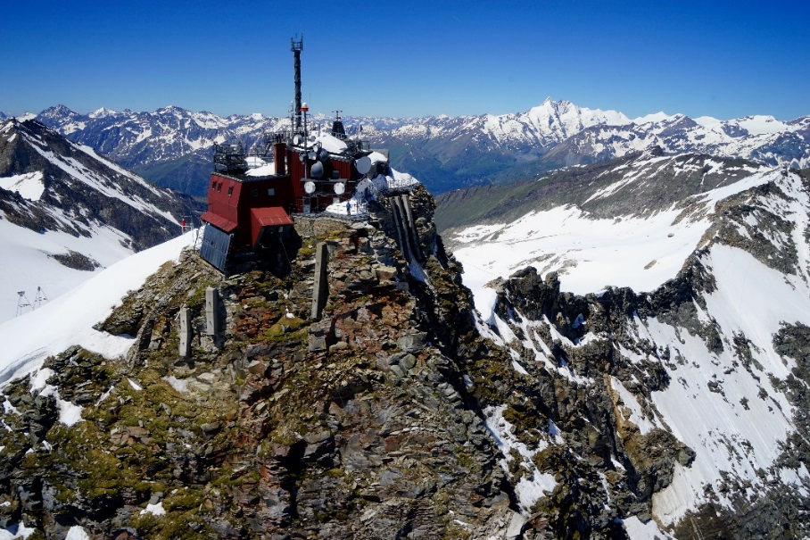
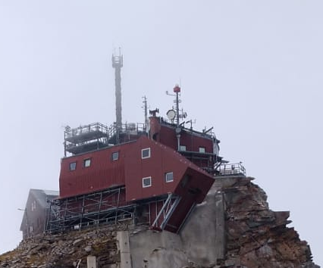
Sonnblick Observatory (SBO), 3.106 AMLS
climate and environmental research station
@SV, Stich von Heilmann
1886
136 years
Climate monitoring
2022 +
... from a weather station to a high-tech research station ...
The Alpine region has warmed twice as much as the global average since the late 19th century. The temperature increase from the late 19th century to the beginning of the 21st century was about 2 °C.

Slide 5
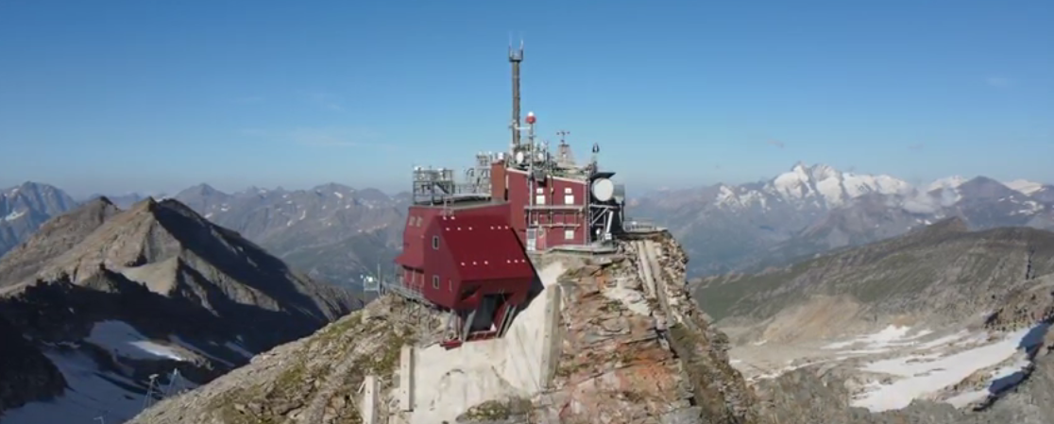
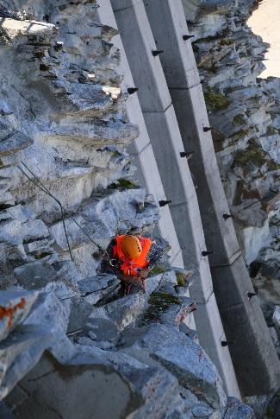
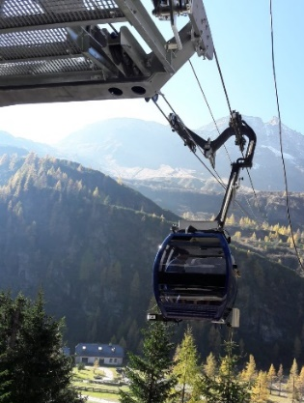
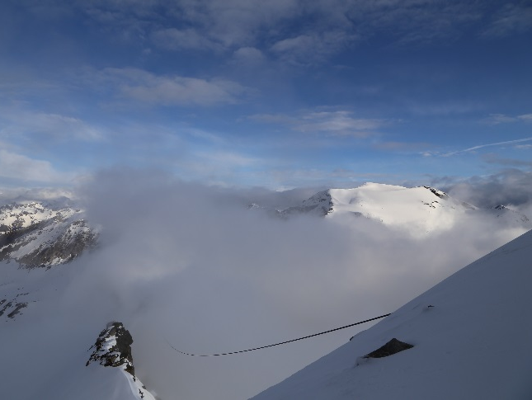
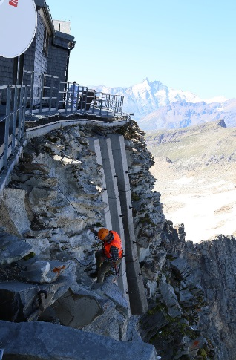
Sonnblick Observatory (SBO), 3.106 AMLS
2001-2007: Securing the site
thawing of Permafrost
1946/47 -2018:
private cable car
1983/2022: power
20kV cable

Slide 6
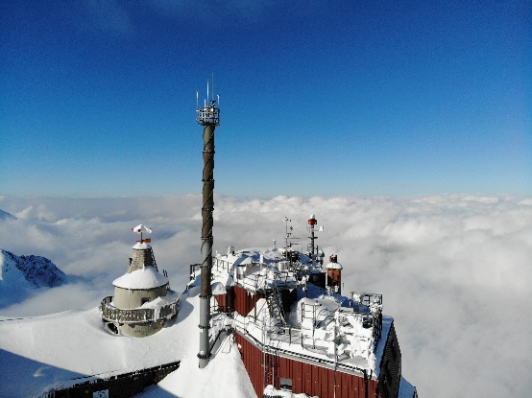
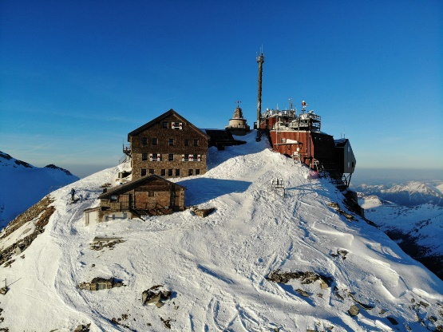
Challenges
Power supply:
  costs
  materials
  permission
Safety and security (thanks to INTERACT for templates and input!)
  scientists/media agree to the rules and notices before arrival
  Tourists agree to the rules and notices before a guided tour
Public relation
  since covid about 20% more tourists
  museum exhibitions
  360° virtual tour
  media requests have multiplied
Instrumentation:
  costs
  delivery times and availability

Slide 7
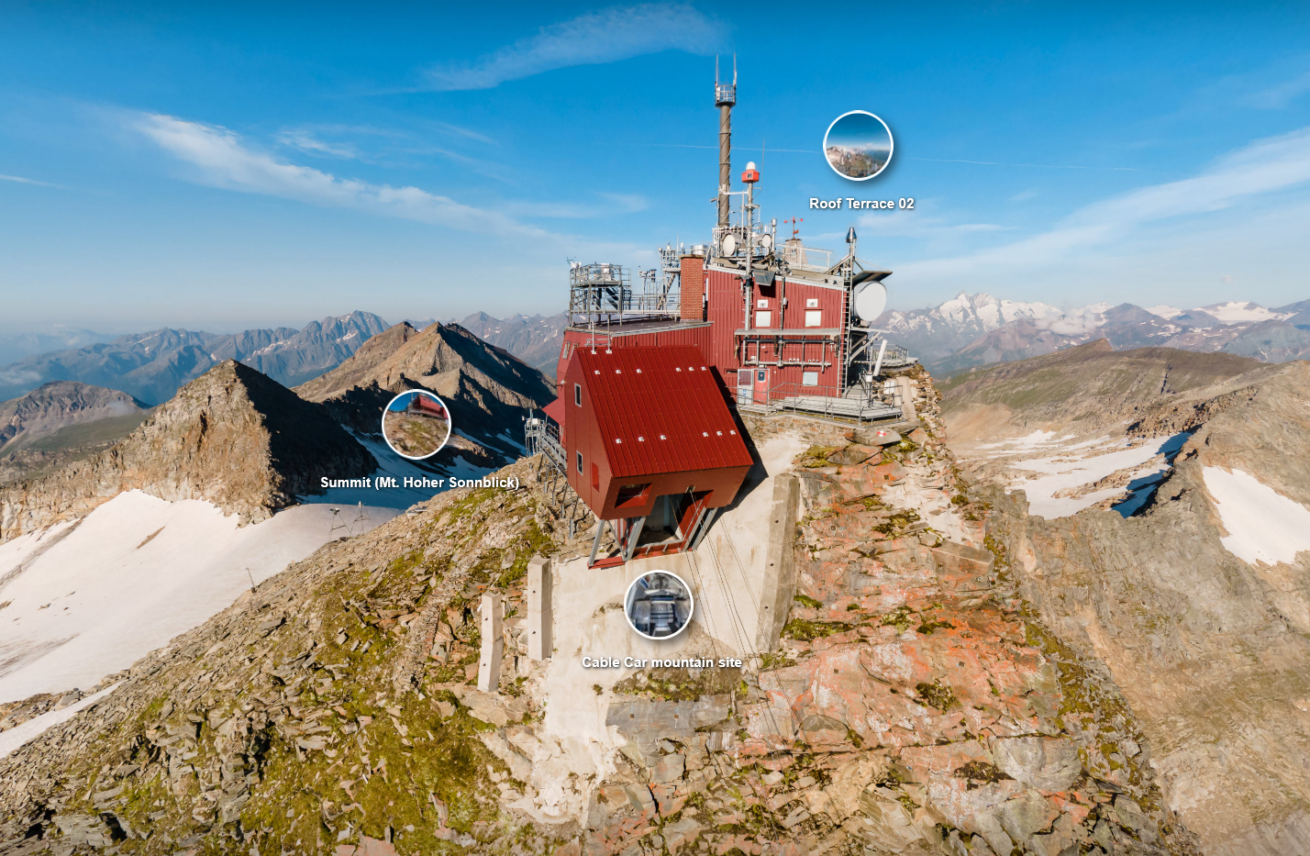
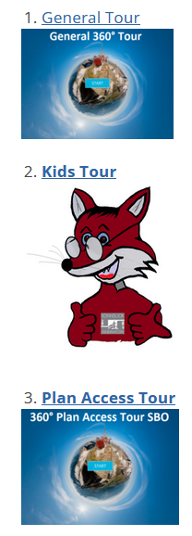
360° virtual tour: www.sonnblick.net
https://www.sonnblick.net/de/das-observatorium/360-tour/

