Slide 1

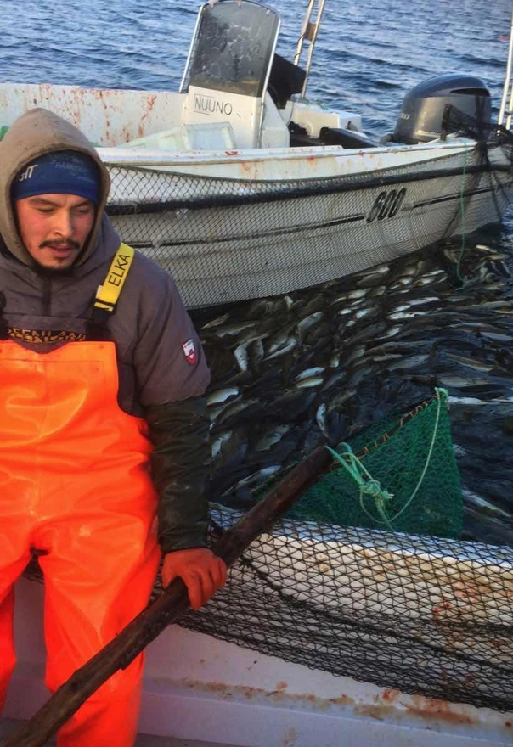
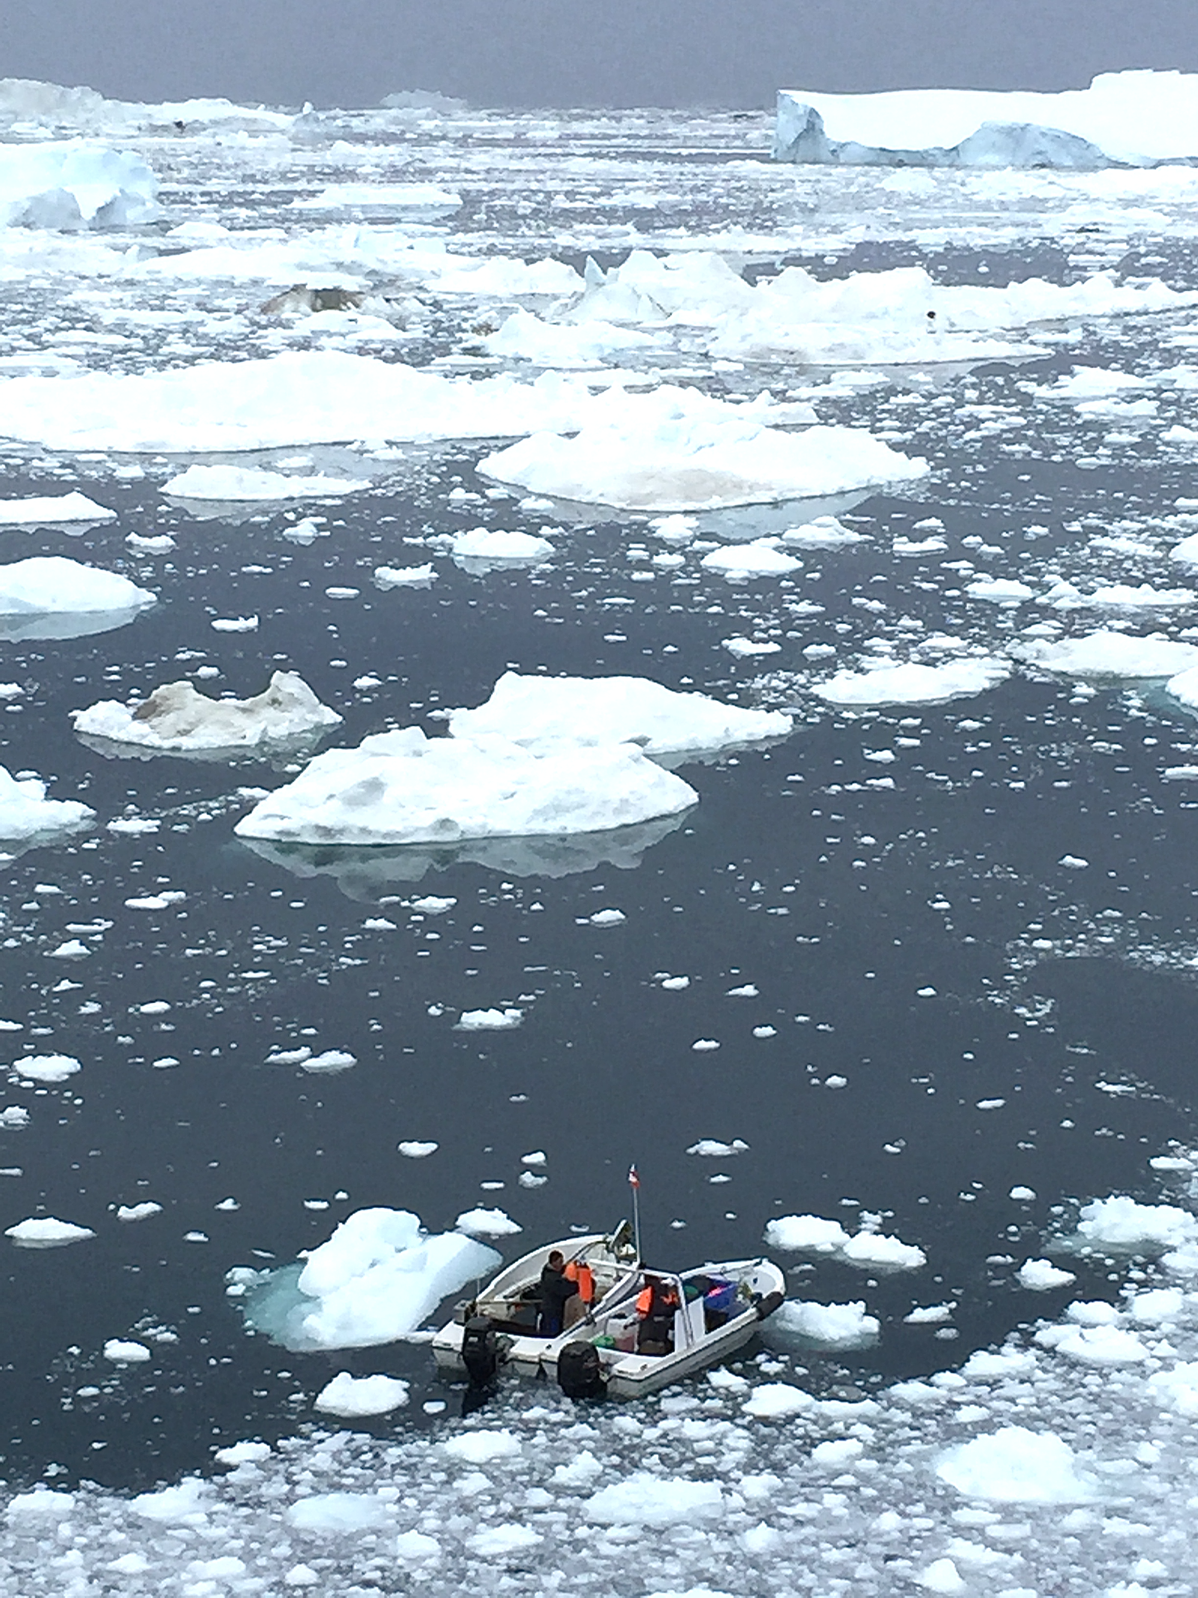
Arctic research stations and citizen observations
Station Managers’ Forum –
Annual meeting INTERACT III
26-30 September 2022, Keflavík
Michael Køie Poulsen
NORDECO - CAPARDUS
mkp@nordeco.dk

Slide 2
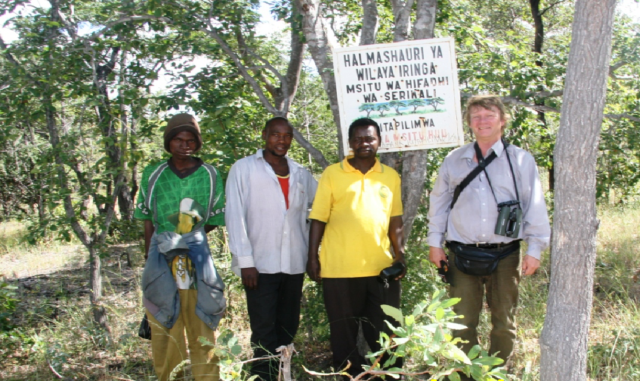
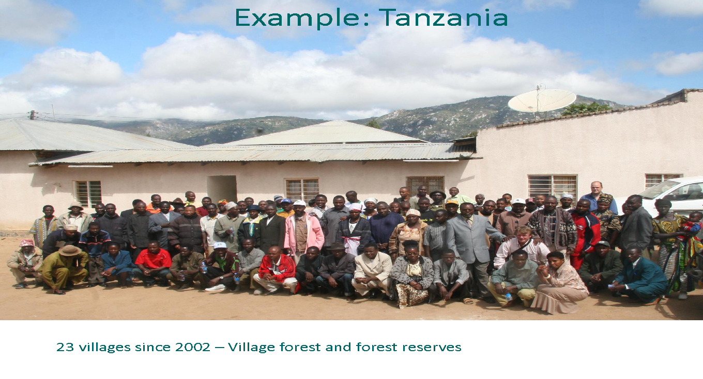
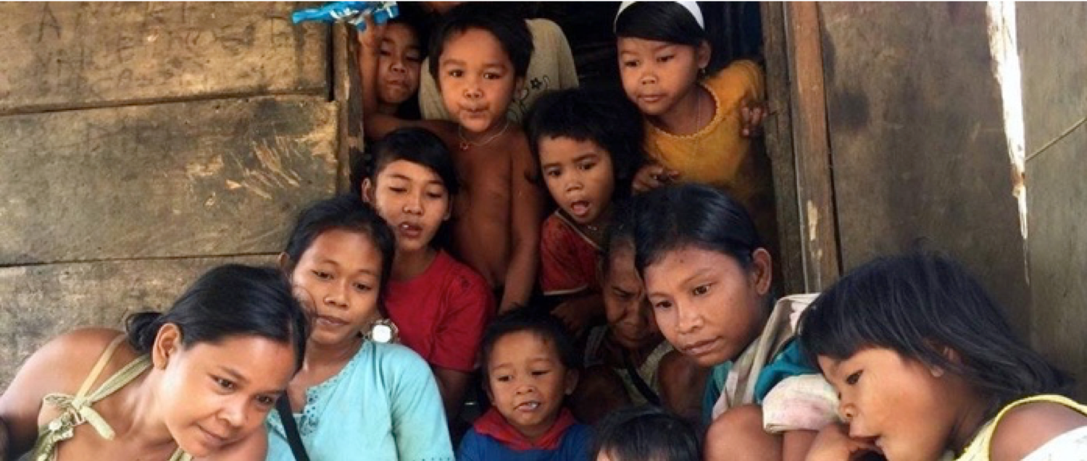
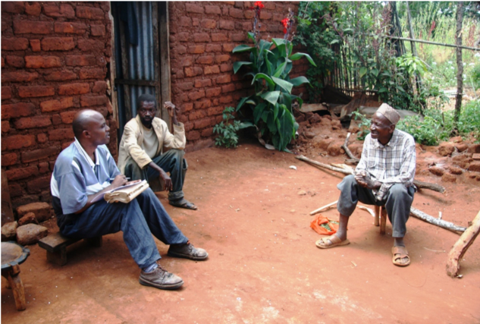
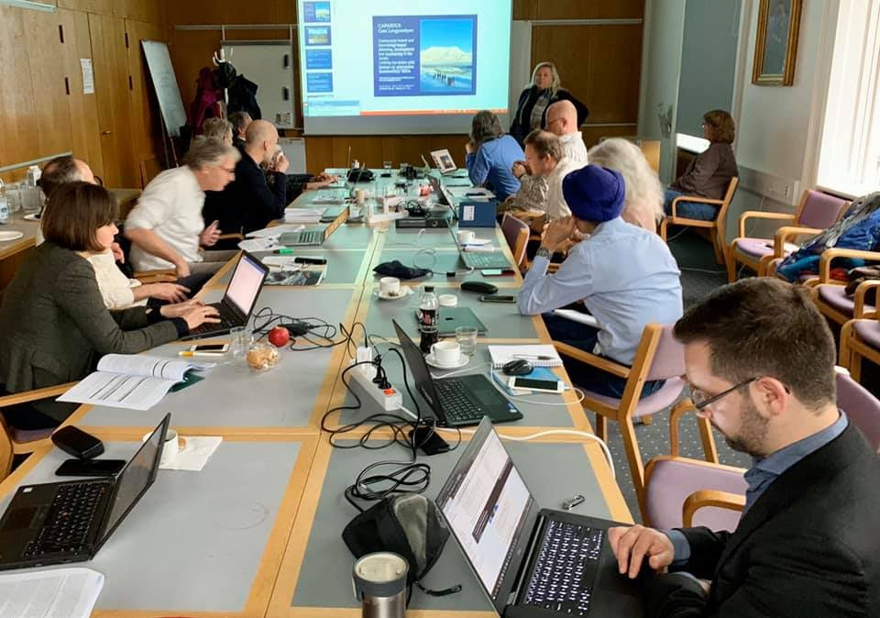
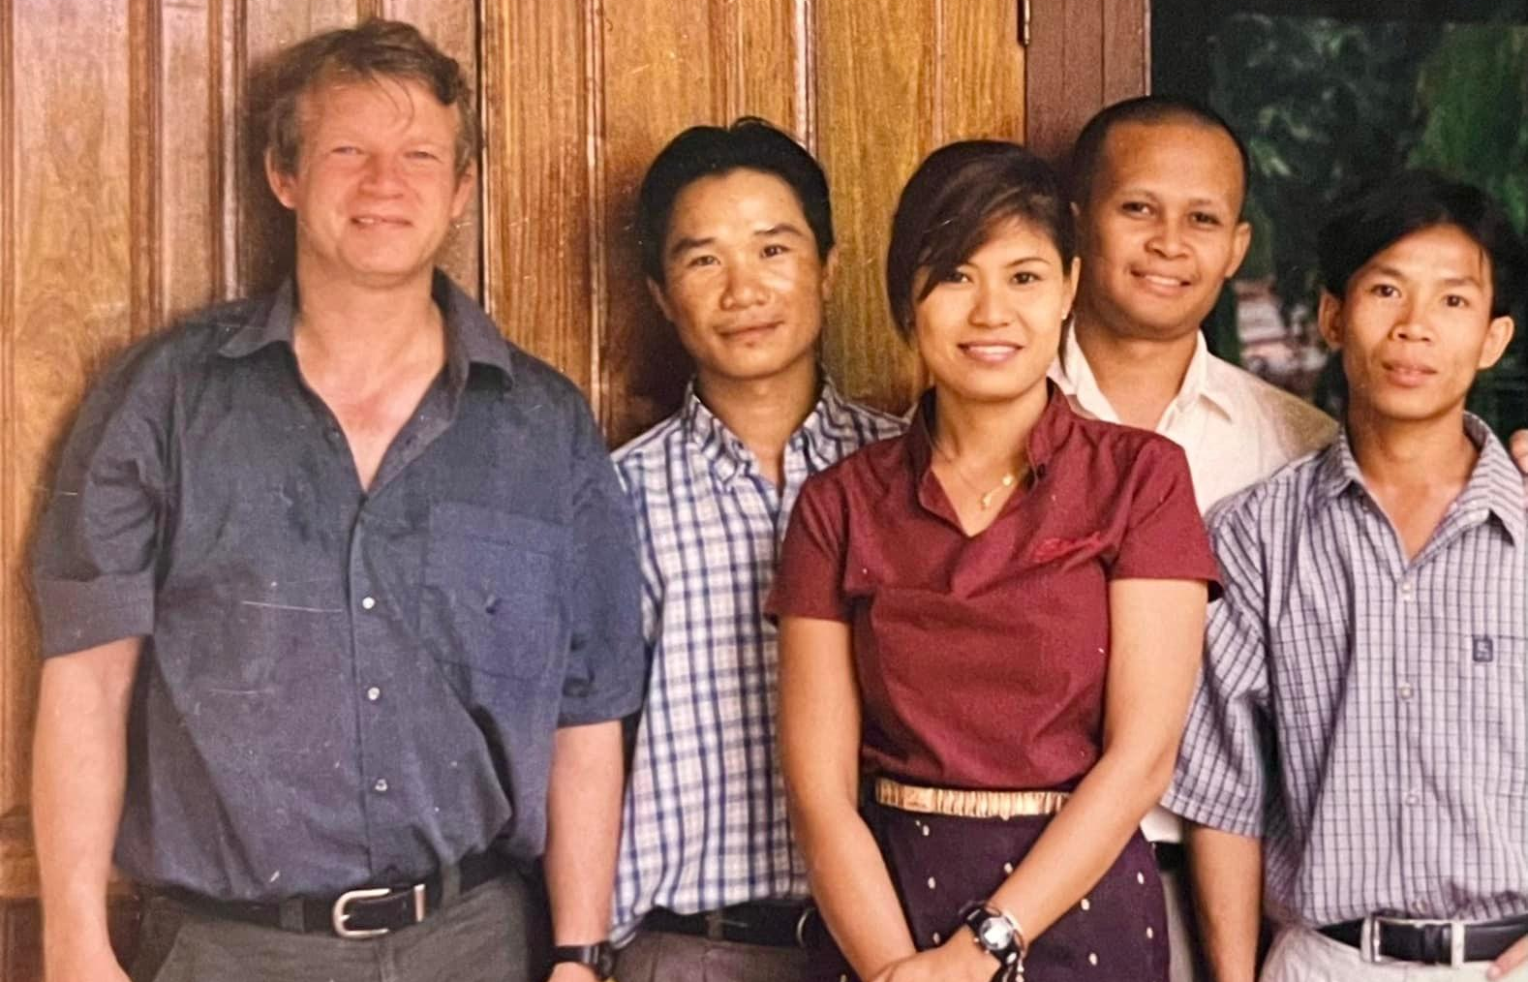
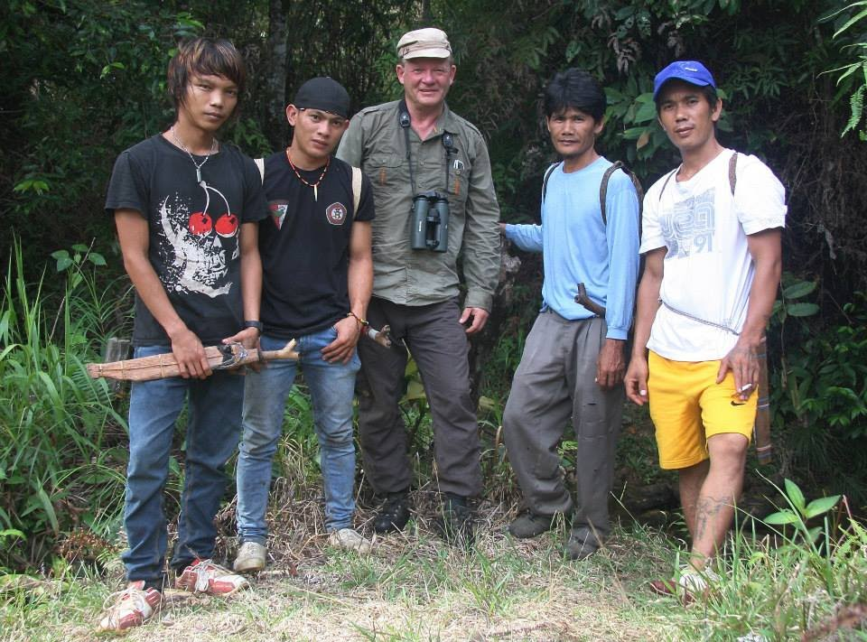
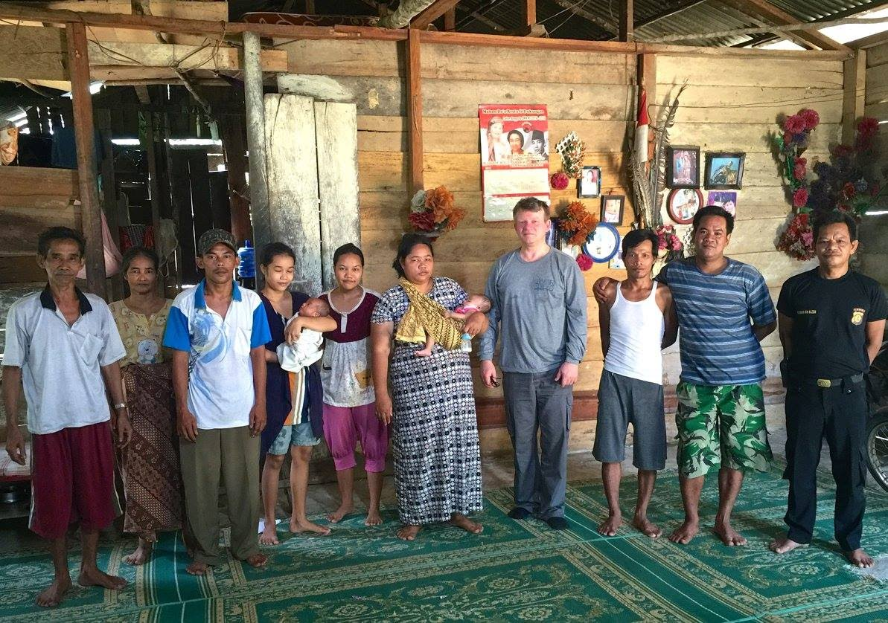
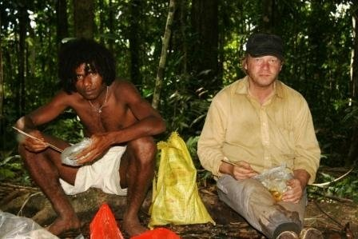
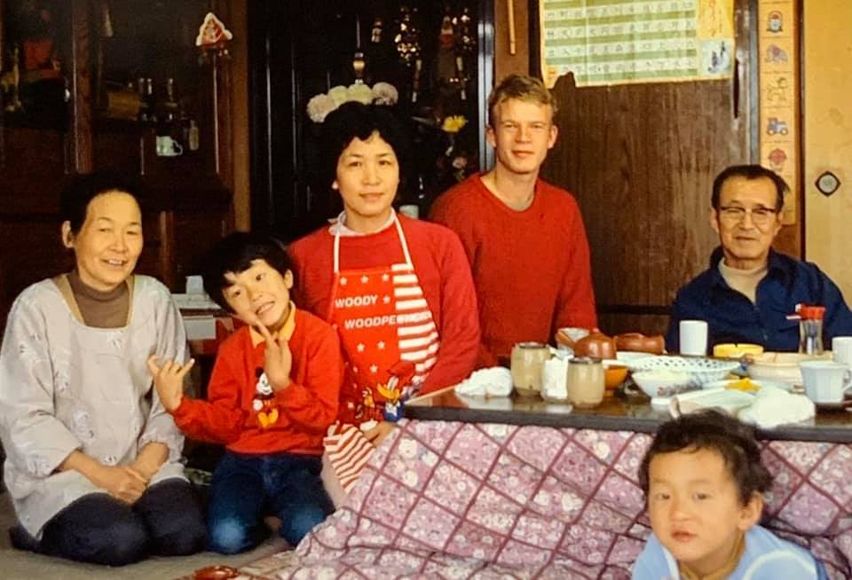
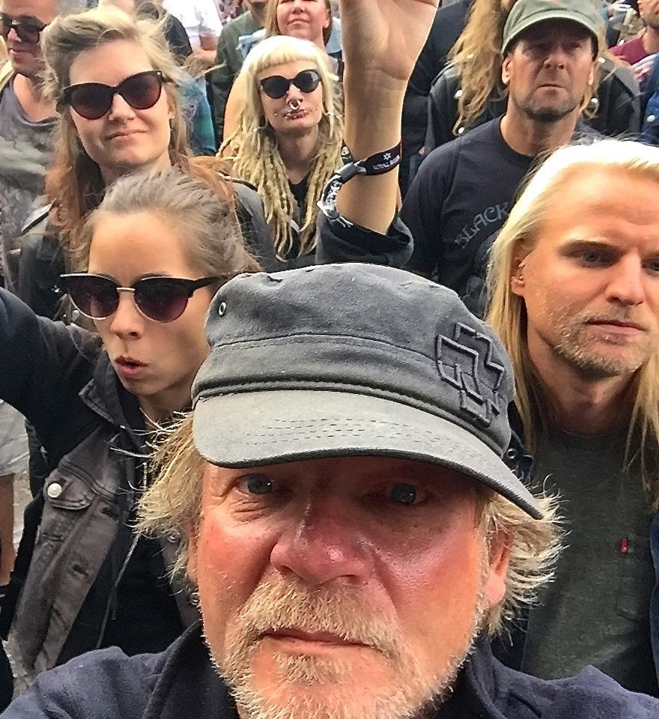
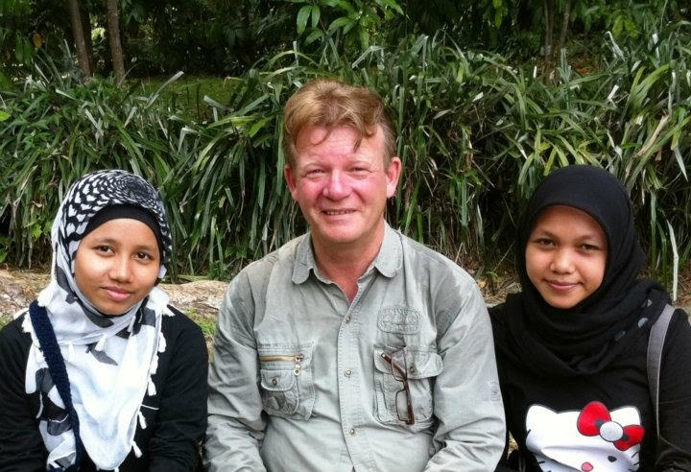
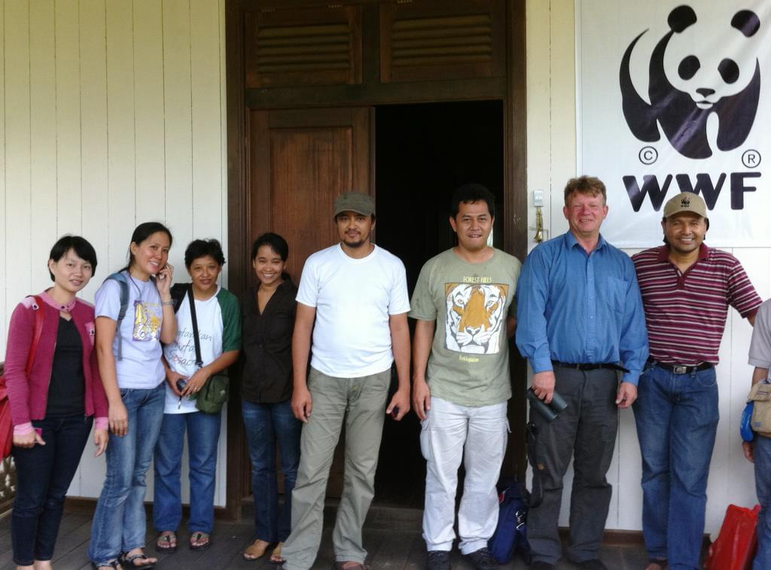
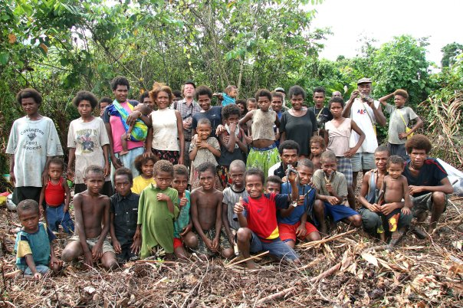
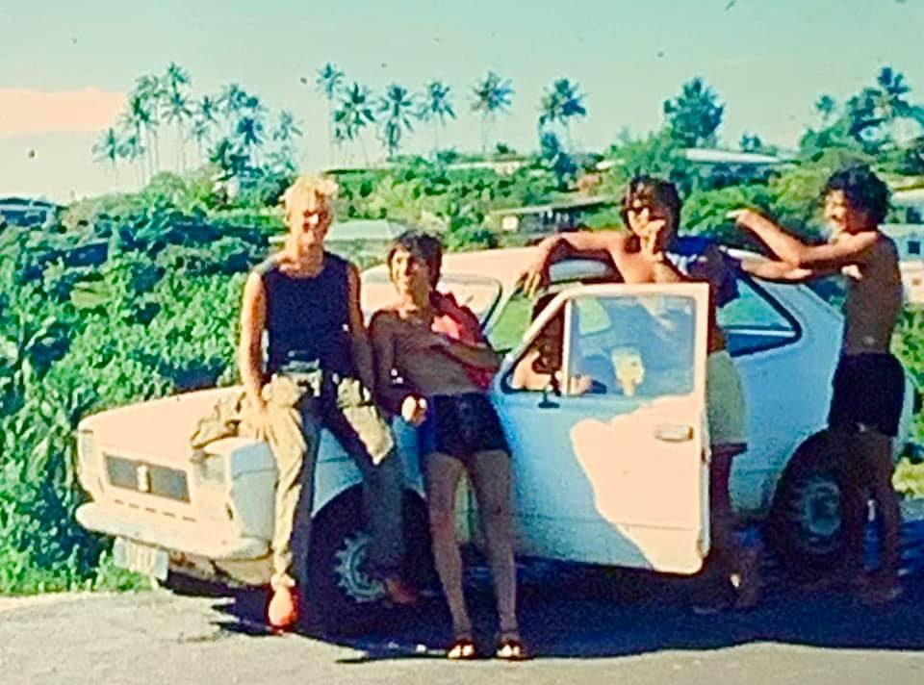
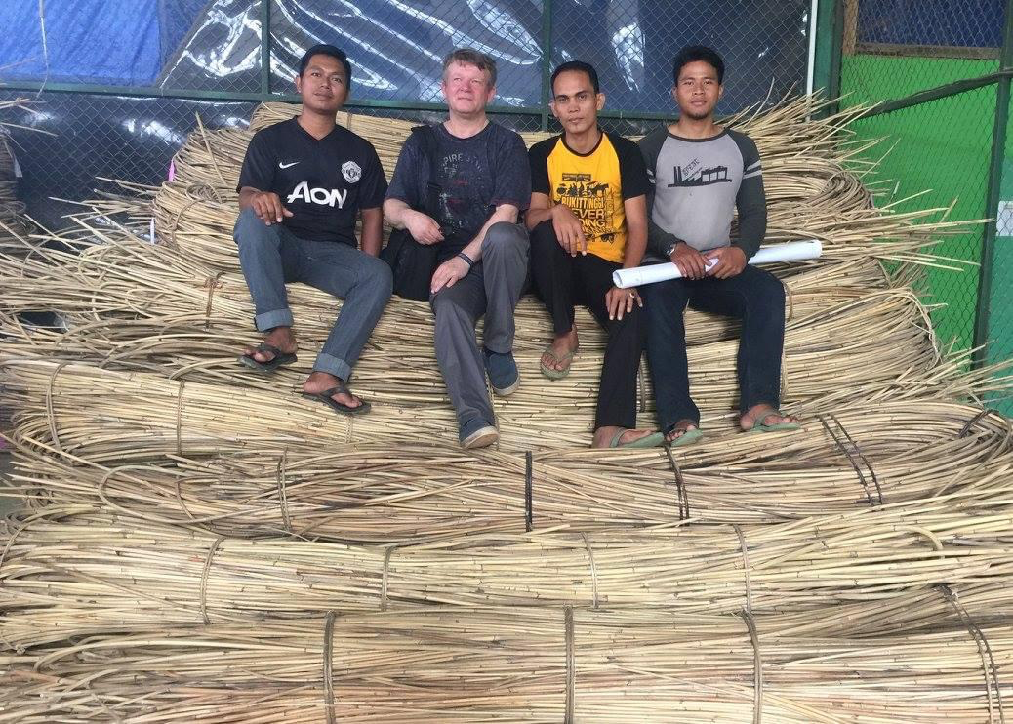

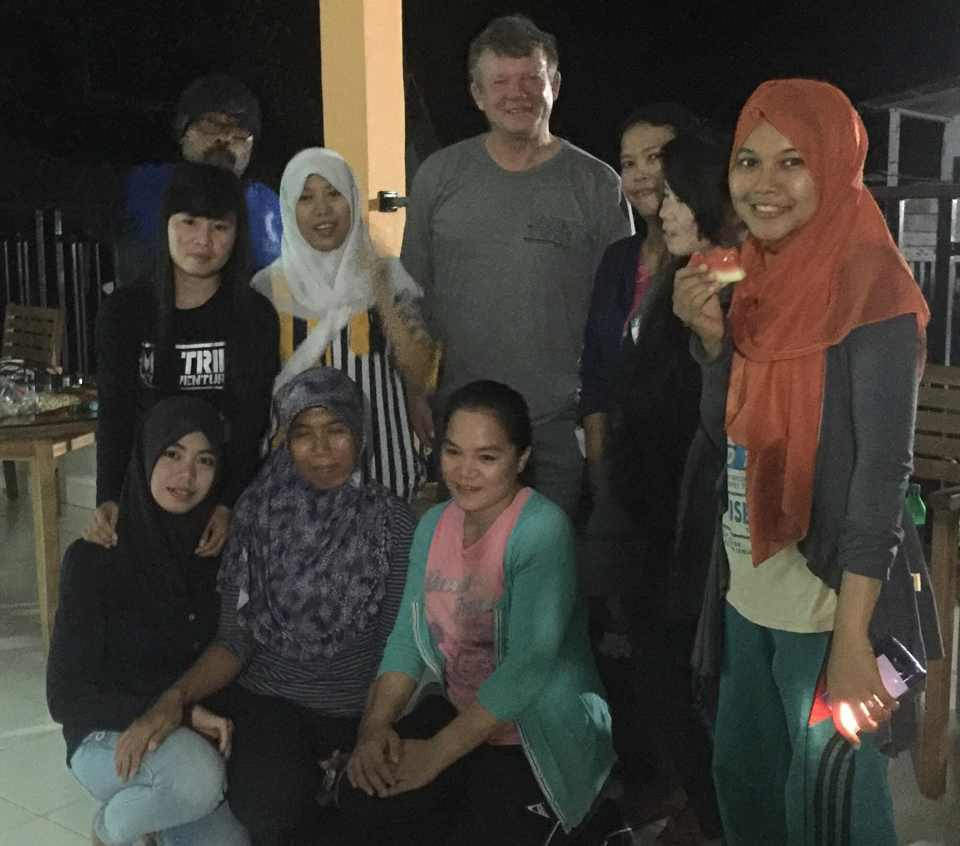
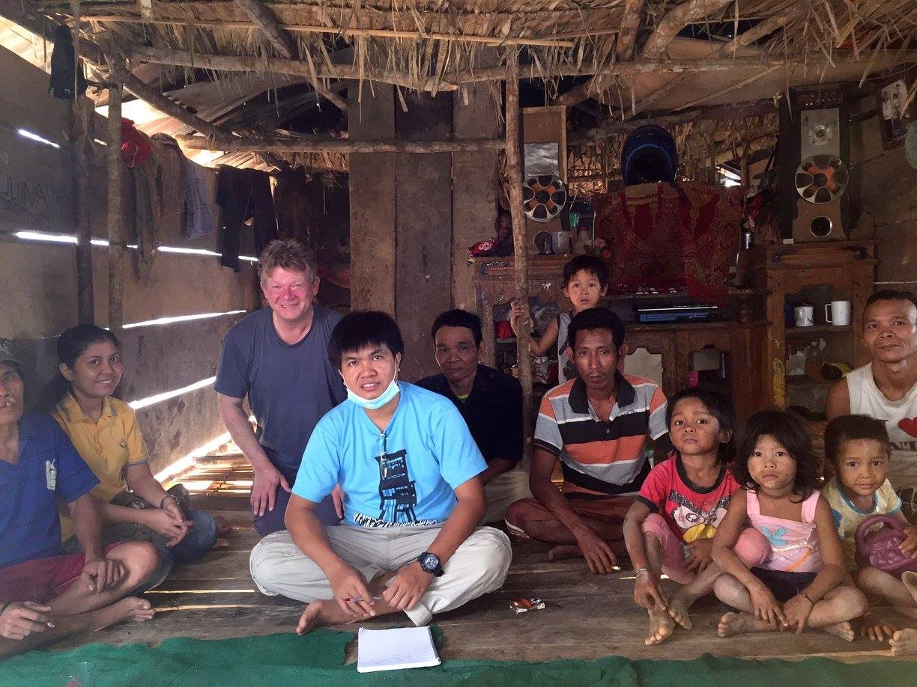
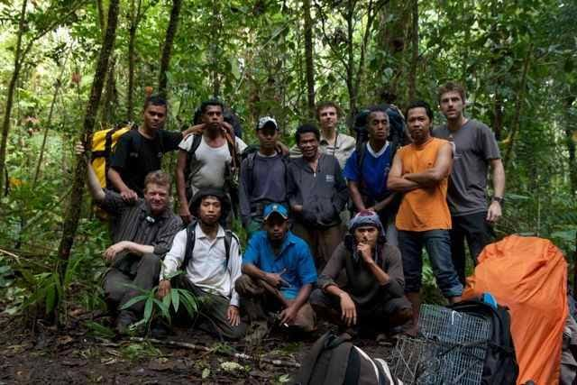
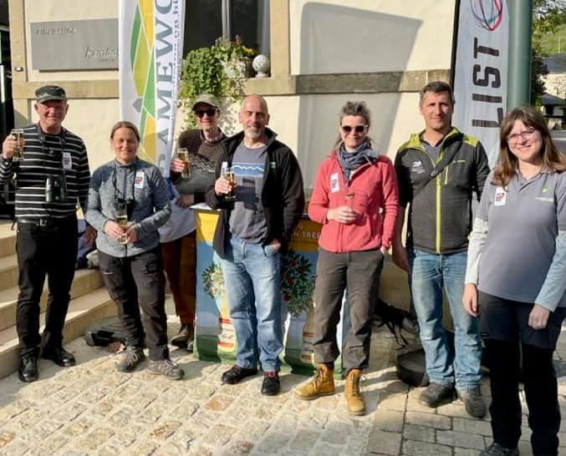
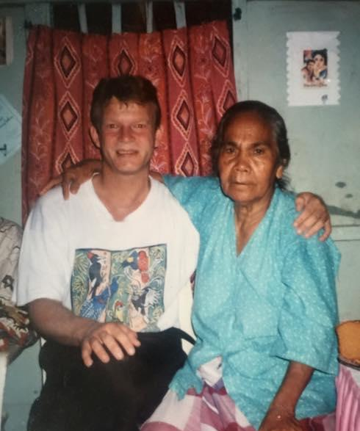
Working around the world with local people to protect biodiversity and improve livelihoods
Notes:
Expertise

Slide 3







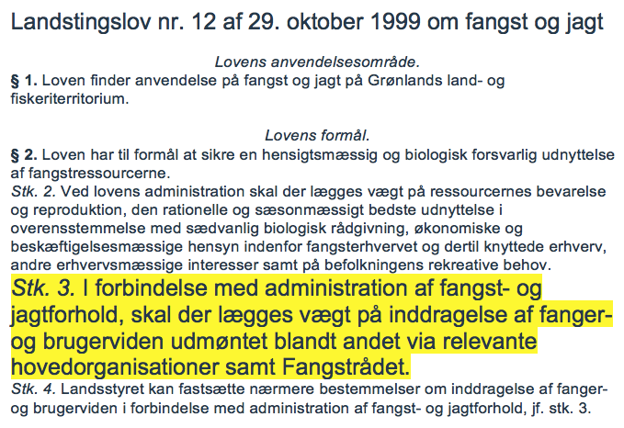


Conventions, Arctic Council, national legislation and management practices
The Convention on Biological Diversity (CBD)
Article 8. In-situ Conservation
Each Contracting Party shall, as far as possible and as appropriate:…
(j) Subject to its national legislation, respect, preserve and maintain knowledge, innovations and practices of indigenous and local communities embodying traditional lifestyles relevant for the conservation and sustainable use of biological diversity and promote their wider application with the approval and involvement of the holders of such knowledge, innovations and practices and encourage the equitable sharing of the benefits arising from the utilization of such knowledge, innovations and practices...
Article 10. Sustainable Use of Components of Biological Diversity
Each Contracting Party shall, as far as possible and as appropriate:…
(c) Protect and encourage customary use of biological resources in accordance with traditional cultural practices that are compatible with conservation or sustainable use requirements
Greenland - The law demand inclusion of user knowledge
Notes:
1a

Slide 4
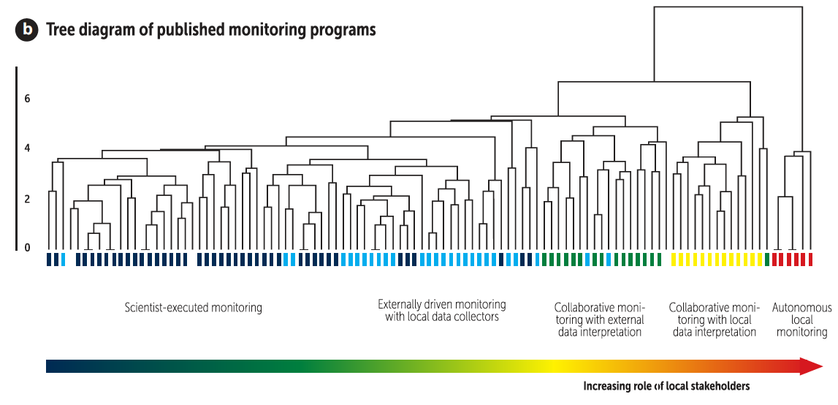

Spectrum of approaches to monitoring
BioScience 71, 484-502 (2021)

Slide 5
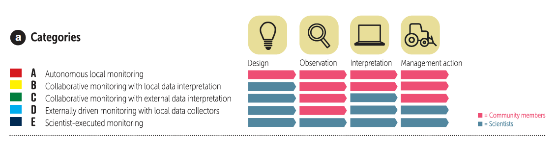
Spectrum of approaches to monitoring
“Community-based Monitoring” - Monitoring where community members are contributing with more than just observations
“Citizen-science” - Research and monitoring involving community members (often used when community members, citizens, only contribute with data gathering
BioScience 71, 484-502 (2021)
Notes:
2a

Slide 6
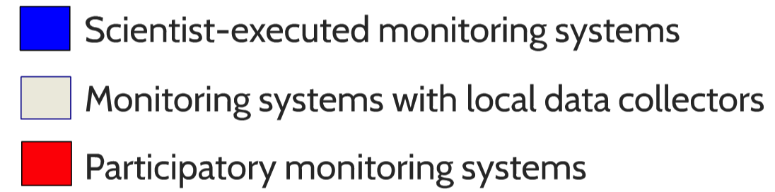
Space and time
Time from data collection to
Decision making (years)
Spatial scale of impact

Slide 7
n=104 monitoring schemes
J Appl Ecol 47:1166-1168

Slide 8
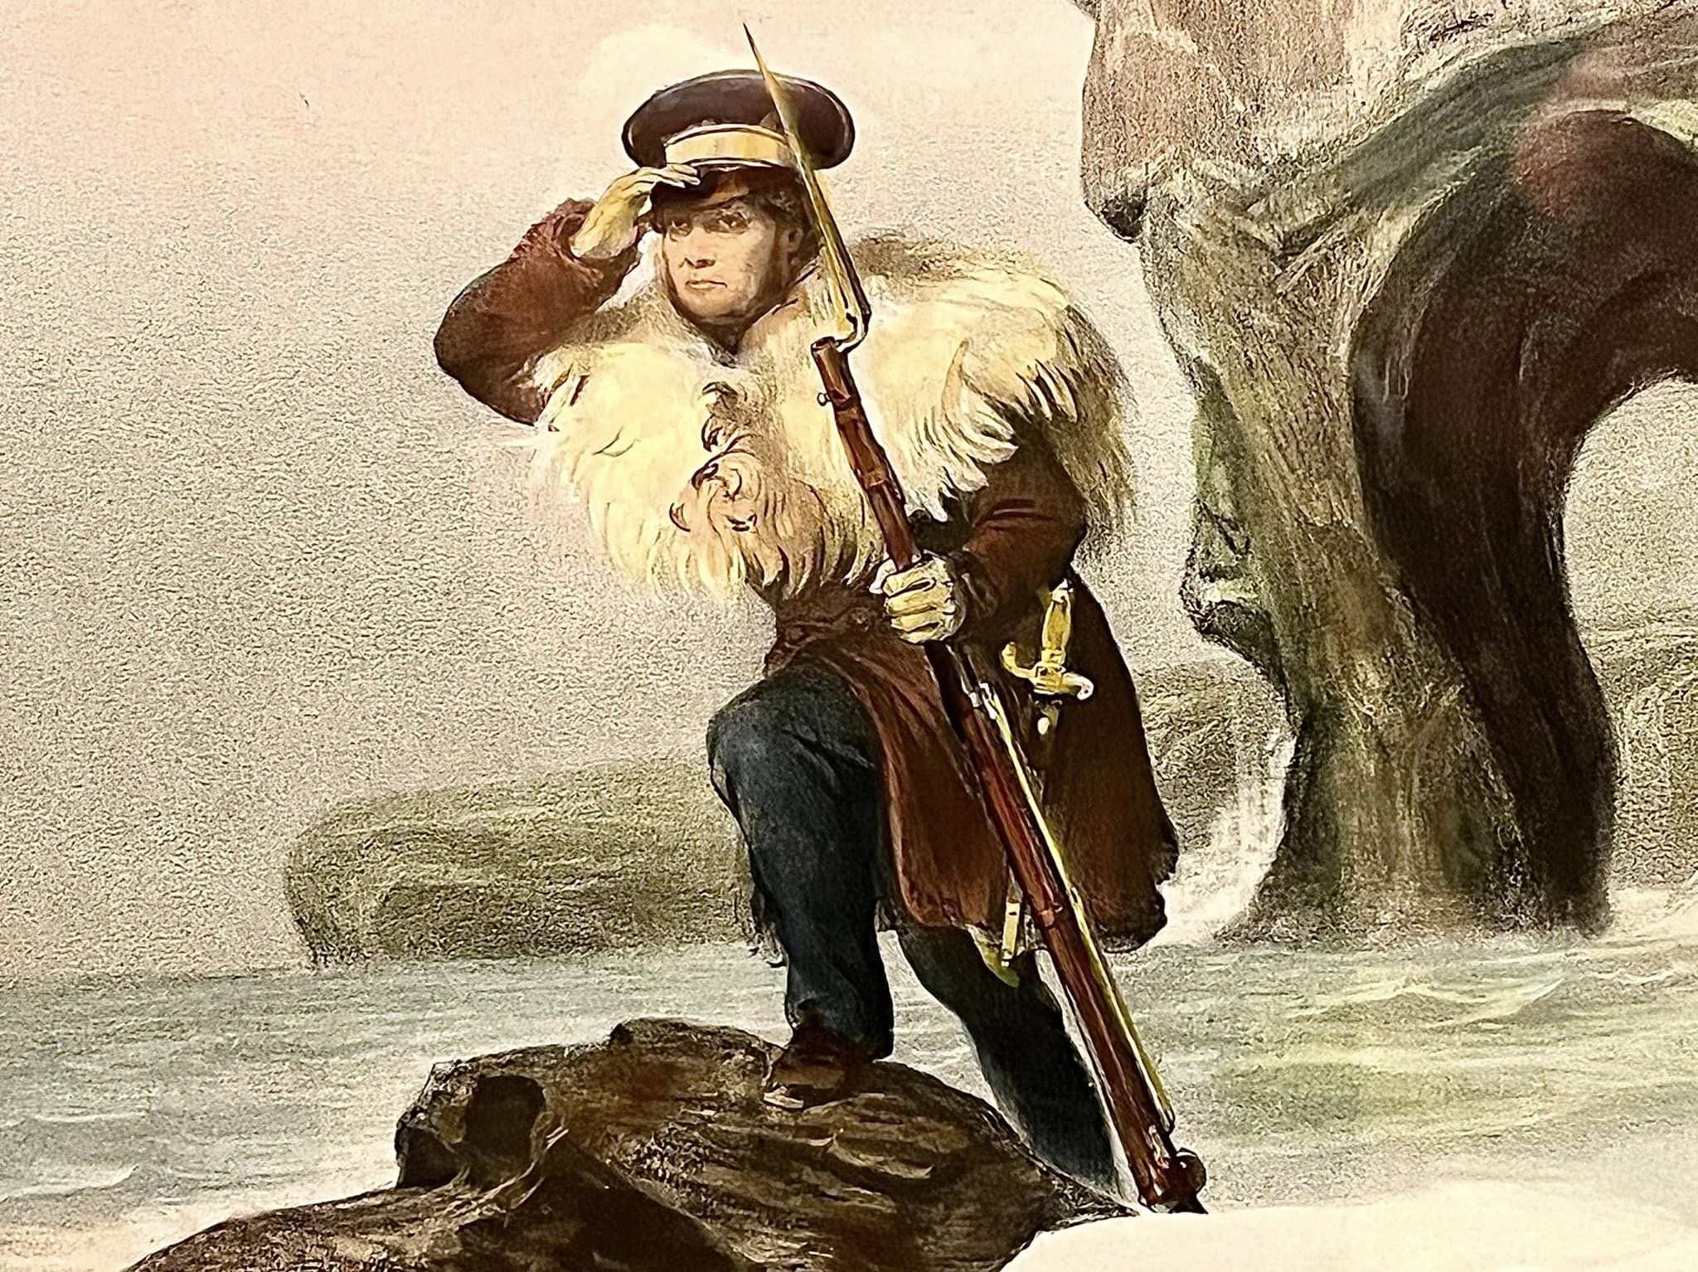
Challenges to scientist-executed monitoring
Strength of scientist-executed monitoring
Accuracy
Scientist can identify difficult species
Costly - Operating costs are high
Technically/logistically demanding
Sustainability - Often of short duration
Data volumes are small
High training needs - there is a shortage of scientists who can carry out monitoring
Will not guide local management decision
Notes:
2c

Slide 9
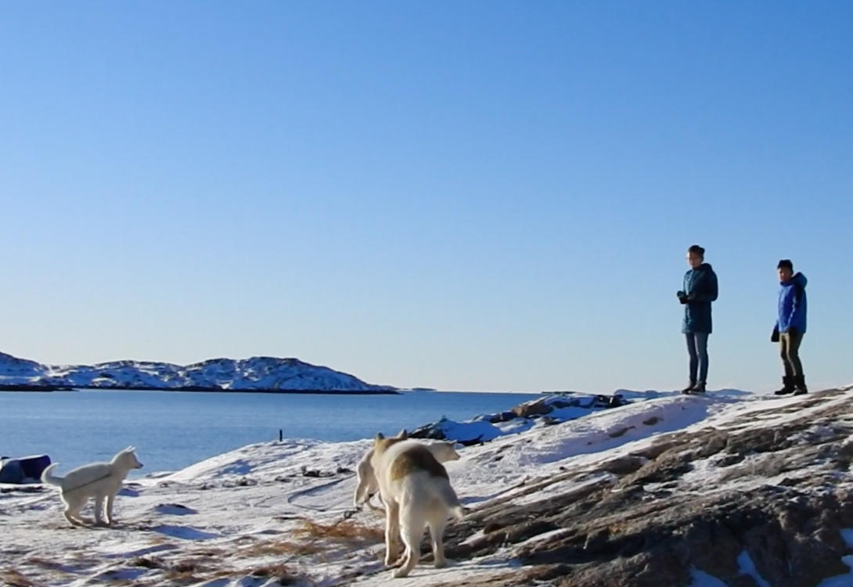
Potential benefits of participatory monitoring
A possible supplement to scientist-executed monitoring ?
Provides relevant information for local management actions
May be low-cost
Can be sustained using locally available resources
Promotes participation of local people in the management
Notes:
2c

Slide 10
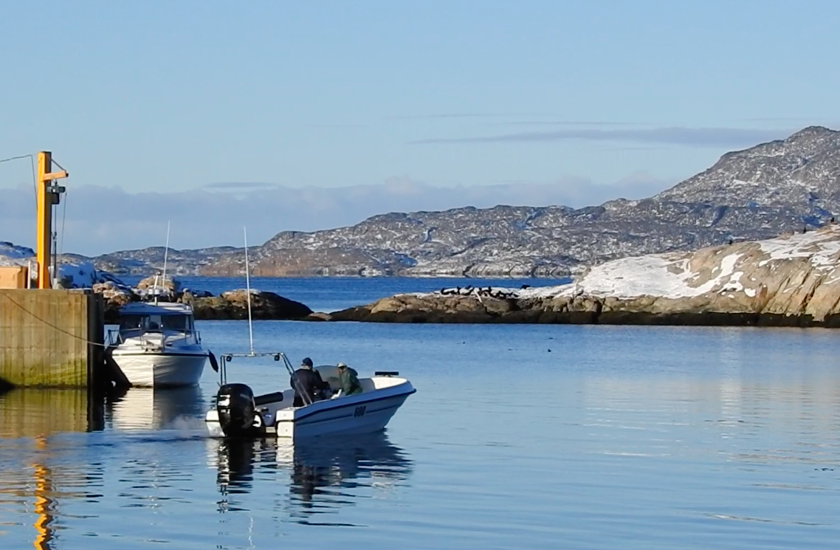
…more potential benefits
Builds the capacity of local government staff and communities in management skills
Reinforces the consolidation of existing livelihoods through strengthening locally-based resource management systems
Promotes awareness, dialogue, discussions and democracy
Notes:
2c

Slide 11
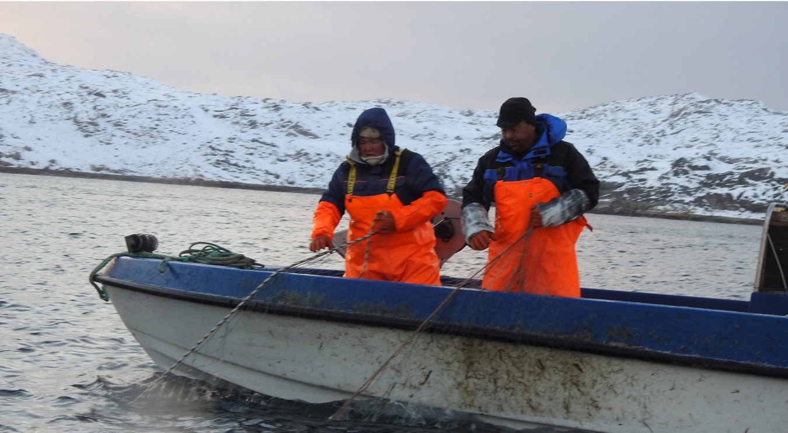
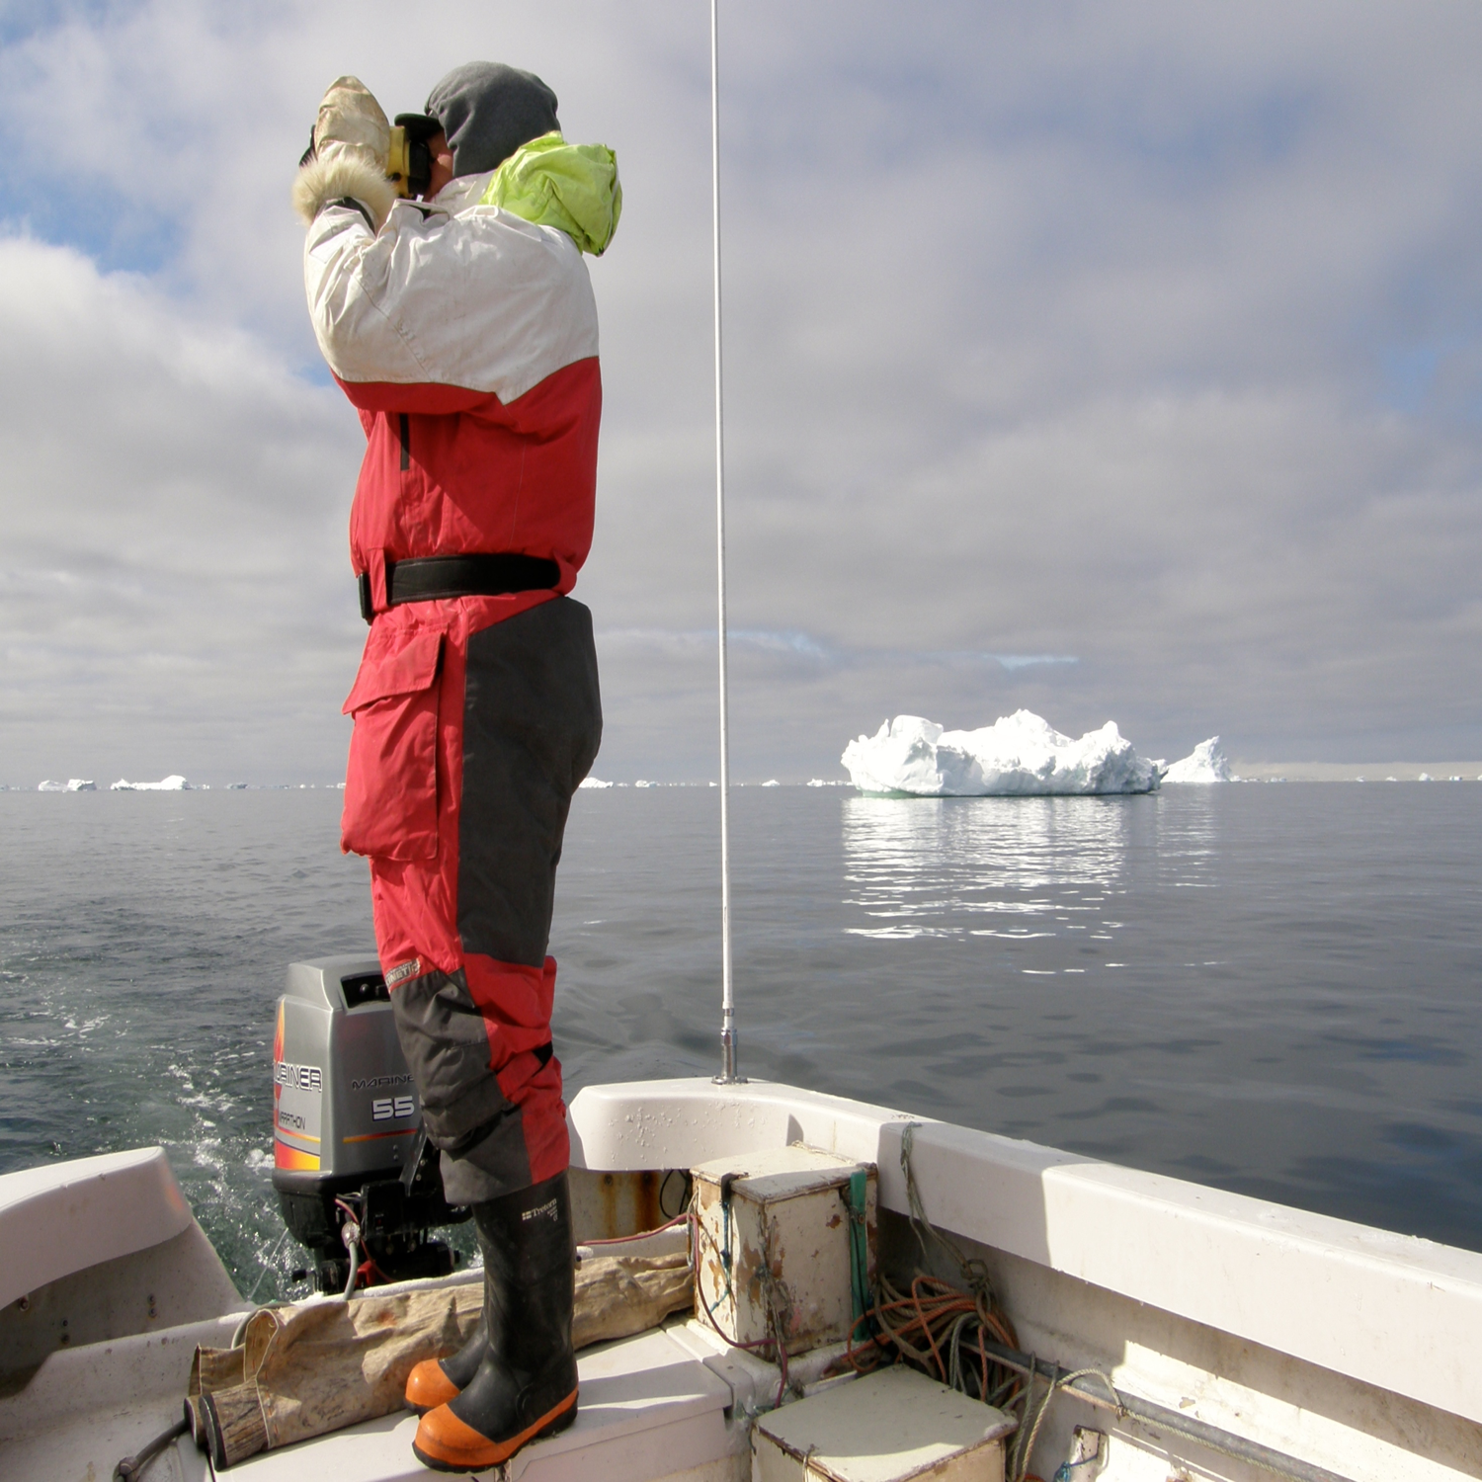
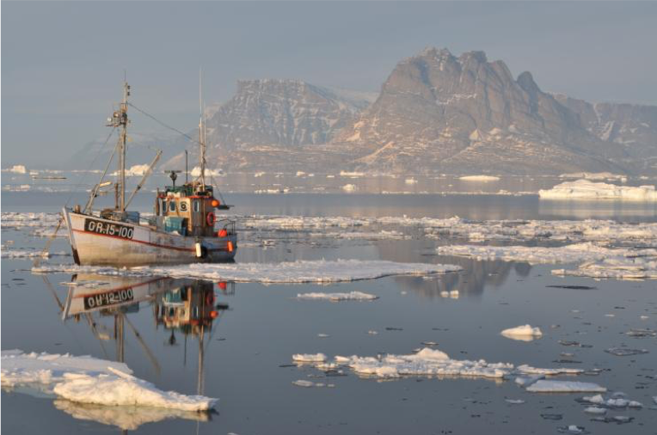
When is community-based monitoring relevant for the communities?
1. When agriculture and natural resources are important to the people
2. When the information generated can have an impact on resource management
3. When there are clear links from monitoring to decision-making on resource management
4. When policies are enabling decision-making at lowest relevant level
5. When the monitoring system will be financially supported
A key motivation for people is to protect local rights over land and resources.
Community monitoring can be an important mechanism for political, social and economic empowerment.
BioScience 71, 484-502 (2021)
Notes:
2c

Slide 12
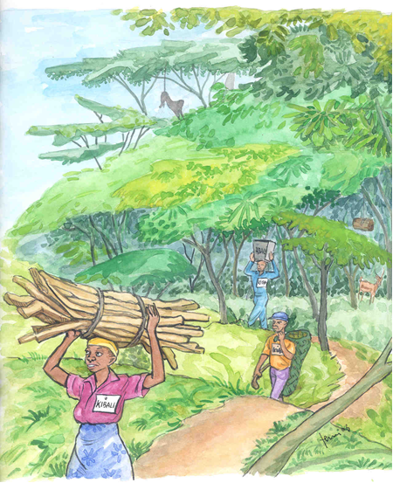
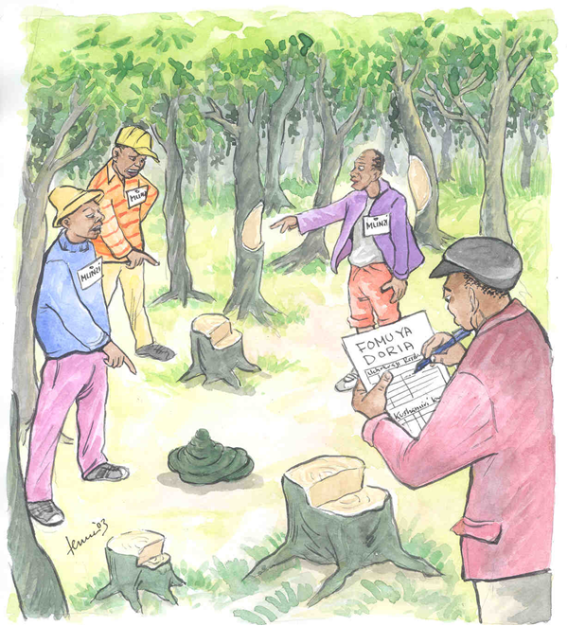
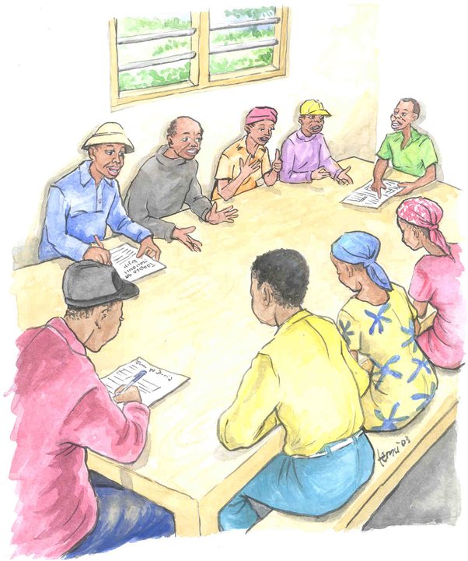
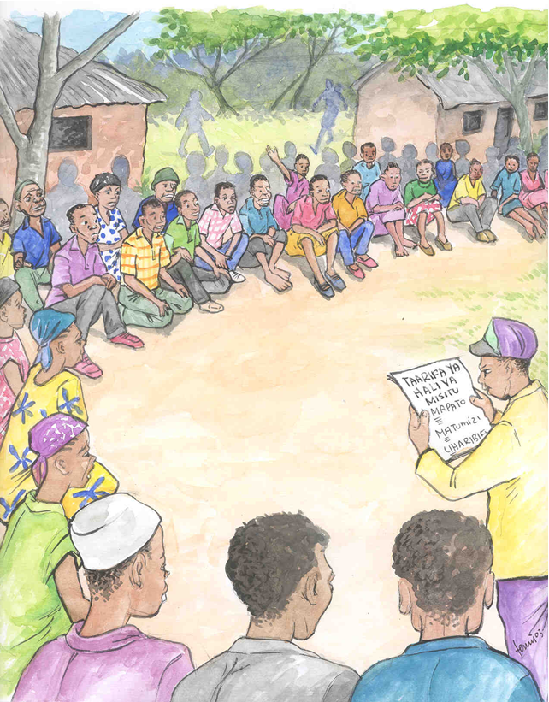
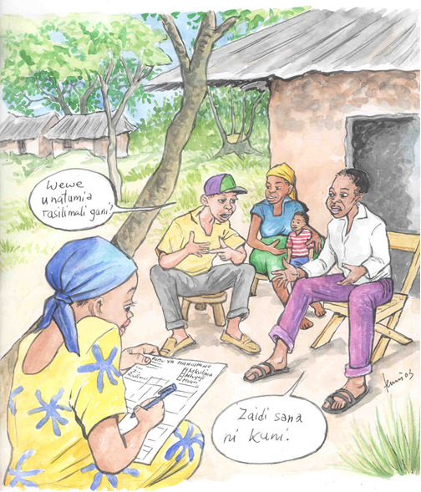
Incentives - Rewards
Tanzania: The high degree of commitment observed at village level is closely linked to economic, social and personal incentives for the villagers involved. Incentives have been financial compensation, appreciation of the water catchment value of the montane forest, exemption from village labour days, and increased prestige associated with being active in the monitoring program.
Notes:
2c

Slide 13
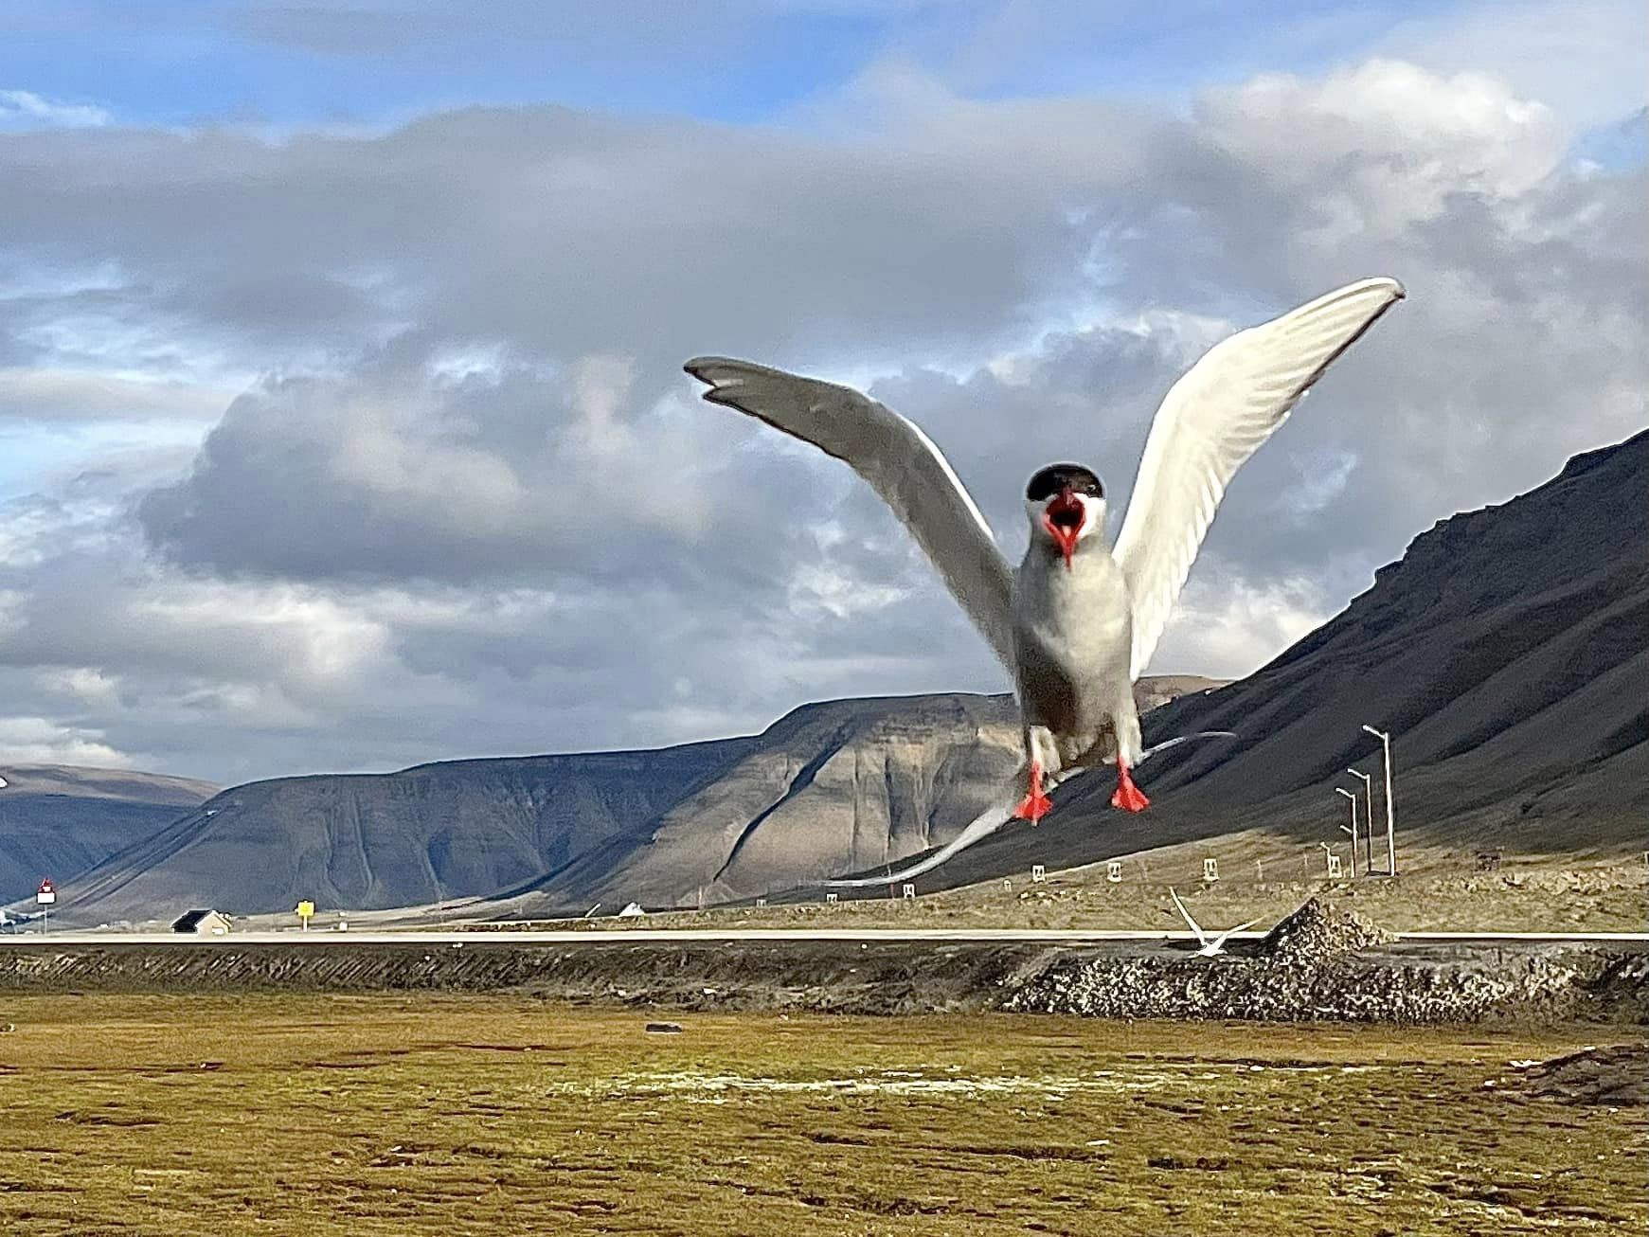
Well-documented positive effects of Community Monitoring
on sustainable development
The effect size is comparable to the effect size of establishment of Protected Areas
Community monitoring was introduced to 400 randomly selected communities, 6 countries
Control communities: 347
Measurable reductions in resource extraction and increases in user satisfaction
Slough et al. 2021 PNAS; Ferraro & Agrawal 2021 PNAS

Slide 14
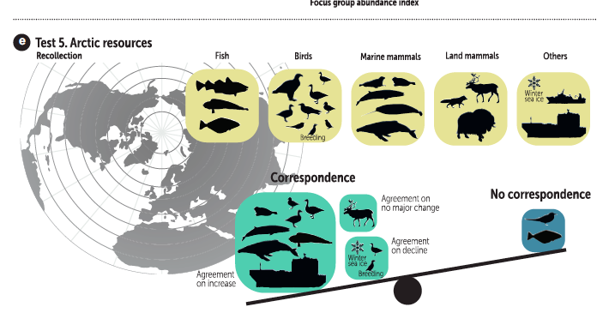
BioScience 71, 484-502 (2021)
Notes:
2d

Slide 15
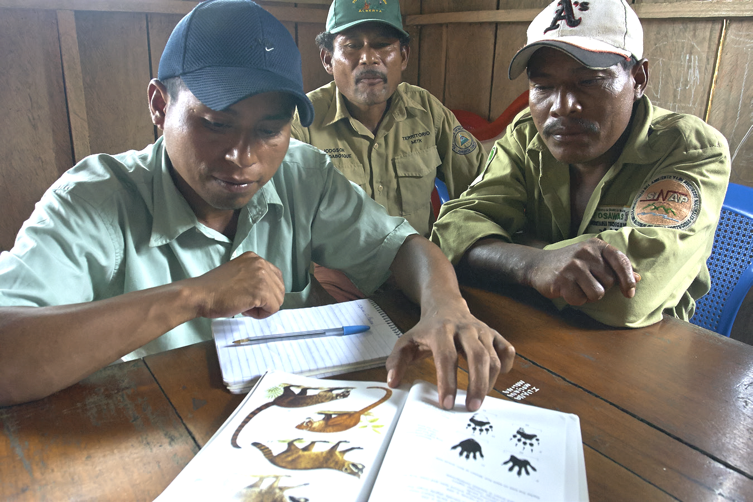
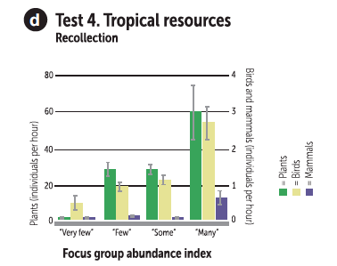
Focus Group Discussions
Focus Group Discussions (FGD) are good at documenting Indigenous and Local Knowledge (ILK).
Gathering the perception of trends from many users
BioScience 71, 484-502 (2021)
Conservation Letters 7(4): 380–389 (2014).
Ambio 36(7):566-570. (2007)

Slide 16
Some guiding principles for working with local communities
FPIC or Free, Prior and Informed Consent is a right for indigenous peoples and is recognized in the United Nations Declaration on the Rights of Indigenous Peoples
FAIR or Findability, Accessibility, Interoperability, and Reusability is the guiding principles for scientific data management and stewardship.
CARE or Collective Benefit, Authority to Control, Responsibility, Ethics is the principles for Indigenous Data Governance.
TRUST or Transparency, Responsibility, user Focus, Sustainability, and Technology is guiding principles to demonstrate digital repository trustworthiness.

Slide 17

PISUNA
Piniakkanik Sumiiffinni Nalunaarsuineq
‘Opening Doors to Native Knowledge’
Local documentation and management of living resources
Notes:
3a pisuna

Slide 18
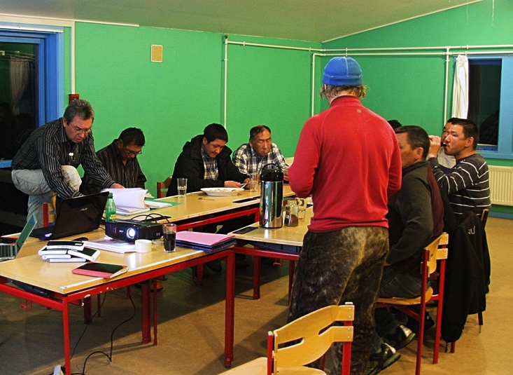
Introducing PISUNA in Attu 2013
Notes:
3a Pisuna

Slide 19
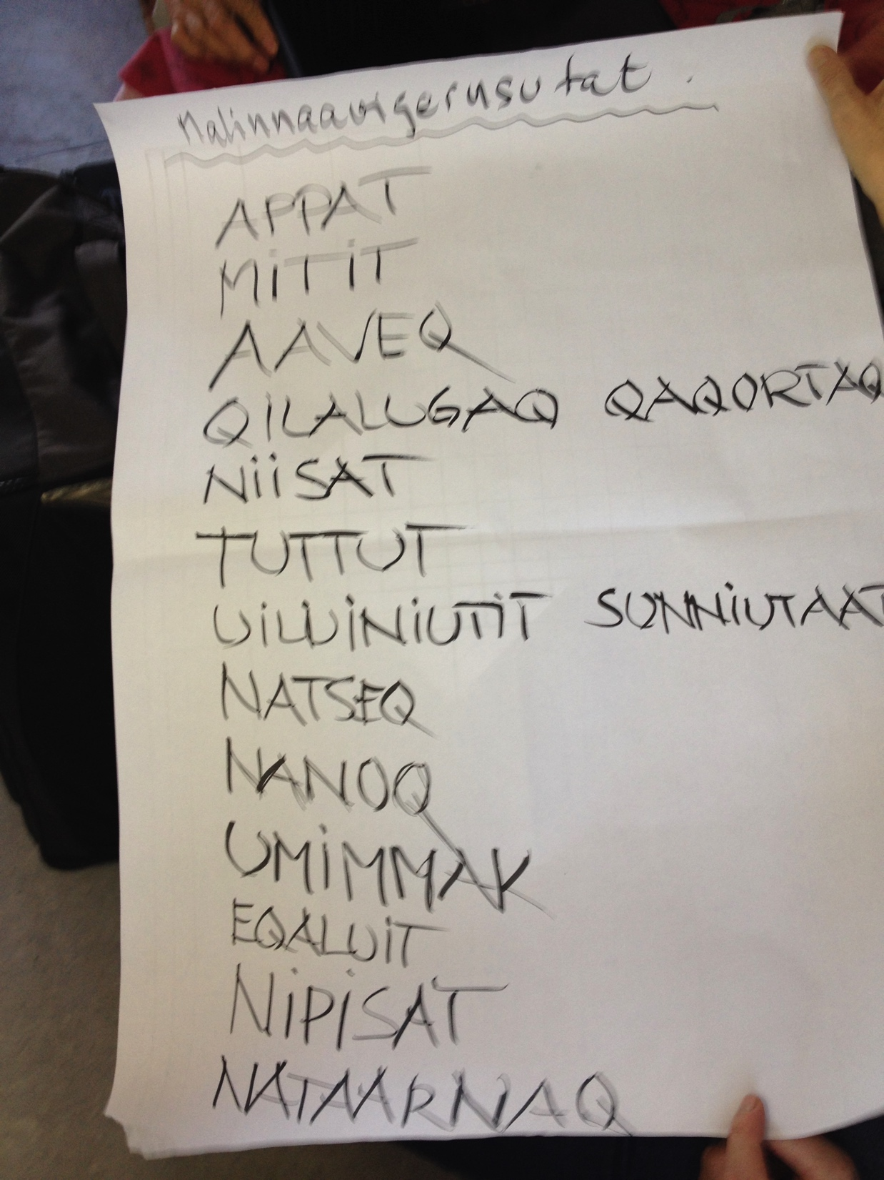
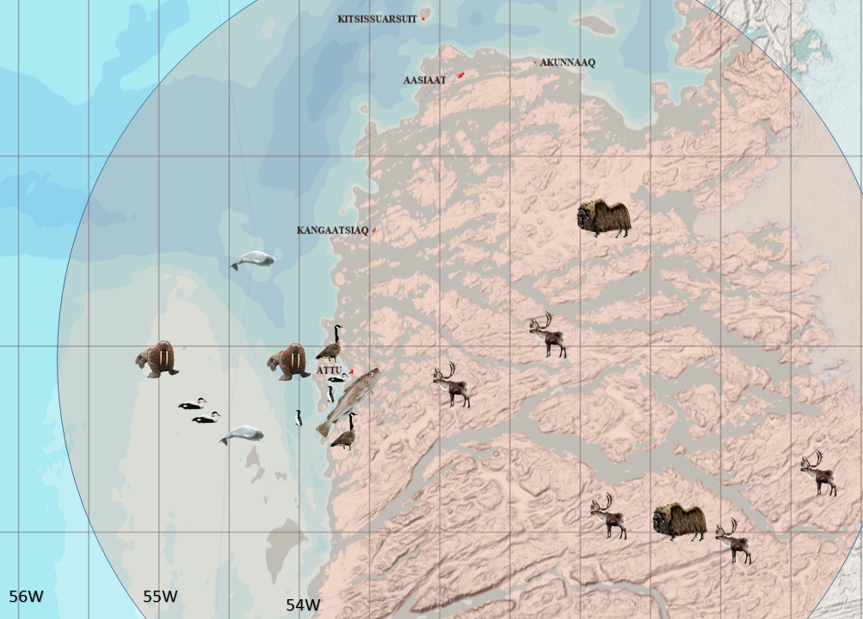
How to introduce PISUNA to a community
Contact community leaders
Let community leaders invite interested community members to a meeting
Ask about how they live and listen
Ask if they are happy with rules and regulation and if they are being heard
Ask if they would like to try to observe and communicate if a more systematic way
They elect a Natural Resource Council (NRC)
Build on existing structures
Let NRC decide focus
Suggest methods with observations along normal daily activities
Keep measuring, counting, meetings and reporting to a minimum
Use Focus Group Discussion approaches
The Natural Resource Council decides which species and resource uses should be monitored.
Council members agree on how they will name and define the extent of each fishing and hunting area in which they will document the living resources.
Notes:
6a

Slide 20
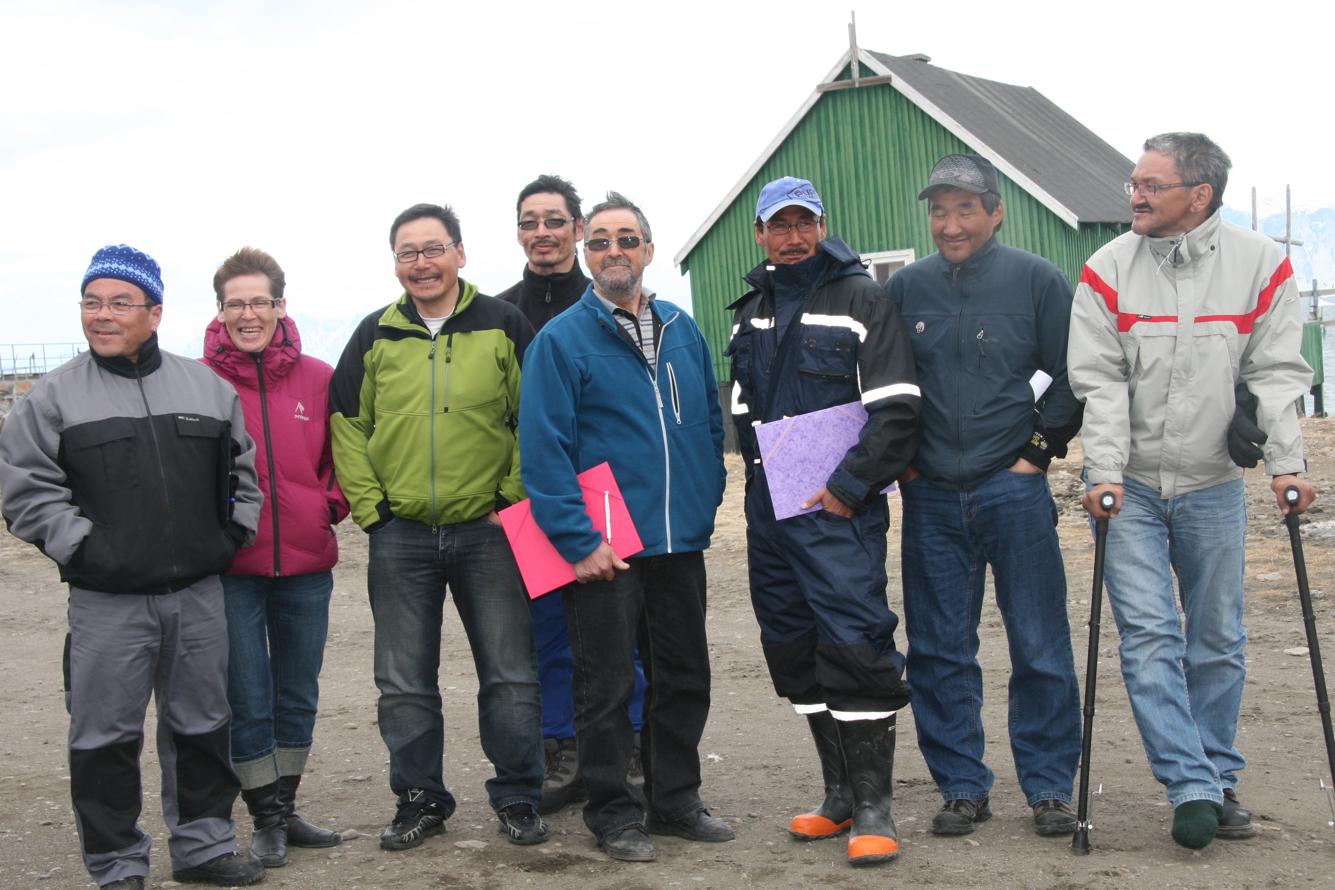
The Natural Resource Council meet quarterly to summarize data and observations
Notes:
3a Pisuna

Slide 21
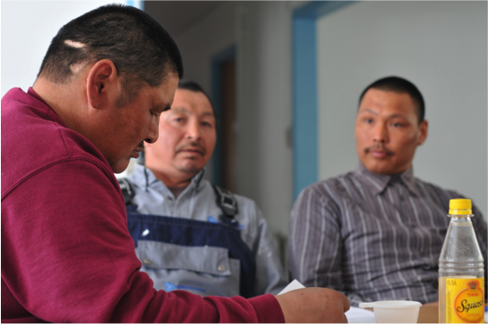
Central
Government
National
decisions
The approach
Local Authority
Local authority
decisions
Village Committee
Natural Resource
Council
Natural Resource Council meeting
Notes:
3a Pisuna

Slide 22
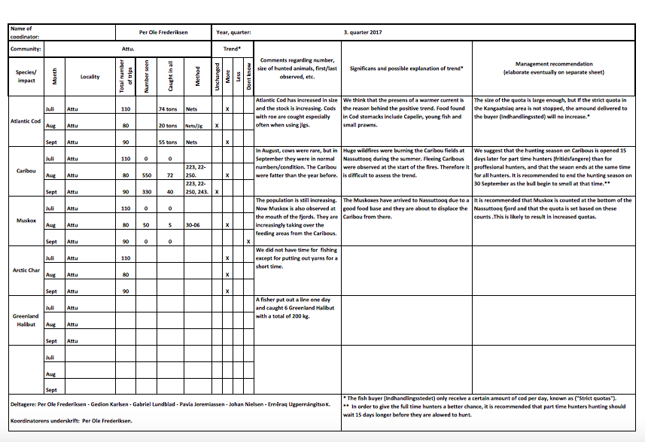
PISUNA Summary Form
Key Topics
Trend
Possible explanation of trend
Management recommendation

Slide 23
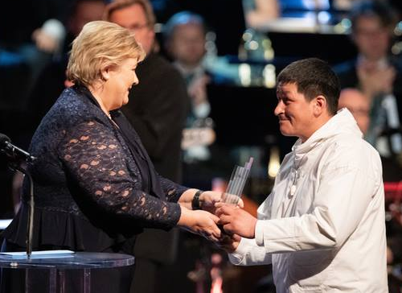
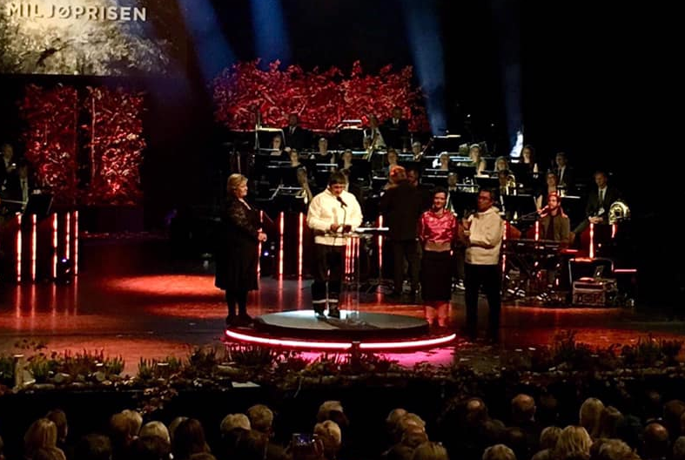
Nordic Council Environment Prize 2018
Per Ole from PISUNA Attu receive the prize
Per Ole (Nuunoq) Frederiksen representing Attu receive the Nordic Council Environment Prize from Norwegian Prime Minister Erna Solberg for Attu’s work in the PISUNA program.
Notes:
3a Pisuna

Slide 24



PISUNA-net observation database – ELOKA- NORDECO
Search for Atlantic Cod
Notes:
3a Pisuna

Slide 25

Fishers proving that there are cods – Akunnaaq 2010
Notes:
The fishers from Akunnaaq in Disko Bay took this photo to show to Greenland Institute of Natural Resources that is is true that thy now have many cods .

Slide 26


Atlantic Cod
Atlantic Cod
Most PISUNA communities report regularly on Atlantic Cod.
Numbers increasing. Spreading northward.
Notes:
Fast changes as climate change. Communities wants fast responses to changes.
The danger of the precautionary principle
Caribou story.

Slide 27
PISUNA field activity through the year
Field trips
Month
Notes:
Community-based approached can increase temporal and geographical scope

Slide 28
PISUNA data – types of records
N = 676 monthly summaries

Slide 29


Slide 30


Collaboration in facilitating Citizen Science in Svalbard
A group of scientists and expedition cruise experts have set up an organisation called the Polar Citizen Science Collective (www.polarcollective.org) which facilitates ship-based citizen science projects on IAATO and AECO vessels. Hurtigruten is on of the cruise operator getting deeply involved in developing citizen science.
- Also to be mentioned: ”Cultcoast” and “Hearts in the Ice”.
Notes:
3b

Slide 31
Polar CS Collective supports Citizen Science projects (2022)
Aurorasaurus - Track auroras around the world (scientific partner: NASA Science Activation)
NASA GLOBE Clouds - Cloud Observations & Atmospheric Measurements (scientific partner: NASA GLOBE Observer
Seabird Surveys for the Antarctic Site Inventory (scientific partner: eBird)
Secchi Disk Study - Long-term Changes of Phytoplankton (scientific partner: Secchi Disk Foundation)
Happywhale - Marine Mammal Photo-ID (scientific partner: International Whaling Commission and multiple regional research partners
FjordPhyto Phytoplankton Sampling (scientific partner: Vernet Lab at Scripps Institution of Oceanography
Notes:
3b

Slide 32


GLOBE Cloud Observations
Participants are photographing clouds and recording sky observations, using the GLOBE Observer app, for comparison with NASA satellite data. Participants can time their observations of clouds with that of satellite observations. This will help refine satellite-derived models and enhance scientific understanding of Earth's atmosphere.
Sites with GLOBE Cloud Observations during 1995-May 2020.
Notes:
3b

Slide 33

Secchi Disk
In 2013, the global citizen science Secchi Disk programme was established for seafarers to study the marine phytoplankton.
The Secchi disc is lowered slowly down in the water. The depth at which the disk is no longer visible is taken as a measure of the transparency of the water.
Sites with Secchi Disk measurements during 2013-2019.
Notes:
3b

Slide 34

Happywhale
Notes:
3b

Slide 35



Happywhale
A total of 234 encounters with 16 species of marine mammals from Svalbard (4 Aug. 2022).
Notes:
3b

Slide 36


Popular CS programs and GBIF
Notes:
3b

Slide 37





eBird: ”Open access to eBird data is critical for conservation actions and we are committed to ensuring that your data will be put to the best use possible for research, conservation, and education”.
Use a phone to track trip and record bird species for a checklist in eBird. Photos and sound recordings can be added
Recent checklists from Svalbard
‘Our’ checklist from Hiorthamn
eBird info on Rock Partridge
Notes:
3b

Slide 38




King Eider
eBird King Eider distribution map
Svalbard records of King Eider in eBird
King Eider distribution map lacking Svalbard
Notes:
3b

Slide 39



Notes:
3b

Slide 40


Research Station with Project on iNaturalist
Notes:
3b

Slide 41



Citizen Science and disappearing coastal archaeology Capardus – CultCoast
Notes:
Capacity-building in Arctic Standardisation Development Cultural Heritage Sites in Coastal Areas.

Slide 42





When establishing community monitoring, keep in mind:
Listen first
Co-create
Keep it simple
Build on existing structures
Keep need for training to a minimum
Ensure that community contributions are “translated” and communicated to decision-makers
Ensure that communities are not ignored
Notes:
6a

Slide 43

Atlas of Community-Based Monitoring in a Changing Arctic http://www.arcticcbm.org/index.html

Slide 44



The EU Horizon 2020 project INTAROS had a work package on CBM programs. With Arcticcbm.org as a starting point we gathered information on 170 Arctic CBM programs and selected 7 for a web-based library. The library presents manuals used by the programs and an overview over the lessons learned. The materials have been prepared by the organizers of each CBM program.
https://mkp28.wixsite.com/cbm-best-practice
Notes:
4a

Slide 45






BioScience from May 2021 with special section on volunteer monitoring
Notes:
4a

Slide 46


ARCTIC Practices in the OceanBestPractices repository
ARCTIC Practices. To locate documents related to the Arctic open https://repository.oceanbestpractices.org. Searcgh under ‘Communities in OceanBestPractices’ ‘Select a community to browse its collections’: ⇒ ARCTIC Practices [154]
OceanBestPractices (OBP) is a secure, permanent document (and other objects) repository. It aims to provide a discovery point for research groups to search and find community accepted existing ocean best practices. This service also invites the ocean research, observation and data/information management communities to submit their own best practice documents to share globally with their colleagues.

Slide 47

Monitoring Matters
"Monitoring Matters" (MOMA) is a research initiative that compares different monitoring systems for biodiversity and the use of natural resources and studies the effects of locally based monitoring schemes in selected rural areas in Europe, Asia, Africa and Latin America.
The MonitoringMatters.org website has links to many papers on participatory monitoring of natural resources.
Notes:
4a

Slide 48

Recommendations regarding best practices for participatory, community-based monitoring of biodiversity and natural resource use developed by the participants of the large International Seminar on Participatory Monitoring of Biodiversity for the Management of Natural Resources held in 2014 in Manaus, Brasil. The recommendations include following areas: Design of monitoring initiatives
Community participation in monitoring initiatives
Institutional arrangements and partnerships
Data quality and management
Relationship between monitoring initiatives and public policy
Recognition of community involvement Institutional and community strengthening
https://repository.oceanbestpractices.org/handle/11329/1463
Notes:
6a

