Slide 1
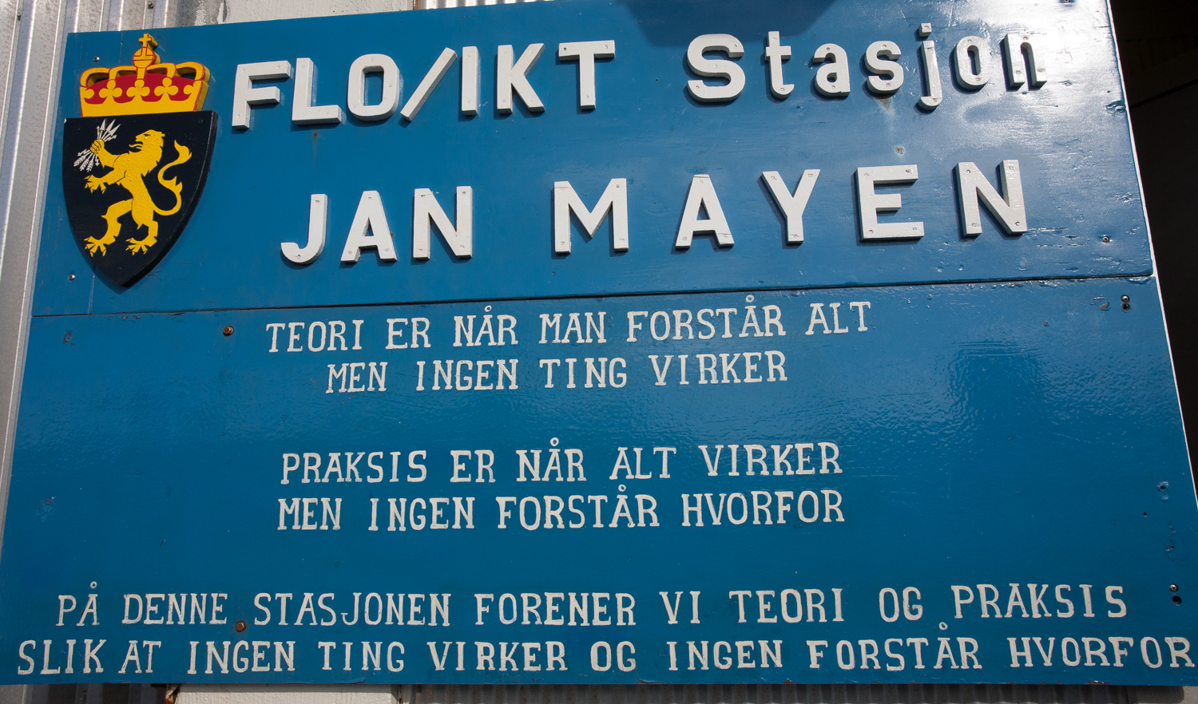
Station Specific Tourism Guidelines
Station Specific Tourism Guidelines
Why and How
“Theory is when you understand everything, but nothing works.
Praxis is when everything works but nobody understands why.
On this station we unite theory and praxis so that nothing works and nobody understands why.”
Troels Jacobsen
AECO Field Operations Manager
Photo: Troels Jacobsen
Notes:
Heading: Safety & Environment

Slide 2
Station Specific Tourism Guidelines
Why?
Interface education for tourism/tourists with station management
Provide visitors with specific information including cautions and considerations ensuring sustainable development and minimum environmental impact
Mitigate disturbance to research station work
Enhance knowledge research conducted at the station
Knowing what’s not allowed is as important as knowing what is allowed!
Notes:
Heading: Safety & Environment

Slide 3
Station Specific Tourism Guidelines
AECO have developed a template that can be used when developing Station Specific Guidelines (part of INTERACT III, WP 9)
Based on AECO experiences developing:
INTERACT Survey results
Site Specific Guidelines
Community Specific Guidelines

Slide 4
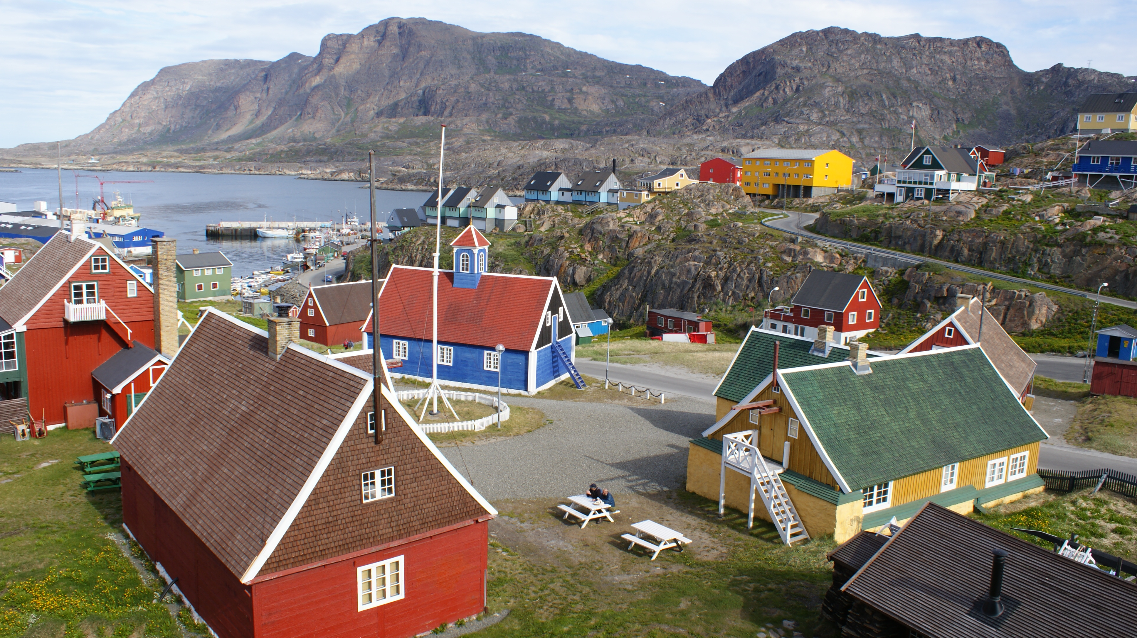
Station Specific Tourism Guidelines
Station Specific Tourism Guidelines
How?
Conduct vulnerability assessment on the natural environment and risk assessment of research infrastructure
Keep an open dialogue with representatives of visitors and local communities to ensure mutual benefits
Photo: Wikimedia

Slide 5
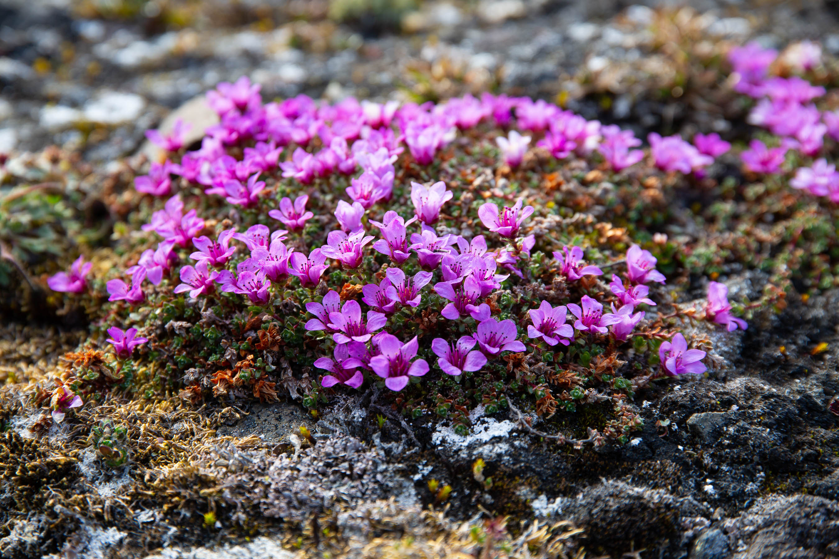
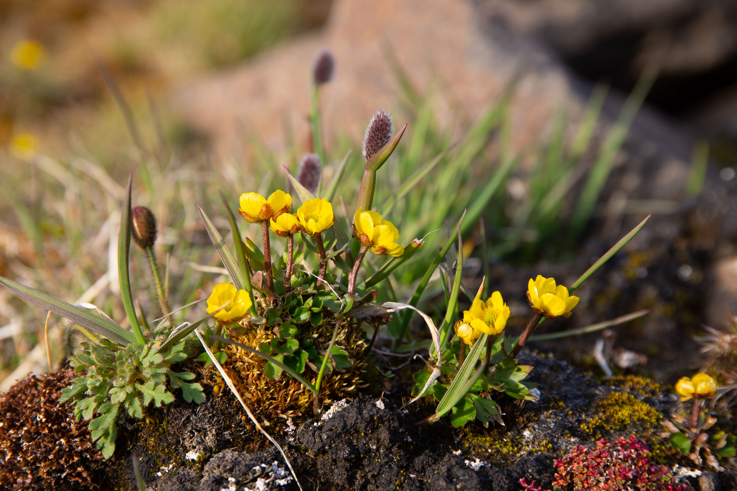
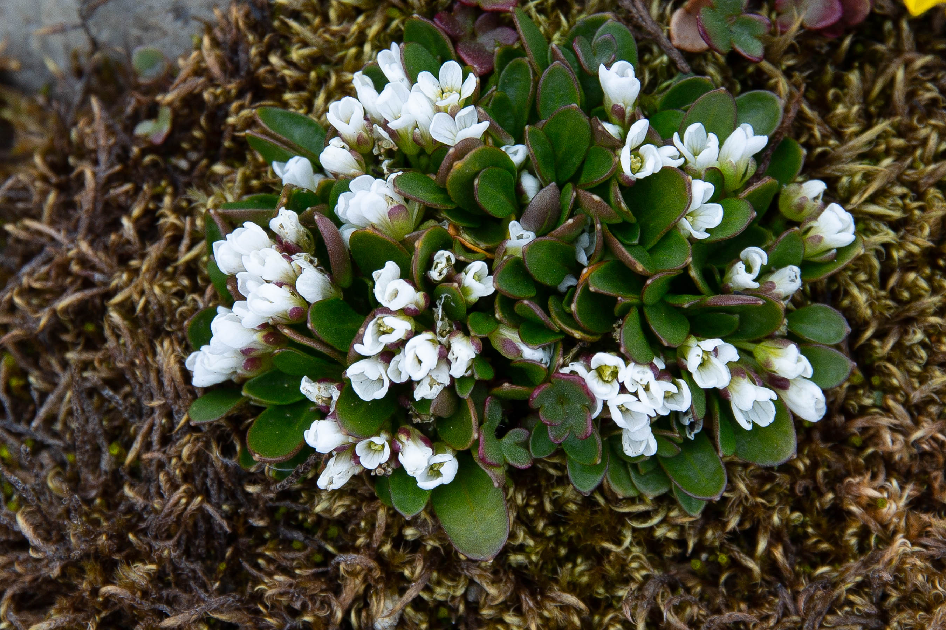
Station Specific Tourism Guidelines
Add content:
Site name and historic background
Description of research topics focused on at the station
Expected behavior of visitors: Do’s and don’ts
Services that may be available:
Souvenir shop
Toilet
Guided tour/Opening hours (if applicable)
Etc.
Flora and fauna descriptions in the general area

Slide 6
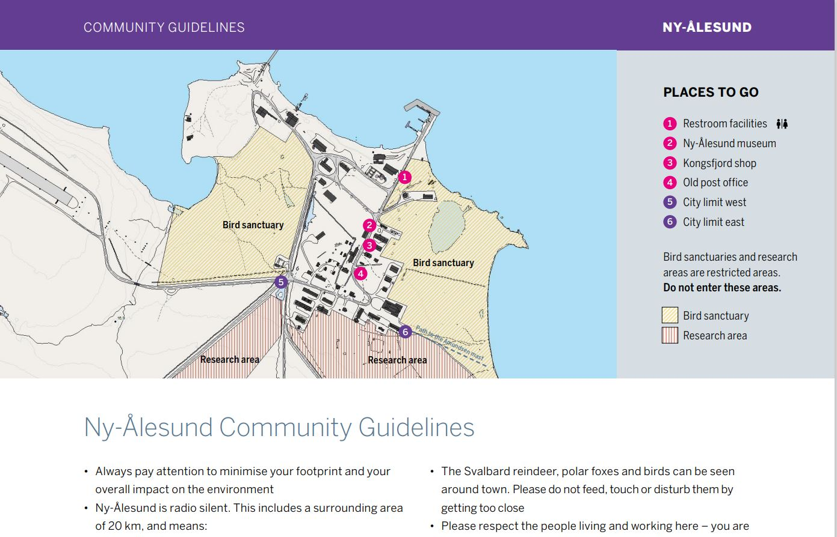
Station Specific Tourism Guidelines
Use vulnerability assessment to create an easy-to-read map
Location of buildings
Location of research equipment
Where can you go
Where you CANNOT go
Recommended paths
Etc.

Slide 7
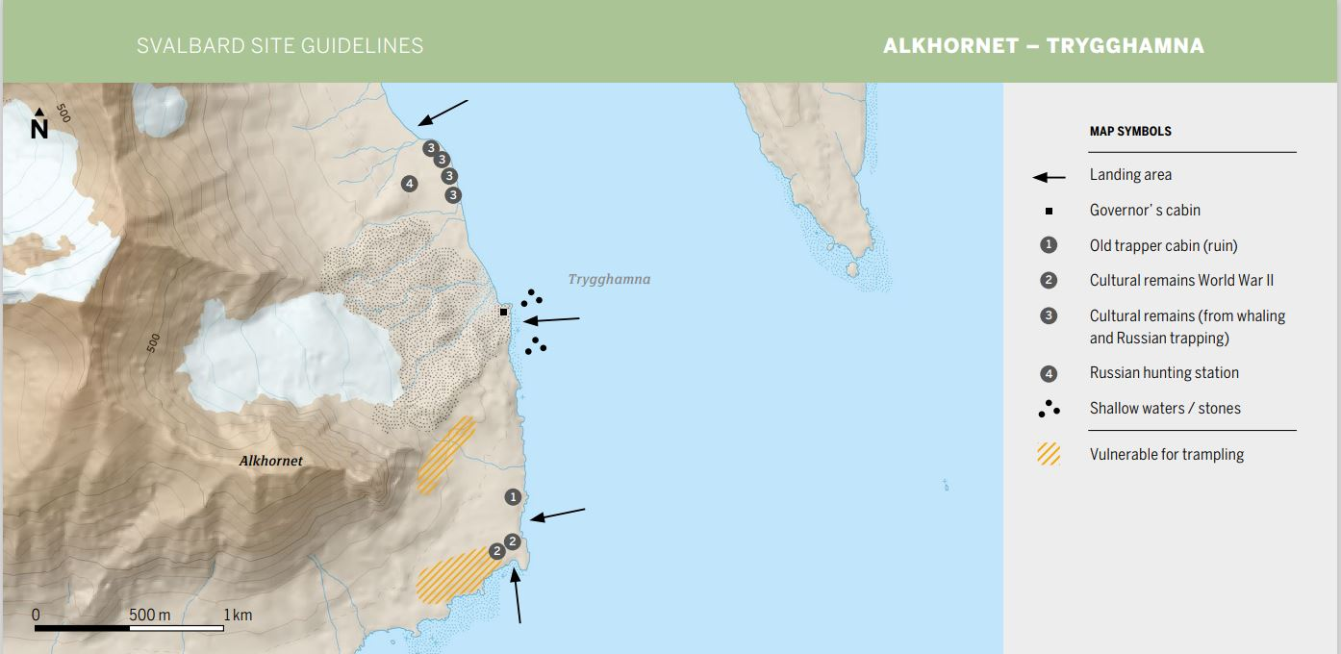
Station Specific Tourism Guidelines

Slide 8
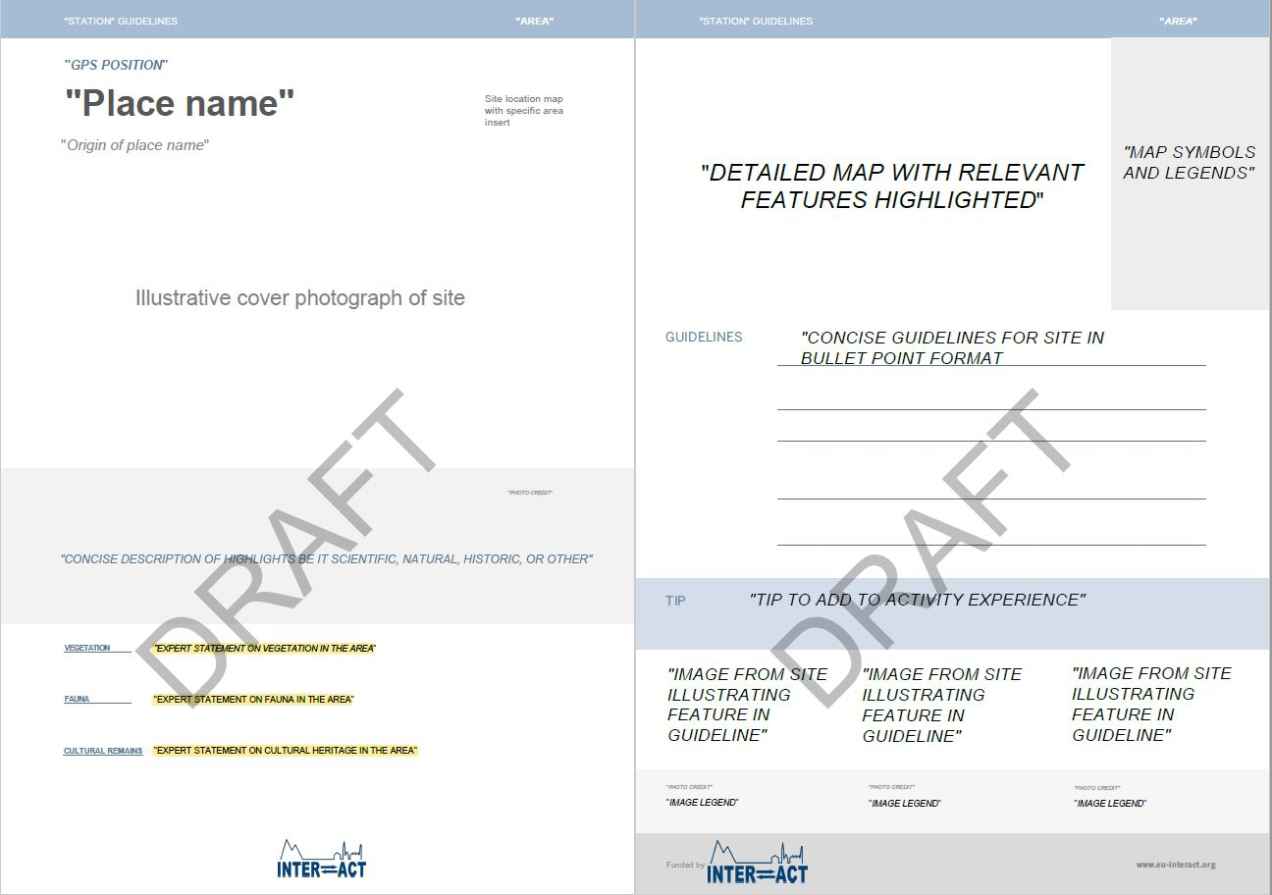
Station Specific Tourism Guidelines

Slide 9
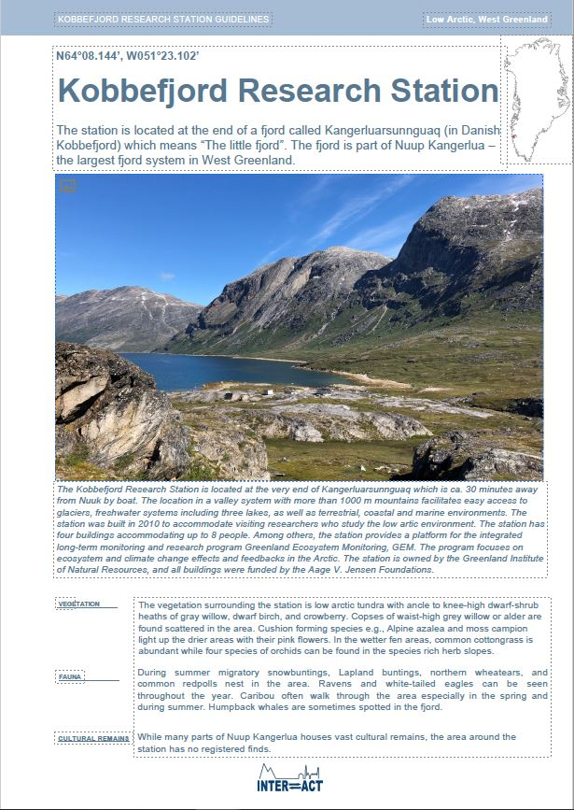
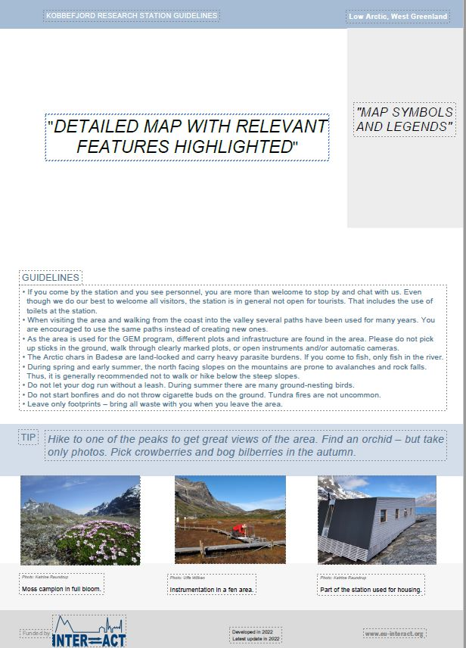
Station Specific Tourism Guidelines

Slide 10
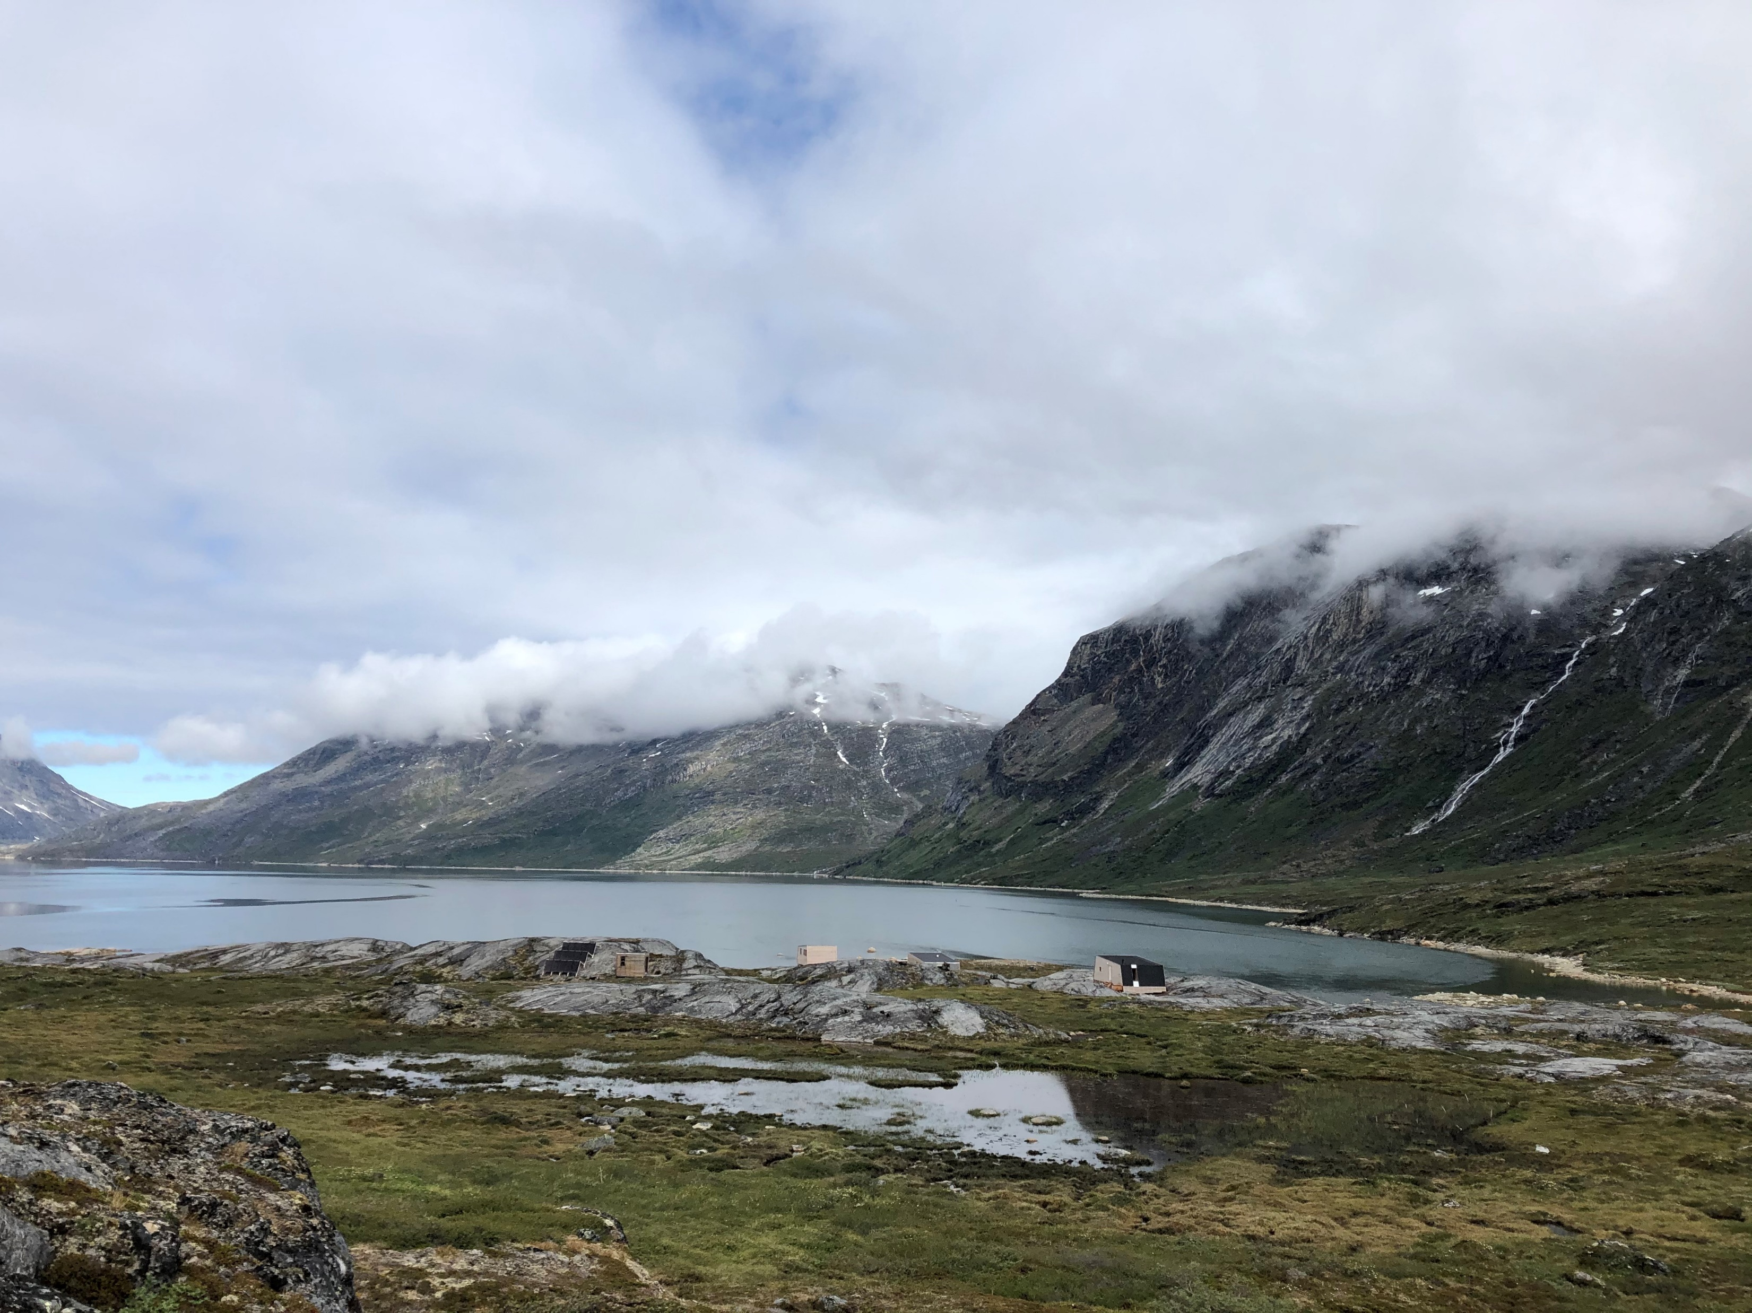
Station Specific Tourism Guidelines Kobbefjord Research Station
Pinngortitaleriffik
Greenland Institute of Natural Resources
Grønlands Naturinstitut
Katrine Raundrup Greenland Institute of Natural Resources

Slide 11
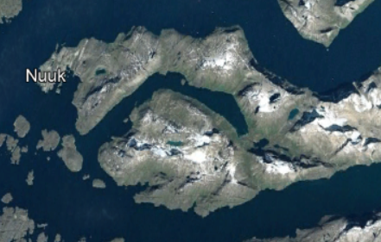
Pinngortitaleriffik
Greenland Institute of Natural Resources
Grønlands Naturinstitut
Small station
35 min boat ride from Nuuk
Off-grid
No cell phone connection
No internet

Slide 12
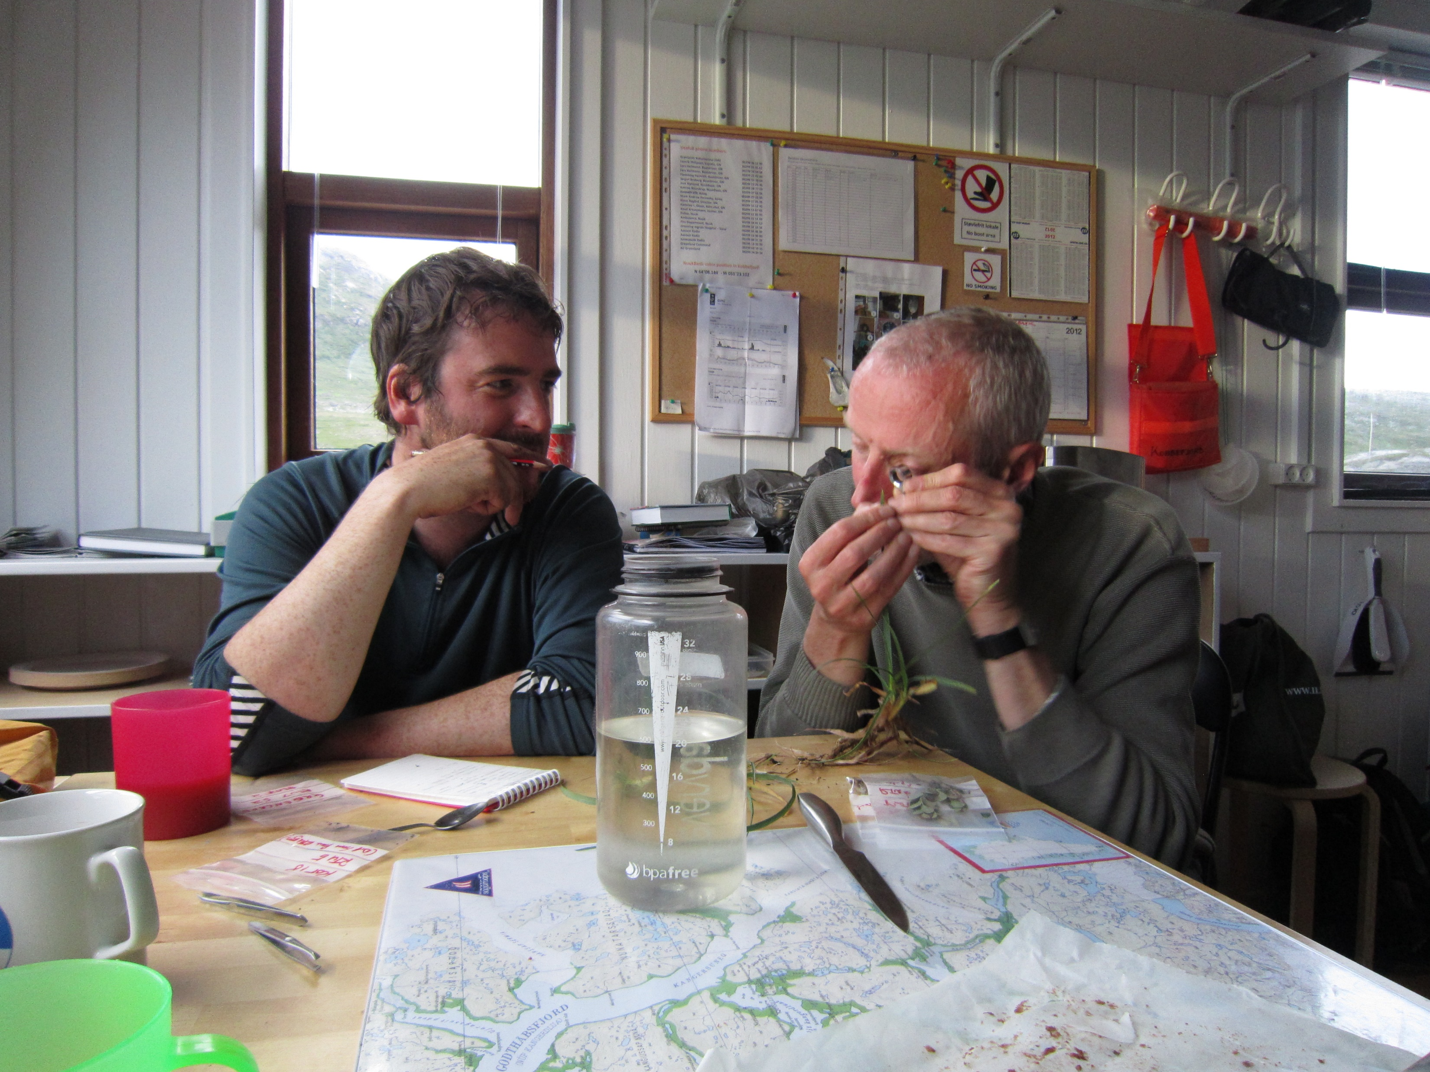
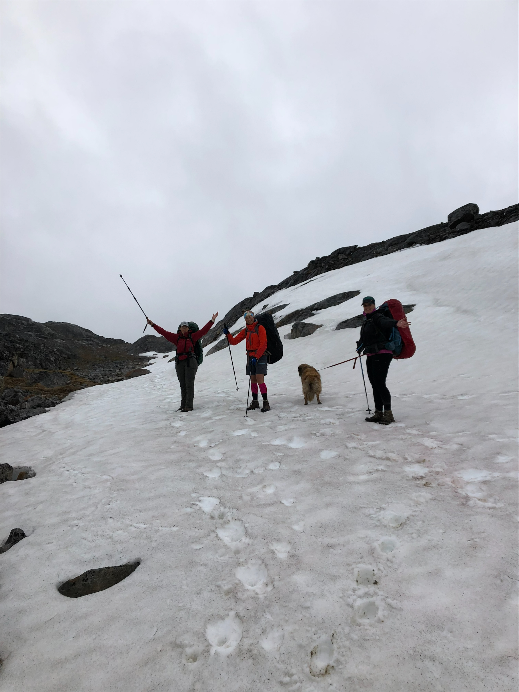
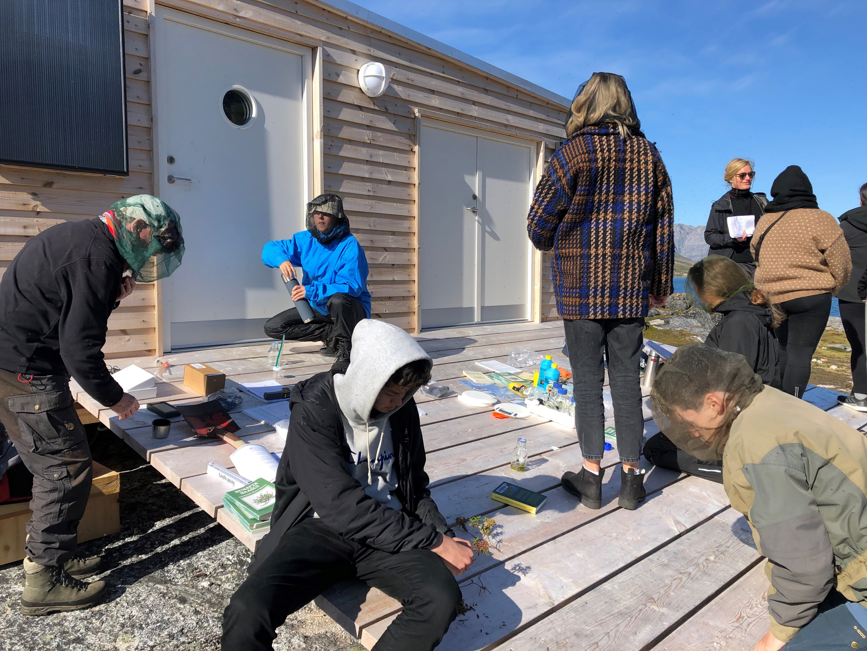
Pinngortitaleriffik
Greenland Institute of Natural Resources
Grønlands Naturinstitut

Slide 13
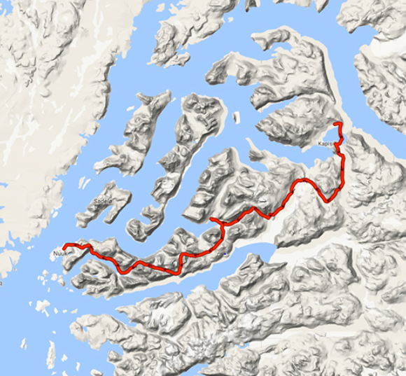
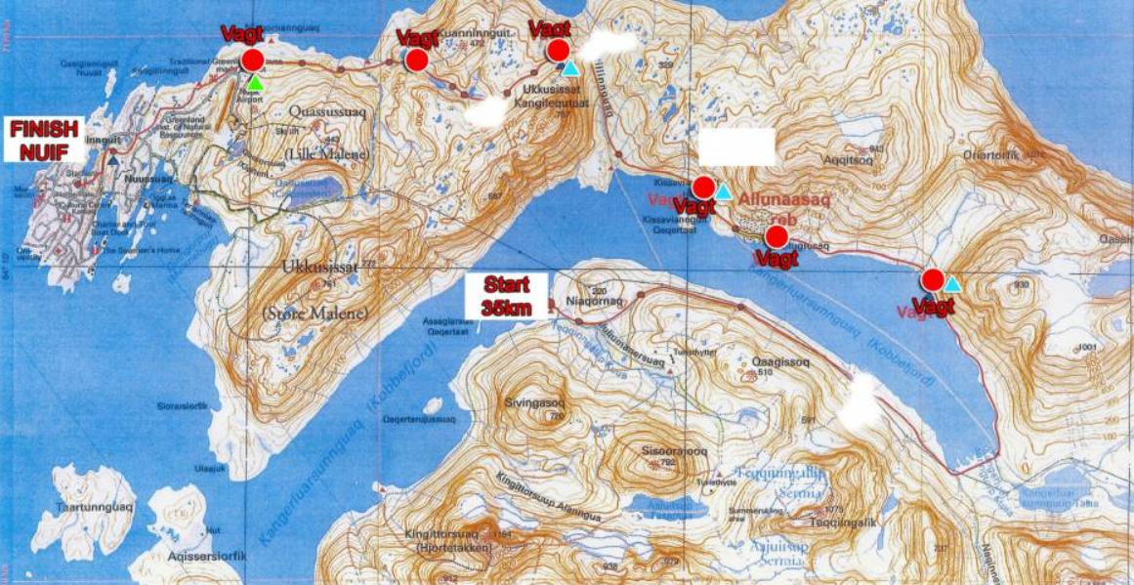
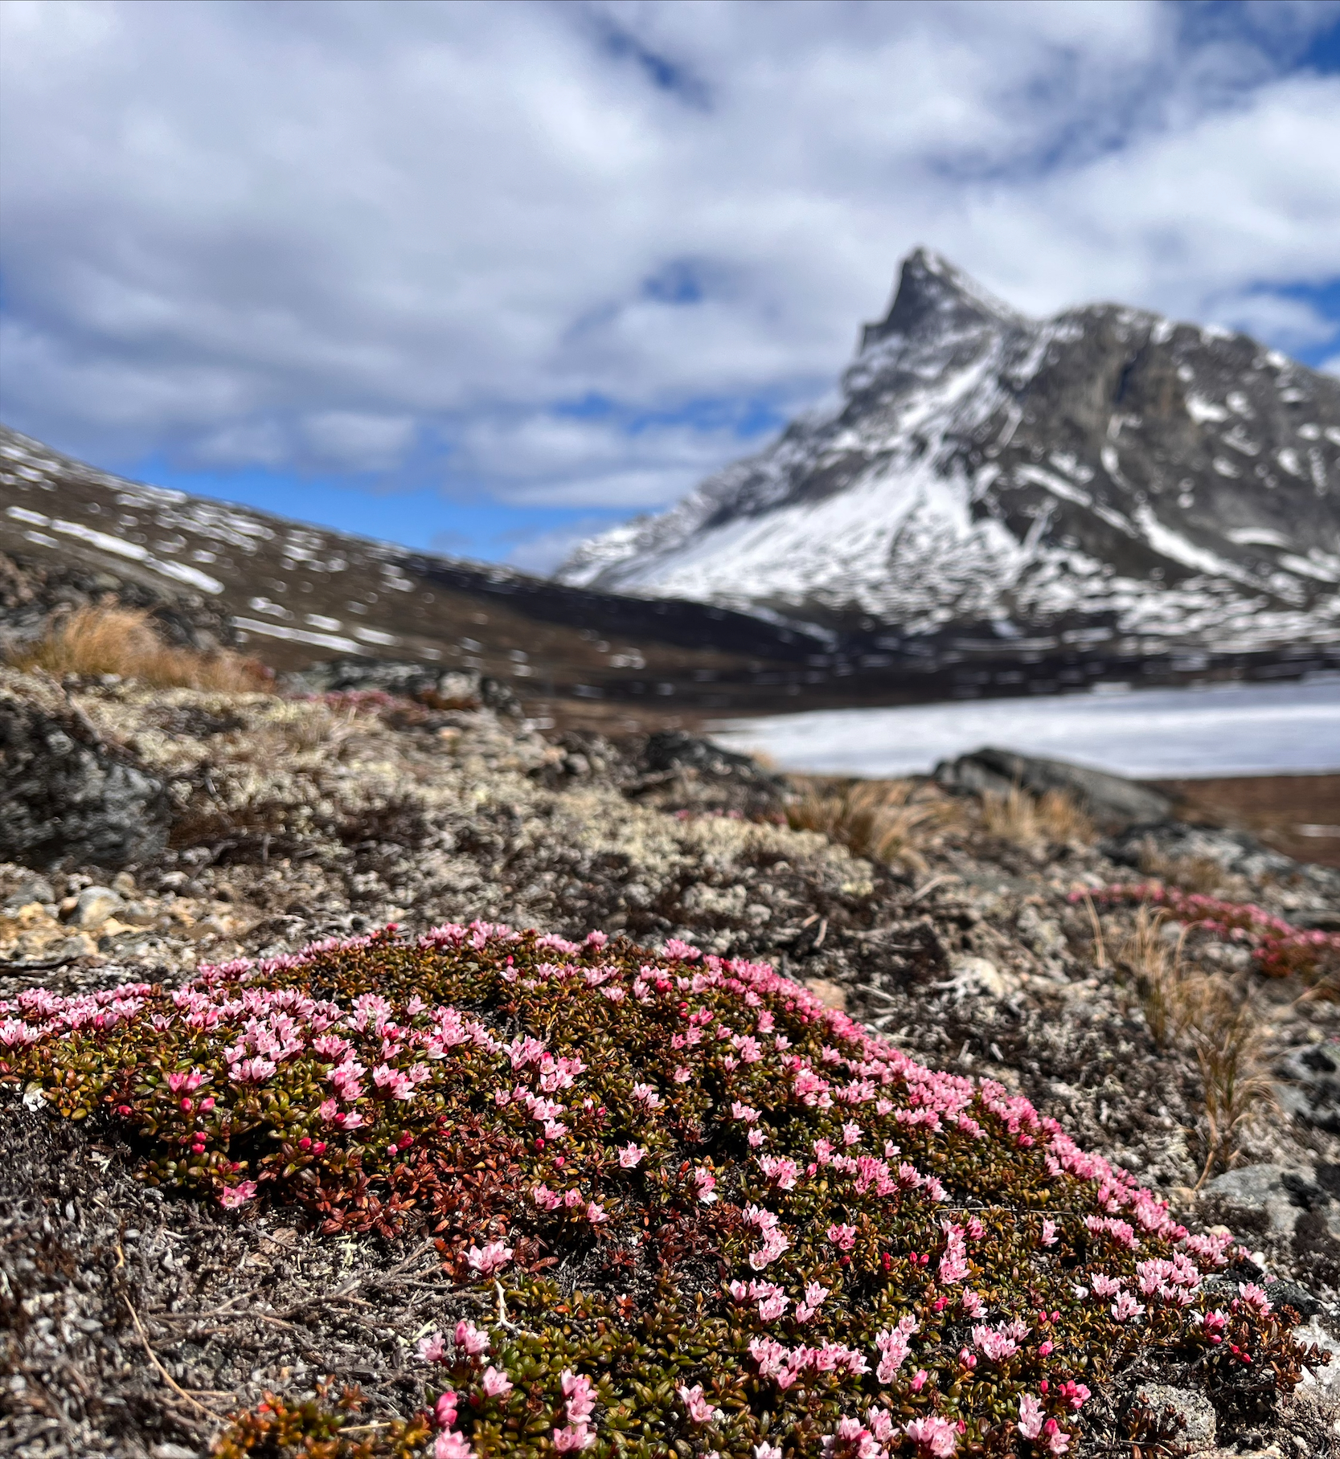
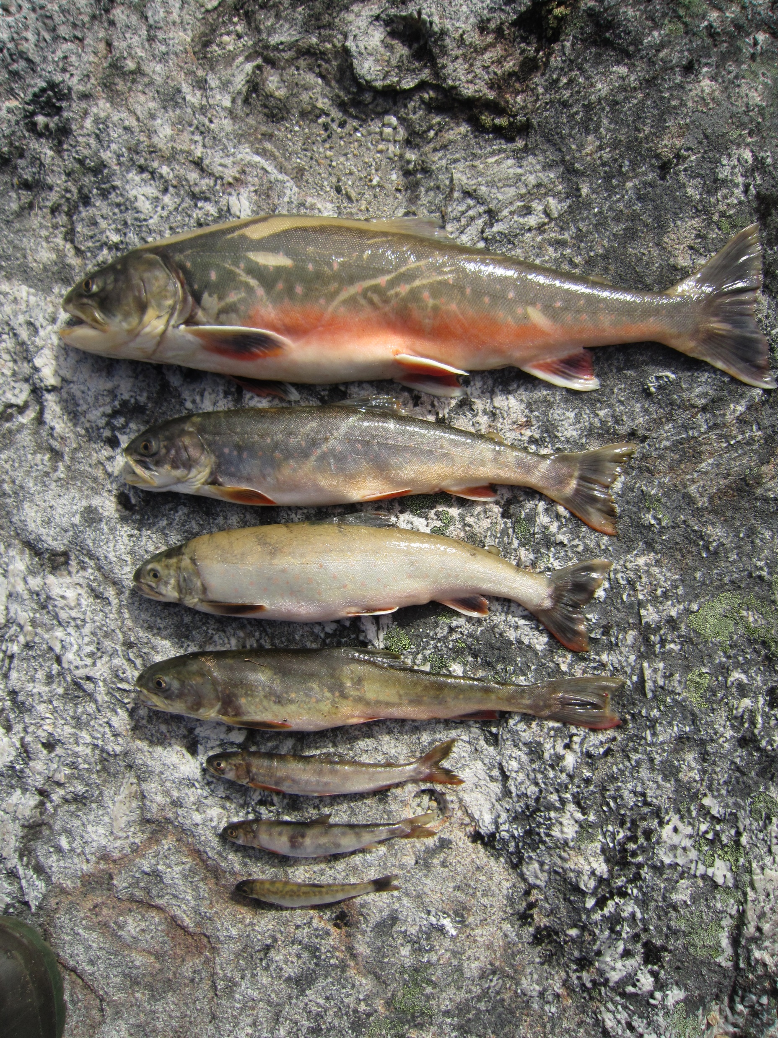
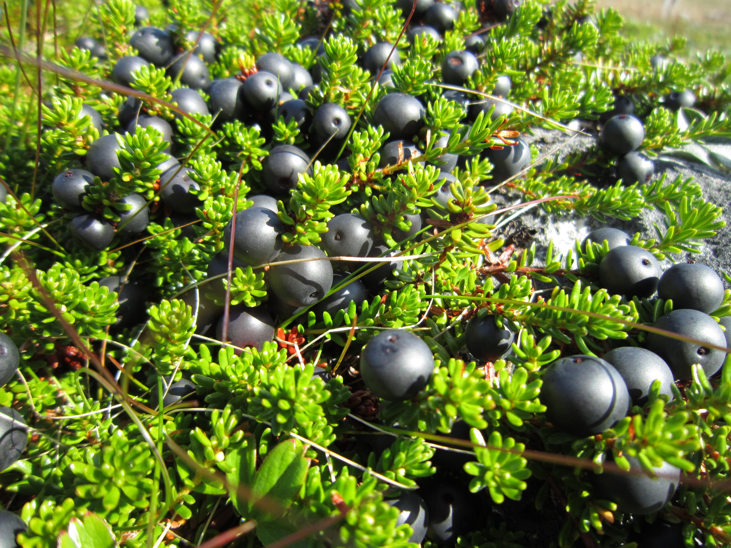
Pinngortitaleriffik
Greenland Institute of Natural Resources
Grønlands Naturinstitut

Slide 14
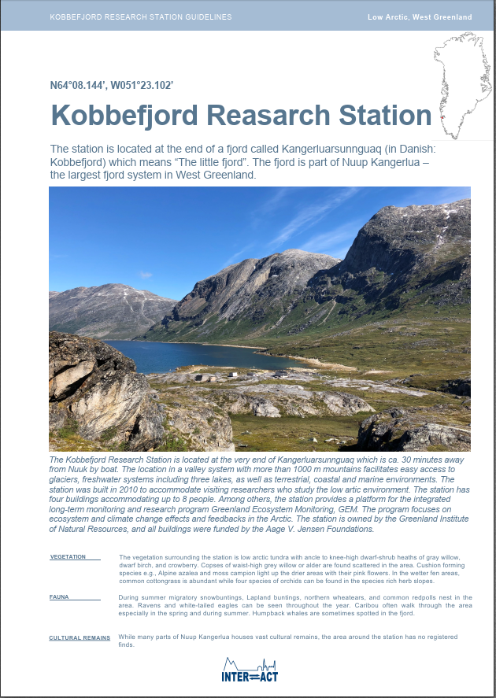
Pinngortitaleriffik
Greenland Institute of Natural Resources
Grønlands Naturinstitut
DRAFT

Slide 15
Pinngortitaleriffik
Greenland Institute of Natural Resources
Grønlands Naturinstitut
”Do not’s…”

Slide 16
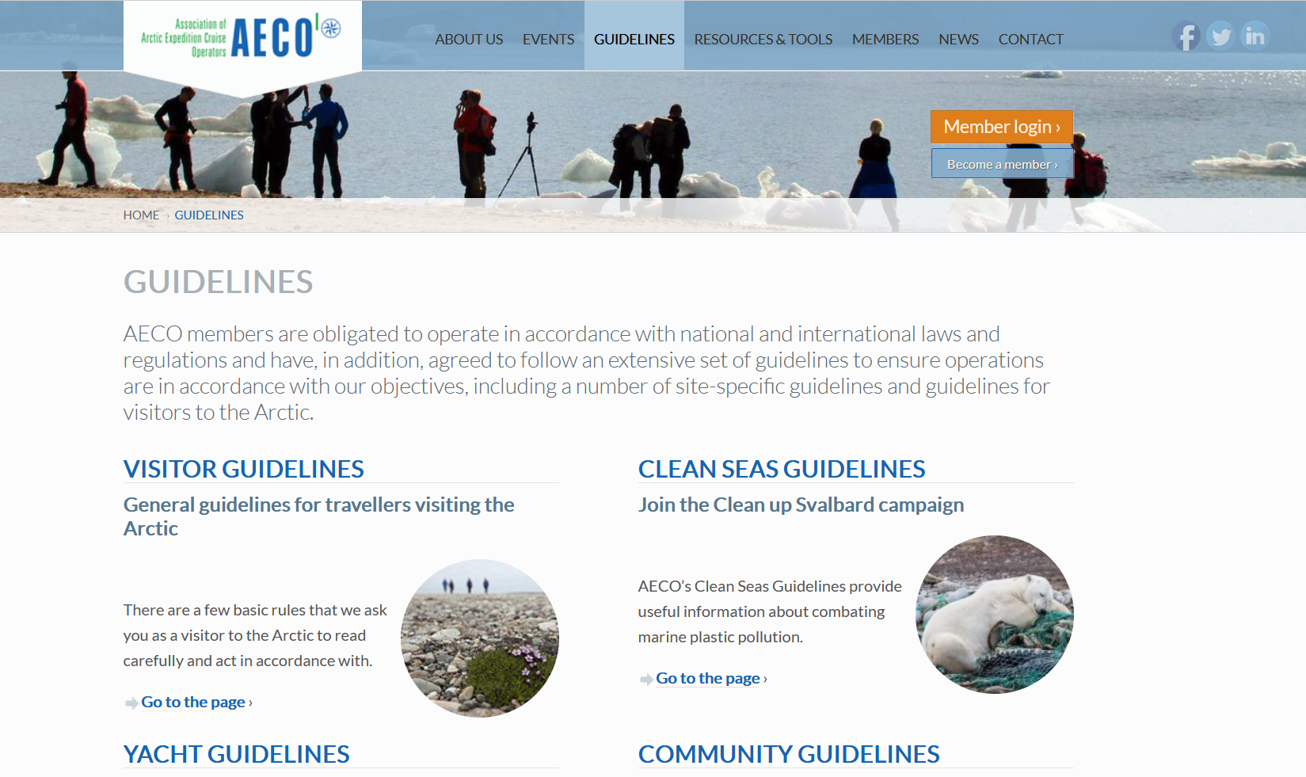
Pinngortitaleriffik
Greenland Institute of Natural Resources
Grønlands Naturinstitut
Online tool…

Slide 17
Pinngortitaleriffik
Greenland Institute of Natural Resources
Grønlands Naturinstitut
Suggestions for changes
Less text (plus specific number of characters per heading)
More photos
Pamphlet version
Large map with important areas etc.
Possibility to print at station
Increase awareness when station is off-line
Something for people to bring home

Slide 18
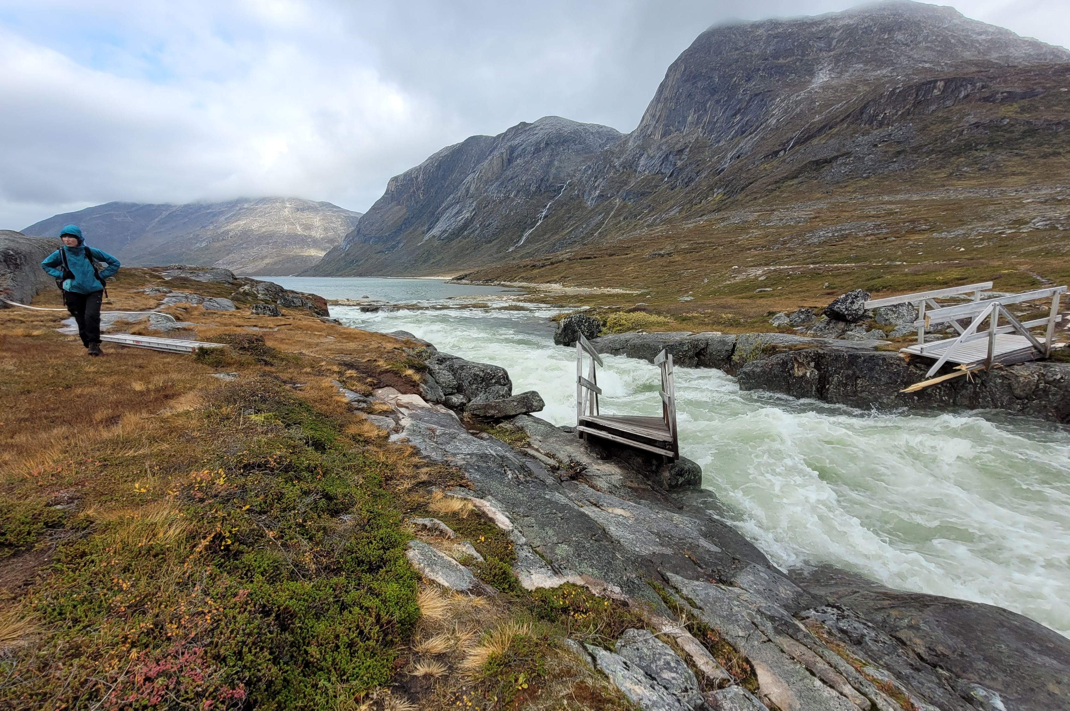
Kobbefjord Research Station @NuukNERO
Pinngortitaleriffik
Greenland Institute of Natural Resources
Grønlands Naturinstitut

Slide 19
www.aeco.no
@ArcticCruiseOperators
@ArcticCruiseOp

