Slide 1
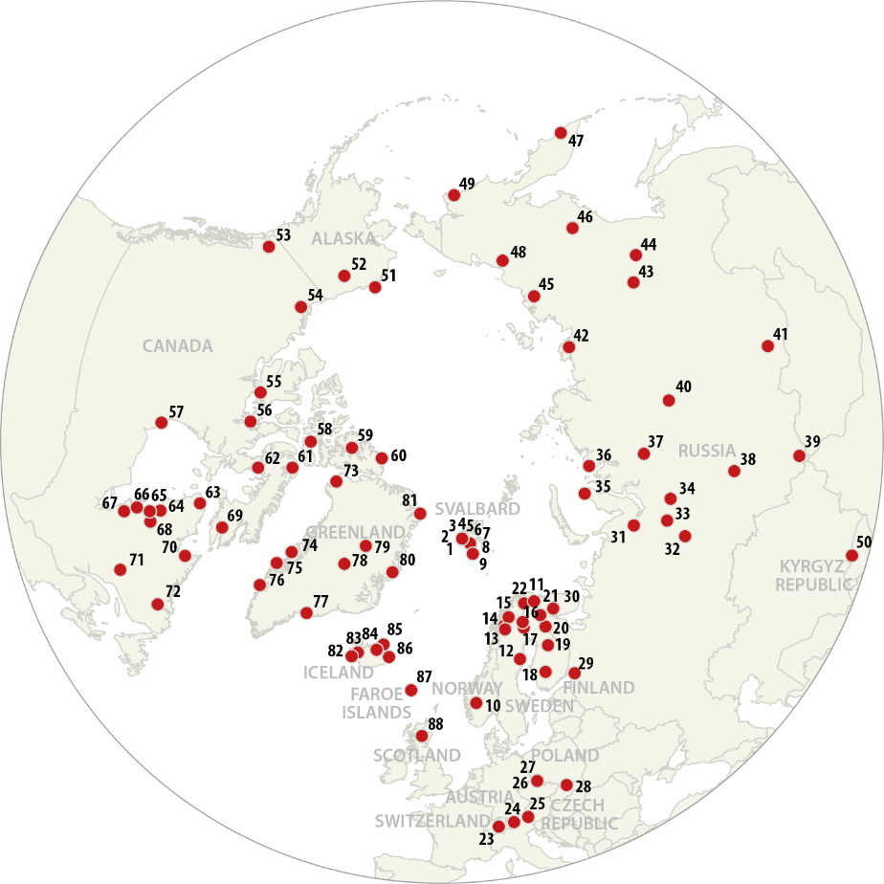
INTERACT SMF
III
Ideas for upcoming seminar on
state of the art environmental monitoring
SMF 5, 27-28 September 2022, Sudurnes Science and Learning Centre, Iceland

Slide 2
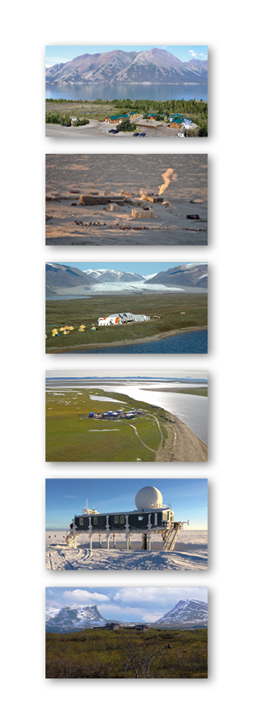
Previous ‘State of the art’ seminars
INTERACT II:
CAFF Biodiversity monitoring (WP CAFF/CBMP experts)
ITEX – International Tundra Experiment (SMF 4, Christine Barnard)
LTER (SMF 4, Jan Dick)
Herbivory network (SMF 4, Alexander Sokolov)
Glaciology (SMF 5, Per Holmlund)
Permafrost (SMF 5, Margareta Johansson)
- International Permafrost Association (IPA)
- Global Terrestrial Network of Permafrost (GTN-P)
- Thermal State of Permafrost (TSP)
- Circumarctic Active Layer Monitoring Network (CALM)
INTERACT III:
- AMAP Emerging pollutants (AMAP experts)
- AMAP Plastic monitoring (AMAP experts)
Technical state of the art seminars:
INTERACT I: Automated photography and image recognition
Energy flux towers
INTERACT II: Drones
INTERACT III: Machine learning

Slide 3
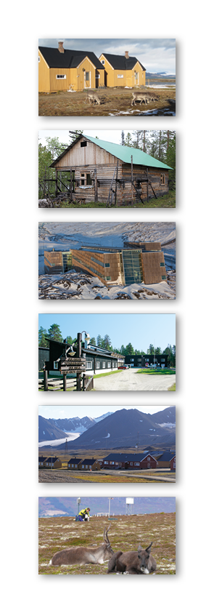
INTERACT Network Ambassadors
- ArcticWeb (http://arcticweb-project.org/): - Alexander Sokolov, The Arctic Research Station (RU).
- CAFF/CBMP (https://www.caff.is/monitoring): - Kari Lárusson, CAFF Secretariat.
- eLTER – Long term ecological research (http://www.lter-europe.net/elter): - Jan Dick, Cairngorms.
- ERA PLANET (http://www.era-planet.eu/): - Henrik Skov, Villum Research Station (GL/DK).
- Herbivory Network (https://herbivory.lbhi.is/): - Alexander Sokolov, The Arctic Research Station (RU).
- iCOS (https://www.icos-ri.eu/): - Henrik Skov, Villum Research Station.
- iCUPE (https://www.atm.helsinki.fi/icupe/index.php): - Henrik Skov, Villum Research Station.
- ITEX – International Tundra Experiment (https://www.gvsu.edu/itex/): - Donie Bret-Harte, Toolik Field Station.
- Permafrost networks;
- GTN-P (https://gtnp.arcticportal.org/) - Margareta Johansson, Lund University.
- Calm (https://ipa.arcticportal.org/): - Margareta Johansson, Lund University.
- SIOS – Svalbard Integrated Observing System (https://sios-svalbard.org/): - Wlodec Sielski, Hornsund.
- UArctic – University of the Arctic (https://www.uarctic.org/): - Kirsi Latola, University of Oulu.

Slide 4
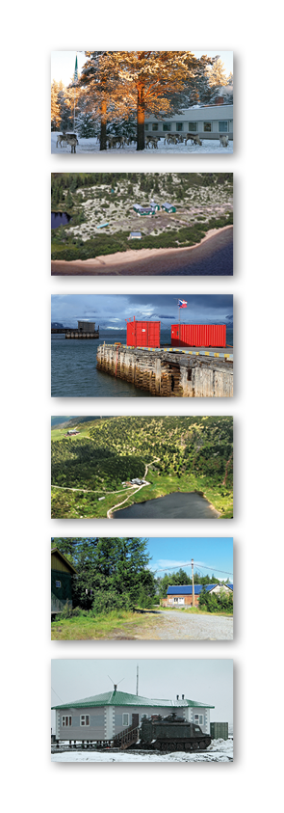
Suggestions for upcoming seminars on
‘State of the Art’ environmental monitoring?
…
…
…
SMF 5, 27-28 September 2022, Sudurnes Science and Learning Centre, Iceland

Slide 5
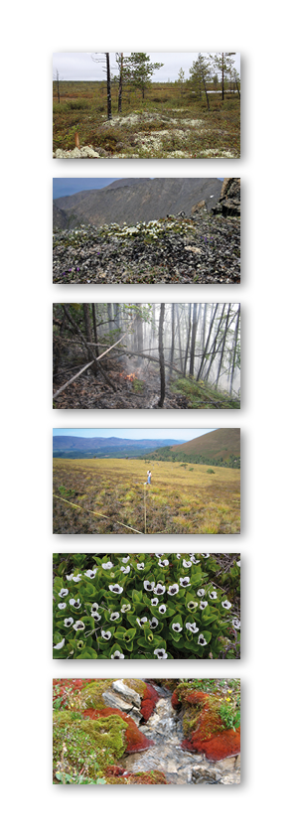
Let’s INTERACT
SMF 5, 27-28 September 2022, Sudurnes Science and Learning Centre, Iceland

