Slide 1
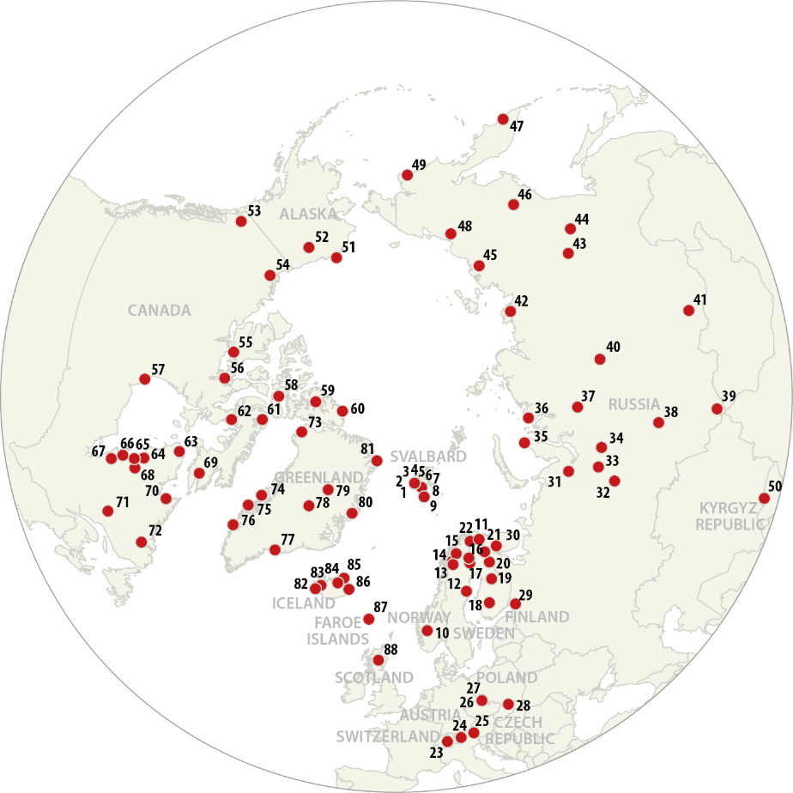
INTERACT SMF
III
Repository for selected climate variables
SMF 5, 27-28 September 2022, Sudurnes Science and Learning Centre, Iceland

Slide 2
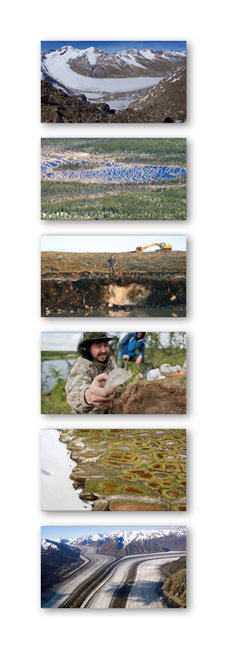
Purpose of session
- Brainstorm and general recommendations
Subtask 2.3.2 will provide open access to selected scientific data by establishing an INTERACT repository for key climate related parameters to be integrated in INTERACT GIS in cooperation with the Data Watch Guard (D2.9)
How can we make a common repository for selected climate variables with data from as many INTERACT stations as possible?
What technical solutions exist to make it feasible and limit the workload for stations?
What variables are relevant and practically feasible to gather and present?

Slide 3
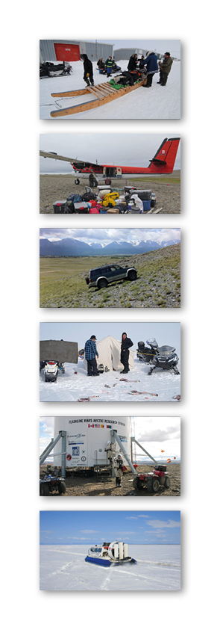
Current initiatives to identify essential variables
INTERACT ‘Minimum Monitoring System’ (2015 and 2020)
Recommended variables
Air temperature
Air humidity
Wind velocity
Wind direction
Air pressure
Precipitation
Short wave incoming radiation
Short wave outgoing radiation
Net radiation
UV-B radiation
Possibly supplemented by:
Snow depth
Soil temperature (at different depths)
Soil humidity (at different depths)
Climate variables only

Slide 4
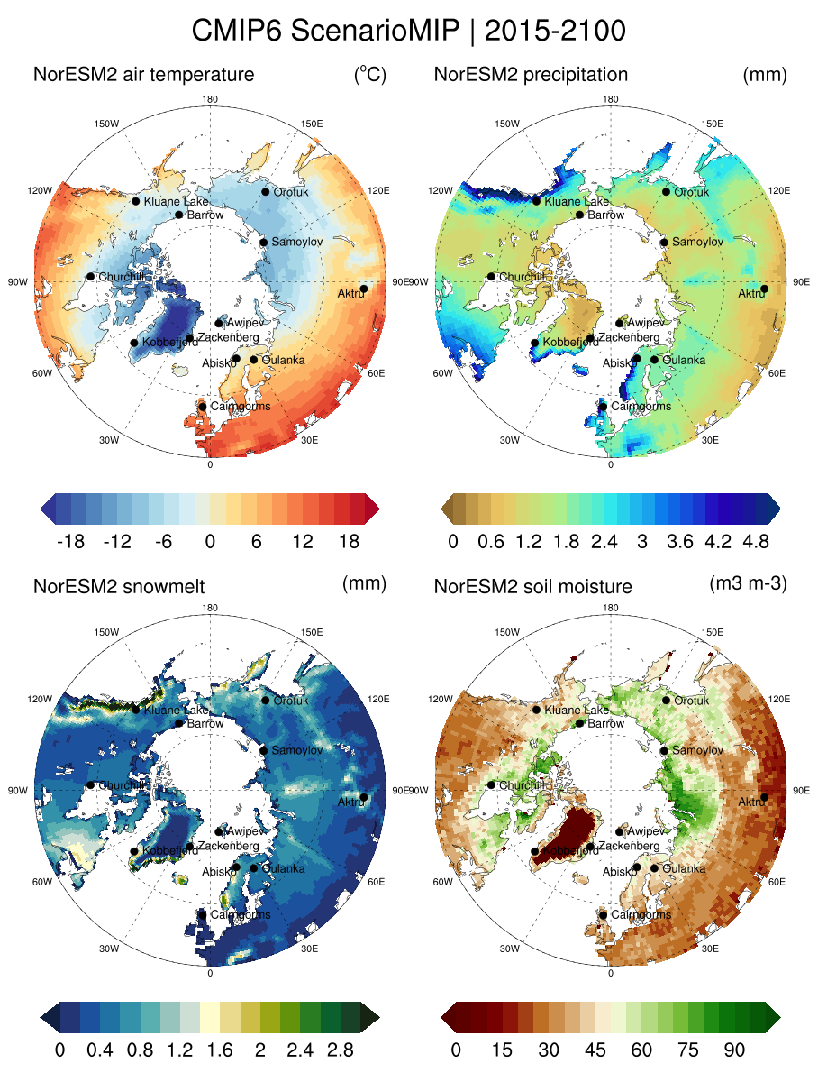
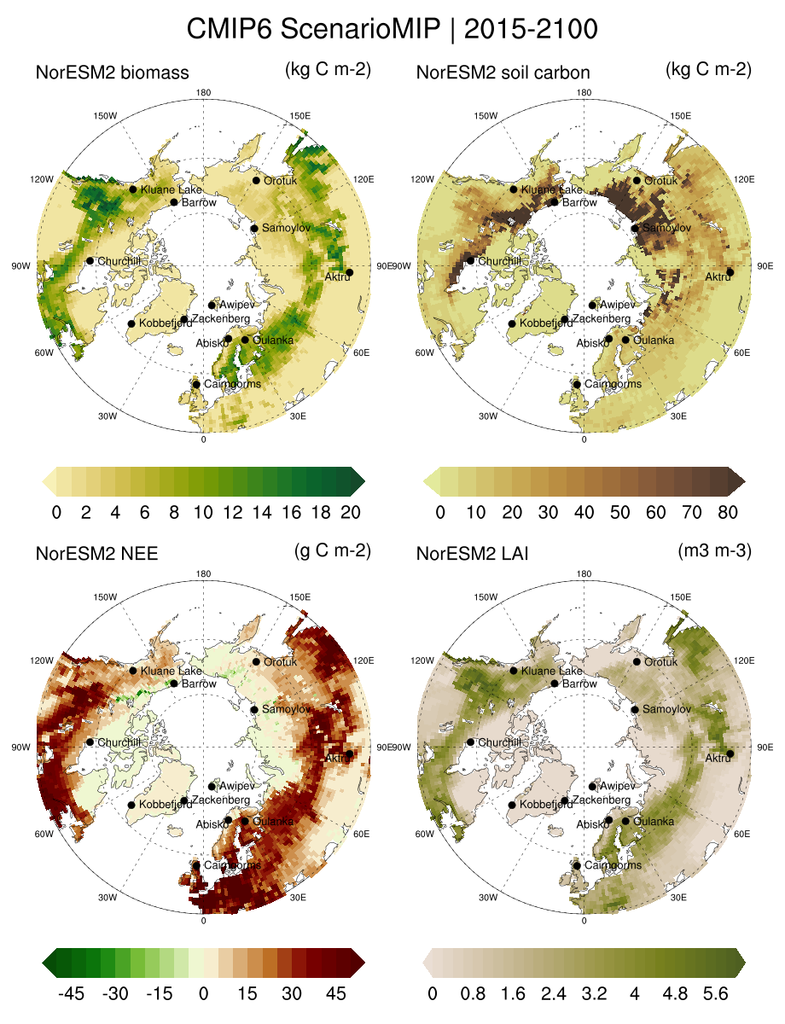
Current initiatives to identify essential variables
INTERACT ‘Minimum Monitoring System’
(Teaser - presented Wednesday 28 Sept. 2022)
Air temperature
Precipitation
Snow depth
Soil moisture
Biomass
Soil carbon
Net ecosystem exchange
Leaf area index

Slide 5
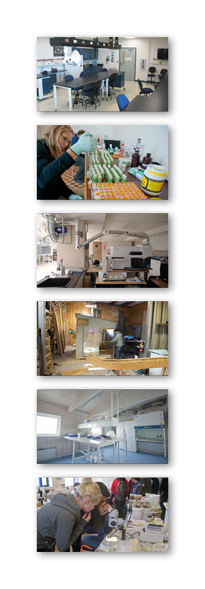
Current initiatives to identify essential variables
WMO – essential climate variables
- https://public.wmo.int/en/programmes/global-climate-observing-system/essential-climate-variables
ECV | Products
Surface variables (others related to upper atmosphere exists)
Precipitation | Estimates of liquid and solid precipitation
Air Pressure (surface) | Air pressure
Surface Radiation Budget | Surface ERB longwave; Surface ERB shortwave
Surface Wind Speed and Direction | Surface wind speed and direction
Air Temperature (near surface) | Air Temperature
Air Humidity (surface) | Air Humidity

Slide 6
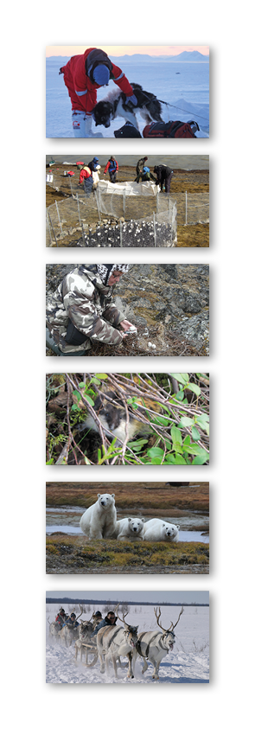
Current initiatives to identify essential variables
DRAFT
Category Parameter
Climate Meteorology Air temperature
Climate Meteorology Air humidity
Climate Meteorology Air pressure
Climate Meteorology Wind velocity
Climate Meteorology Wind direction
Climate Meteorology Precipitation
Climate Energy balance and radiation Short Wave incoming
Climate Energy balance and radiation Short wave outgoing
Climate Energy balance and radiation Long wave incoming
Climate Energy balance and radiation Long wave outgoing
Climate Energy balance and radiation Net radiation
Climate Energy balance and radiation UV-B
Climate Energy balance and radiation Sensible heat flux
Climate Energy balance and radiation Latent heat flux
Climate Energy balance and radiation Soil Heat flux
Cryosphere Sub surface characteristics Ground surface temperature
Cryosphere Sub surface characteristics Soil temperature
Cryosphere Sub surface characteristics Active layer depth
Cryosphere Sub surface characteristics Permafrost temperature
Cryosphere Snow characteristics Snow depth
Cryosphere Snow characteristics Snow density
Cryosphere Snow characteristics Snow temperature
Arctic Passion
Prioritising of AMAP Essential Climate Variables
(c. 100)
To be implemented
at 10 INPA stations

Slide 7
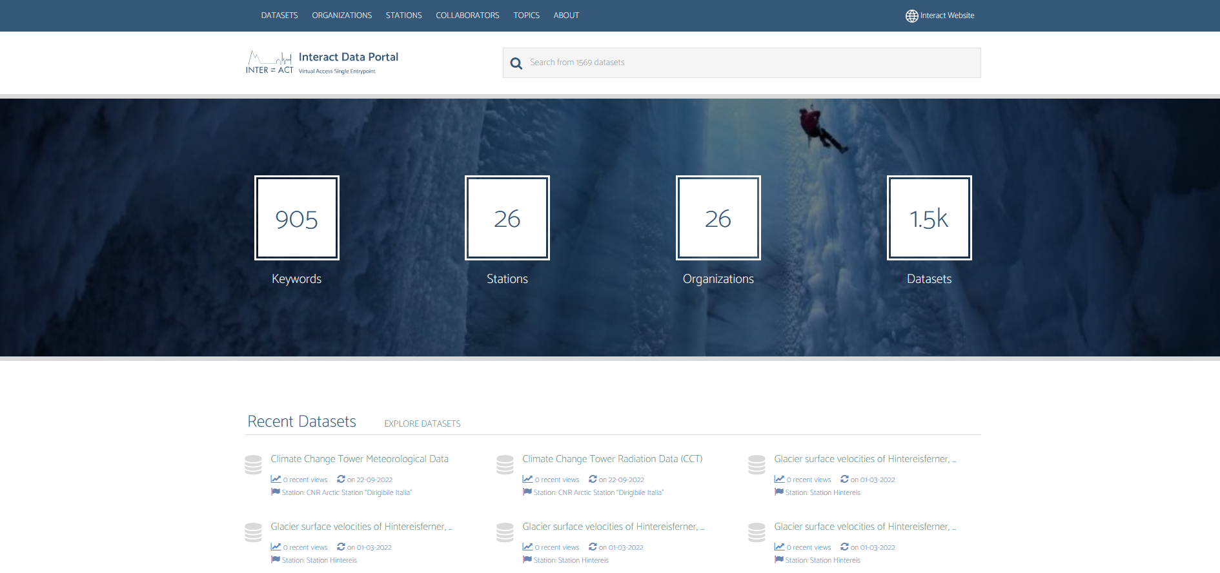
INTERACT Data Portal
- Searches for data sets across station repositories
https://dataportal.eu-interact.org/

Slide 8
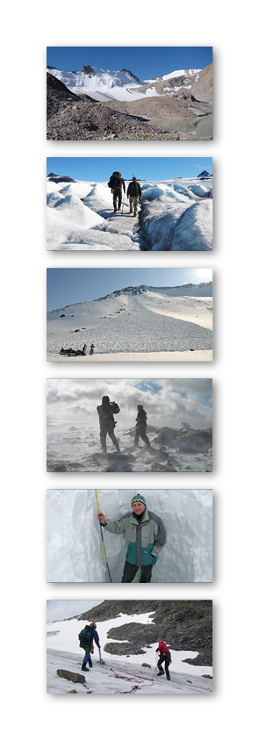
Aim:
One common repository for selcted climate variables
Any recommendations in relation to the selection of climate variables?
How can we get data from stations?
Capture live streaming of climate data?
Automatised harvesting of data from repositories?
Annual submission by stations (e.g. Excel-sheet uploaded to webportal)?
Other suggestions?

Slide 9
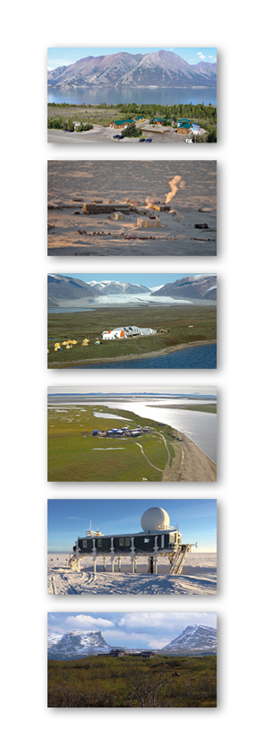
Let’s INTERACT
SMF 5, 27-28 September 2022, Sudurnes Science and Learning Centre, Iceland

