Slide 1
Survey - Resource use, emissions and waste handling at INTERACT stations - Results and links to guide books

Slide 2
Survey
Subtask 2.5.1 will
make a survey on energy use and sources (heat and electricity), plastic types and usage, and waste handling at INTERACT stations to document current consumption and emission levels (M2.22),
develop a checklist for environmentally friendly stations (D2.10),
produce a pocket guide on how to reduce plastic consumption and pollution at research stations and in local communities (D2.11).
Subtask 2.5.2 will make
a pilot implementation plastic monitoring programme at four selected INTERACT stations in collaboration with local communities in the actual data collection (M2.23),
develop recommendations to reduce environmental impact based on surveys in Subtask 2.5.1 (M2.22).

Slide 3
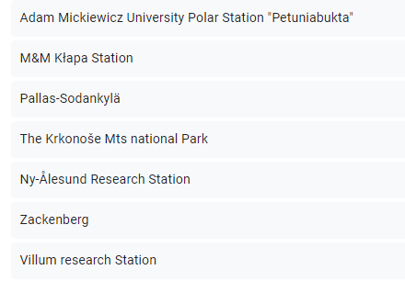
Survey response (25)

Slide 4
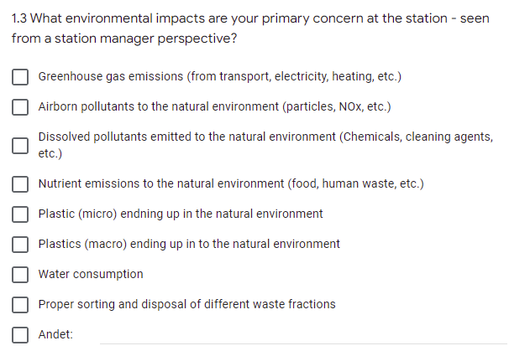
Environmental impacts of primary concern

Slide 5
ENVIRONMENTAL ISSUE | GUIDE BOOK
CO₂ | Guidebook for CO₂ Reduction in Arctic Science
Reducing environmental impacts / environmental impact assessment (EIA) | Reducing the Environmental Impact of Arctic Research Stations
Plastic | Pocket guide on how to reduce plastic consumption and pollution at research stations and in local communities
Tourism | D2.13 - Pocket guide for tourist on how to behave around research station, incl. their study areas and local communities

Slide 6
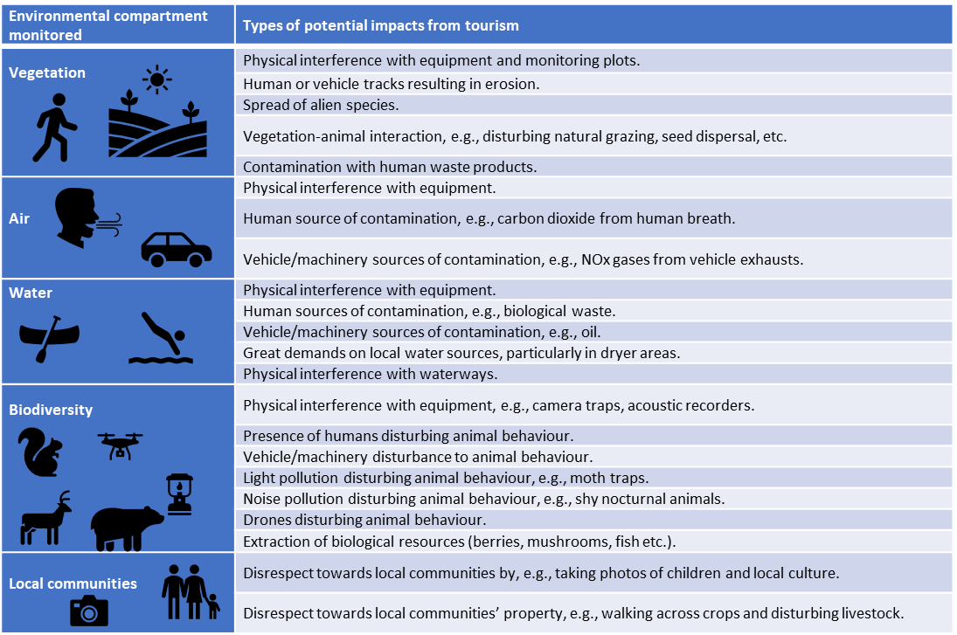
Tourism
Raising awareness
Nudging
Regulation

Slide 7
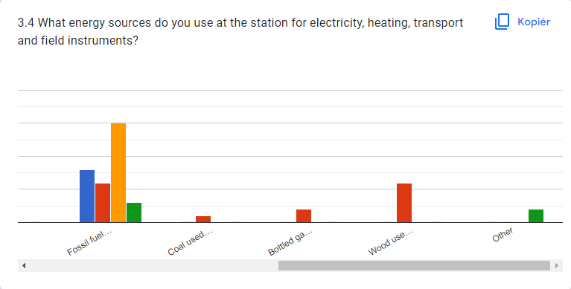
CO₂

Slide 8
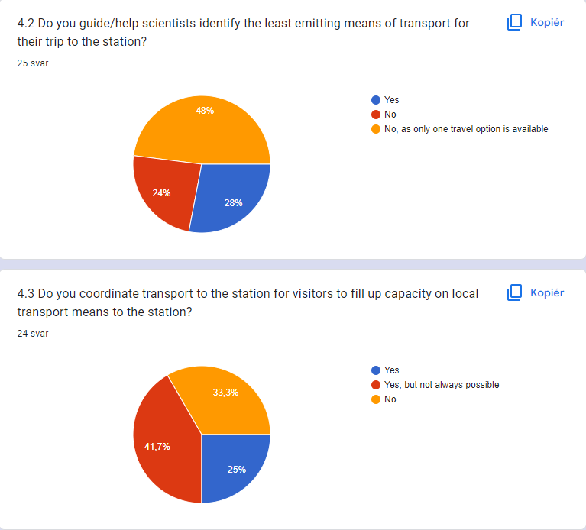
Guidebook for CO₂ Reduction in Arctic Science
Primary focus on carbon footprint from transport

Slide 9
Reducing Environmental Impacts from Field Stations

Slide 10
Chapter 1
EIA
(site survey, baseline)
EMP
Tourism
Waste
Mitigation
Monitoring
…

Slide 11
Impact | Impact type | Vector | Source | Recipient | Chapter
Disturbance | Physical environment | Constructions |  | Landscape | 2
 | Changes/erosion |  |  | Terrain
 |  |  |  | Shoreline
 | Hydrology |  |  | Rivers, fjords
 | Activities/noise | Power | Generator | Terrestrial wildlife | 6
 |  | Transport | Vehicles | Vegetation | 5
 |  |  | Air borne | Terrestrial wildlife
 |  |  | Ship, boat | Marine mammals | 3
Pollution | Light |  |  | Wildlife | 2
 | Invasive species |  |  | Biodiversity | 3
 | Discharges | Waste | Solid waste |  | 9
 |  |  | Liquid waste |  | 9
 |  |  | Wastewater | fresh or marine waters | 4
 | Emissions (CO₂, SO_{x}, NO_{x}) | Power |  | Air | 7
 |  | Propulsion |  | Air | 3
 |  | Incinerator |  | Air | 9
 |  | Heat loss |  | Air, ground | 2
 |  | Black Carbon |  | Land, snow, ice
 | Spills (spills, accidents) | Fuel |  | soil | 7
 |  | Chemicals |  | soil | 2
 | Materials production | Constructions | Production footprint |  | 2
Introduction
1. Environmental management
2. Buildings
3. Transport facilities
4. Water use and waste water
5. Management of solid waste
6. Power
7. Transport
8. Research projects
9. Fuel and chemicals
10. Ethics

Slide 12
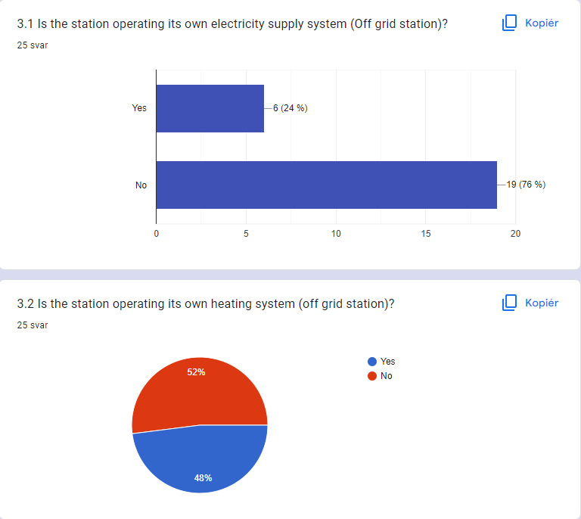
Power - Highly dependent on fossil fuel

Slide 13
Reducing the environmental impacts from air emissions from, e.g., fossil fuels
1. Reducing energy demand and use
2. Use of, if possible, sustainable energy
6. Power
6.1. Reducing energy demand and use
6.2. Renewable energy
6.2.1. Renewable energy technologies
- Solar energy
- Wind energy
- Hydropower
- Biopower
6.3. Environmental assessment of power supply
- Fuel
- Solar panels (Photo-voltaic (PV) panels)
- Wind turbines
- Hydro power
- Wood

Slide 14
Water
4. Water use and waste water
4.1. Water consumption
4.2. Waste water

Slide 15
Waste
Minimise > Reuse > Recycle > Recover Energy > Landfill
5. Management of solid waste
5.1. Non-hazardous waste
5.1.1. Disposal
5.1.2. Incinerator
5.2. Hazardous waste

Slide 17
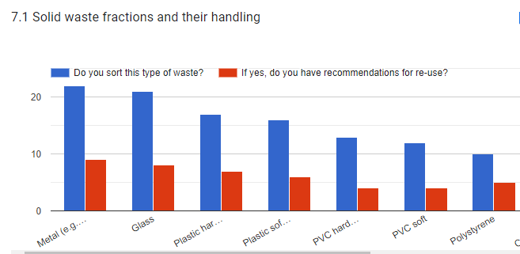
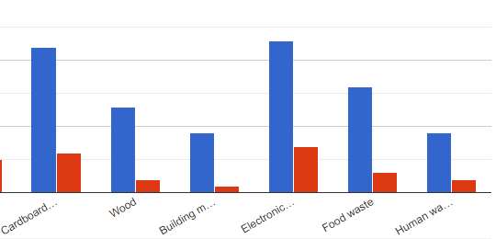
Plastics

Slide 18
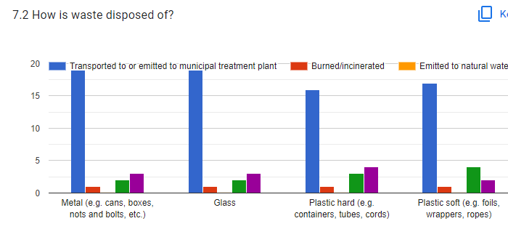
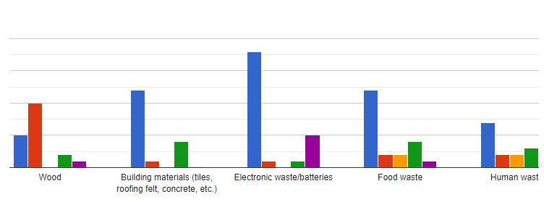

Slide 19
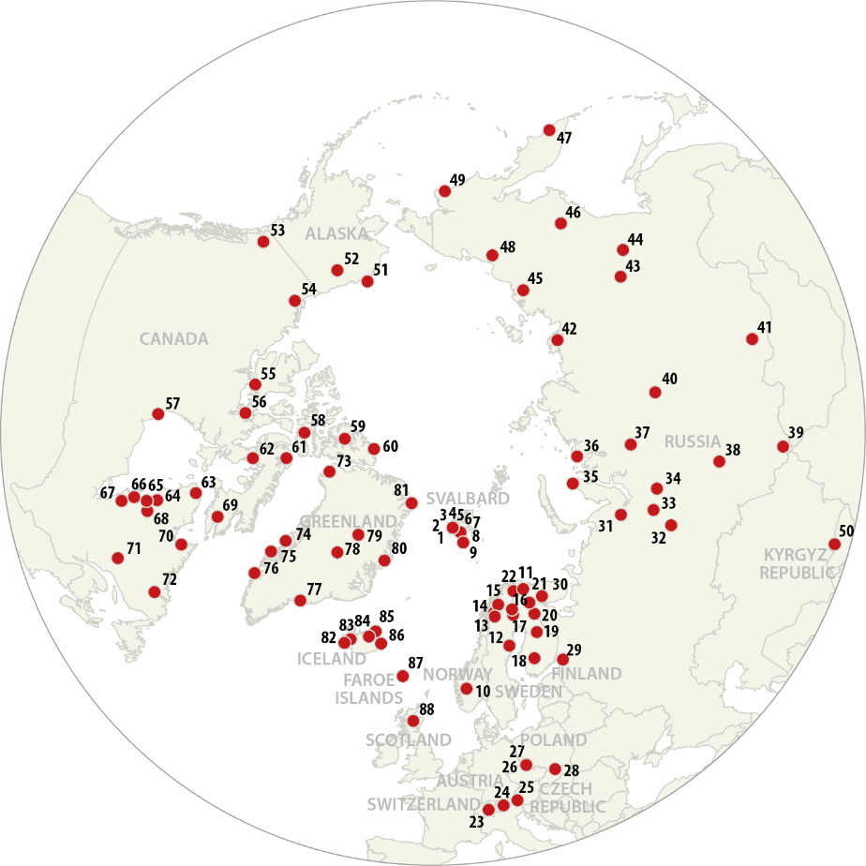
Pocket guide on how to reduce plastic consumption and pollution at research stations and in local communities Deliverable D2.11, DEADLINE April 2023
Suggested draft content, preliminary
Introduction to Plastic
Plastic and climate change
Increasing plastic production and waste
Recycling of plastic
Break down of plastics
- Size
Sources and sinks in the Arctic
Physiological effects
Legislation
How to reduce the plastic consumption and pollution on a research station
How to reduce the plastic consumption in research labs
How to reduce the plastic consumption and pollution in field work
How to reduce the plastic consumption and pollution in local communities
Monitoring of plastic pollution

Slide 20
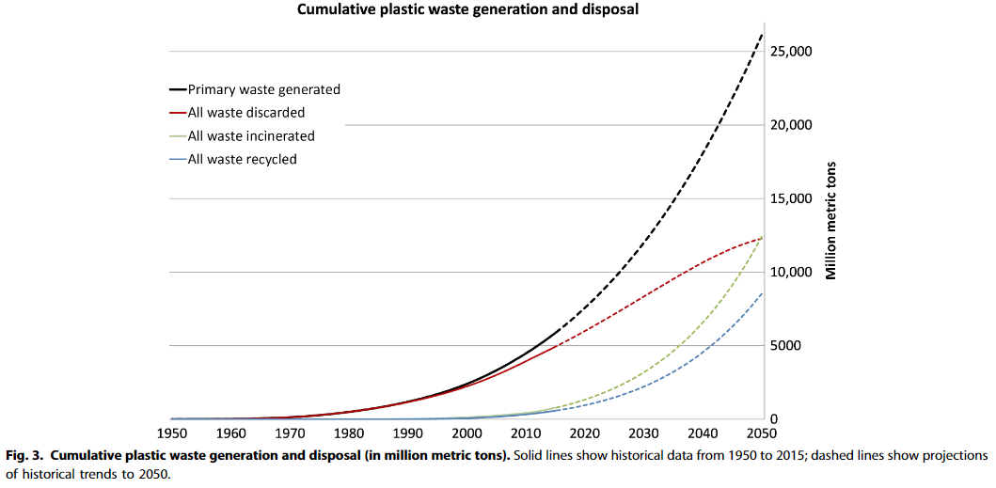
Increasing problem
Recent studies place the total amount of global plastic produced since its invention at 8300 million metric tons (Mt).
Modern plastics industry relies on fossil fuels for its raw material, the production of plastic has an impact on climate change, contributing to global CO₂ production.
Currently a total of 6% of the global raw oil extraction is used for plastic, equaling the aviation sectors global usage.
CO₂ is emitted when plastic is broken down by the sun’s rays in nature
Geyer et al , 2017
Notes:
If current production and waste management trends continue, Geyer et al estimate roughly 12,000 Mt of plastic waste will be in landfills or in the natural environment by 2050.

Slide 21
Break down and size
Plastic do not decompose!
Over time plastic items will break down into smaller particles through mechanical abrasion, hydrolysis or photodegradation through UV from sunlight. Degradation rates are slow and especially under cold arctic temperatures.
SIZE
Macroplastics are generally defined as plastic items larger than 5mm.
Microplastics are generally defined as synthetic polymer less than 5mm at their longest point. They exist in different shapes and can be spheres, fragments, granules, pellets, flakes, beads, filaments, or fibers.
Notes:
Over time plastic items will break down into smaller particles through mechanical abrasion, hydrolysis or photodegradation through UV from sunlight. Degradation rates are slow and especially under cold arctic temperatures.

Slide 22
Sources
Plastic pollution can be transported to the Arctic from far away:
due to wet or dry deposition,
brought in by humans (tourists, researchers, locals),
sea ice,
currents,
or river transport.
- Industries in the Arctic (both at sea and on land, that generate plastic pollution, for example from fishing industry )
traditional waste management solutions are landfills and uncontrolled dumpsites, sometimes next to the sea
Lack of wastewater treatment ( plastic litter and microplastics more easily reach the environment and to the ocean).
Sinks
Scientists believe that 80% of the plastic in the aquatic environment ends on the ocean floor

Slide 23
Recommendations for the research station
Make sure to collect all plastic in a secure place
Put filters on outlets to rivers, oceans. etc to collect microplastic
Use washing liquid instead of powder – the powder will, through the ‘scrub’ function, loosen the fibers of the clothes
Fill up your washing machine – a full load results in less friction between the clothes and less fibres will be released (microfiber fleeces are the most commonly detected type of fragments in various water bodies )
When hanging out washing clothes offer wooden pegs instead of plastic ones
..
Plastic free shopping for a research station:
Avoid excessive food packaging in plastic
buy furniture, flooring etc made from natural fabrics (to avoid accumulation in indoor air and house dust)
…
…
Notes:
Find antal microplastic frigivet ved fleecevask!

Slide 24
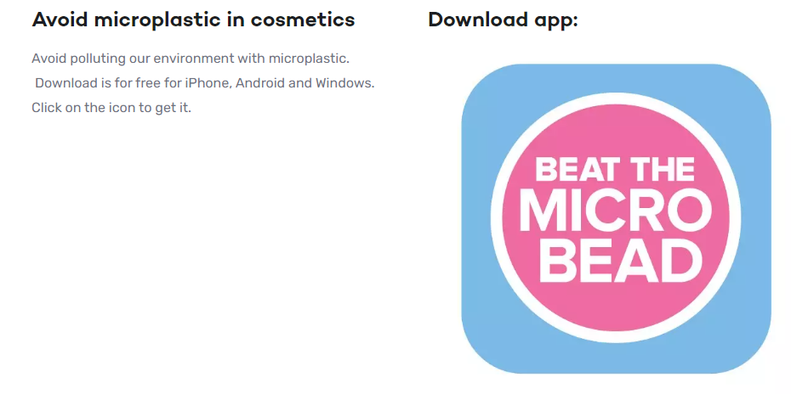
How to reduce the plastic consumption and pollution for reseachers visiting a research station
Bring paper bags or sustainable shopping bags instead of plastic bags
Avoid using personal care products that use micro-plastics,
wear natural fabrics (wool, cotton, silk, linen, cashmere), or environmentally certified clothing
pick up the trash that you find in the environment
…
…..

Slide 25
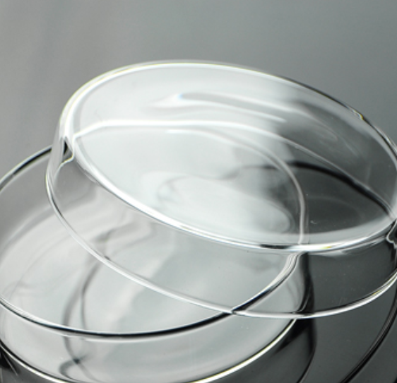
How to reduce the plastic consumption and pollution in labs
Replace plastic pots with compostable paperboard pots
Where contamination is less of an issue, consider reusing items like weighing boats and gloves if possible
Use natural rubber gloves
Use pipette tips that allows to be washed before reuse
Use glass centrifuge tubes instead of plastic
Use glass syringes instead of plastic versions
Recycle or reuse sample boxes
Use sustainable materials, such as reusable wooden sticks for patch plating and metal loops for inoculation.
Reuse plastic tubes following chemical decontamination and autoclaving
replace plastic petri dishes for cell culture with glass ones
…
….
Notes:
Grant – extra funding for sustainable labs i.e washig machines instead of single use plastics

Slide 26
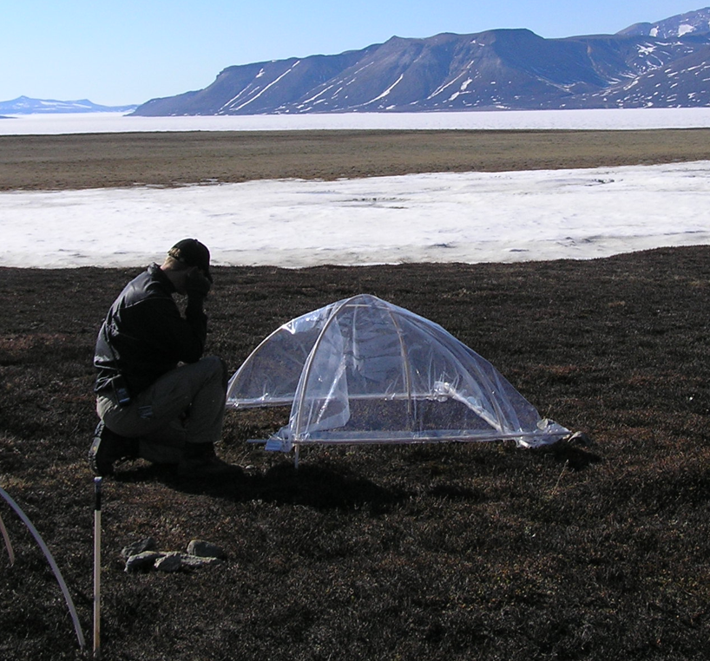
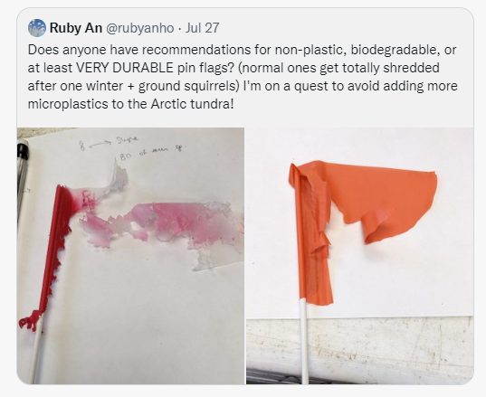
How to reduce the plastic consumption and pollution in field work
Make sure not to contribute to the plastic pollution in the environment by using unnecessary plastic in your field work.
Plastic markers can easily be broken down or destroyed by the harsh weather in the Arctic or by curious animals. Plastic pollution left behind from researchers will stay in the ecosystems for many years.
..

Slide 27
How to reduce the plastic consumption and pollution in local communities
Address the problem locally
Develop outreach and communication materials, engagement with indigenous and local communities, and contribute to prevention or reduction of marine litter activities
Community-based monitoring (AMAP guidelines). Beach litter – collection
International standards for plastic monitoring methods.
Monitoring
In the future more monitoring could be done by drones and satellites. Automated monitoring can be done using a combination of (multispectral) camera imagers and artificial intelligence.
Milestone M2.23
Plastic monitoring programme implemented at four stations

Slide 28
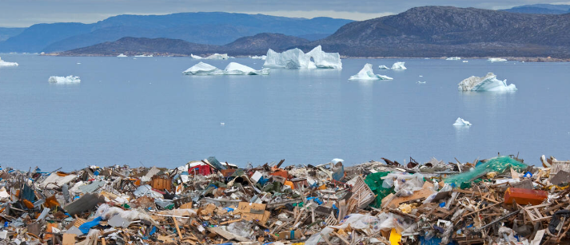
How to reduce the plastic consumption and pollution in local communities?
Deliverable D2.11
Pocket Guide
Milestone M2.23
Plastic monitoring programme implemented at four stations
All ideas, inputs, comments and suggestions are welcome
Volunteers are welcome ☺
Email Marie at: mfa@ecos.au.dk

Slide 29
DELIVERABLE / BOOK / REPORT | STATUS
Guidebook for CO₂ Reduction in Arctic Science | Launched ☺
Survey | Report under development
Pocket guide for tourist on how to behave around research station, incl. their study areas and local communities | D2.13 Guide book manuscript Article under development
Reducing the Environmental Impact of Arctic Research Stations | Guide book manuscript Checklist draft
Pocket guide on how to reduce plastic consumption and pollution at research stations and in local communities | Guide book development

