Slide 1
Task 2.6 The Arctic Resort (Lead: UKCEH)
By Jan Dick, Chris Andrews, Elmer Topp-Jørgensen, Susse Wegeberg
And all those who contributed to the deliverables

Slide 2
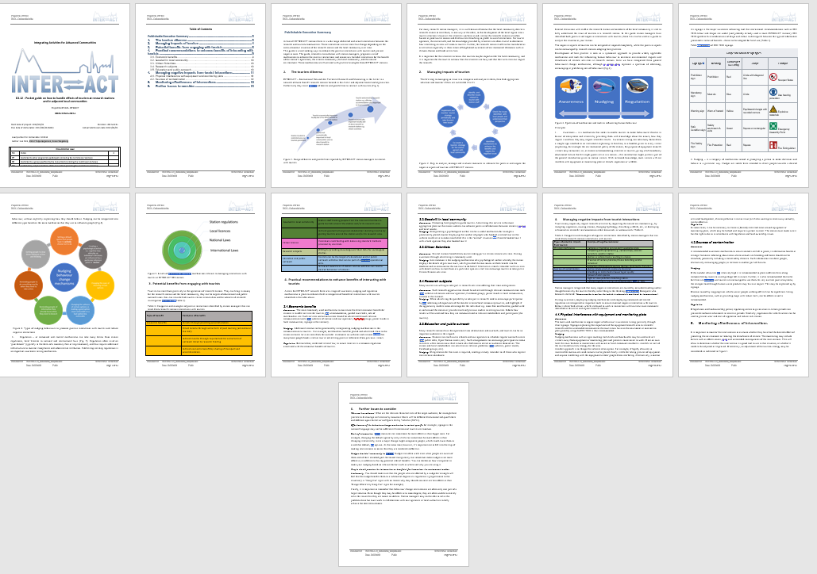
Deliverable D2.12
Pocket guide on how to handle effects of tourism at research stations
and in adjacent local communities
Notes:
Resulted in deliverables – Point to arrow diagram wide range of relationship of station managers with tourists, three types of mechanism to influence human behaviour

Slide 3
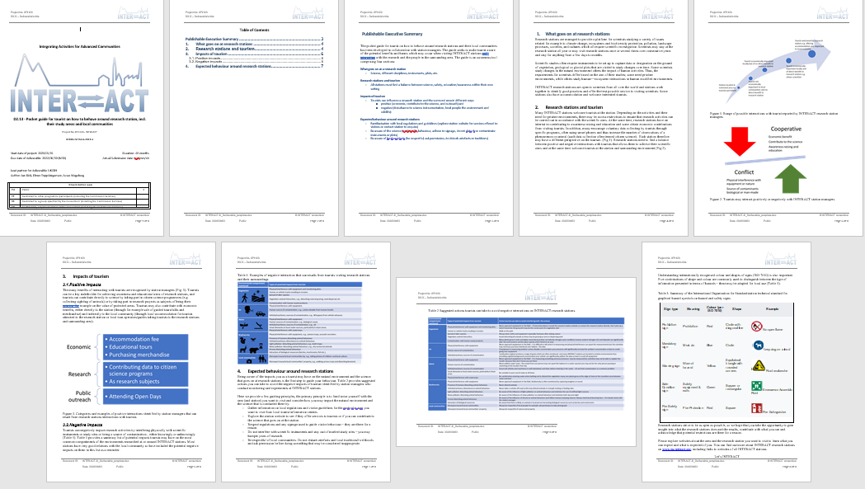
Deliverable D2.13
Pocket guide for tourist on how to behave around research station, incl. their study areas and local communities
Notes:
Point out tables of benefits and negative interactions

Slide 4
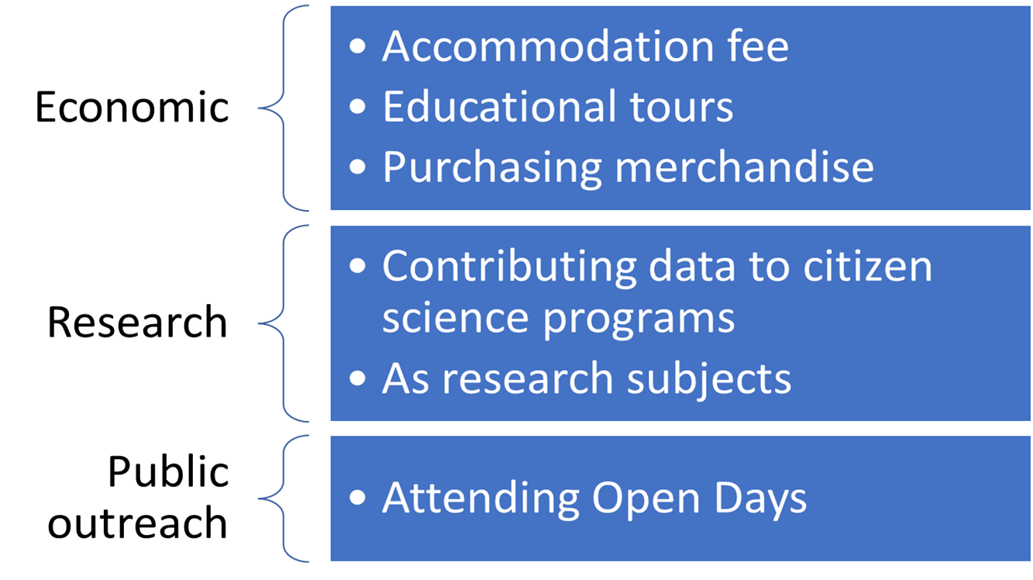
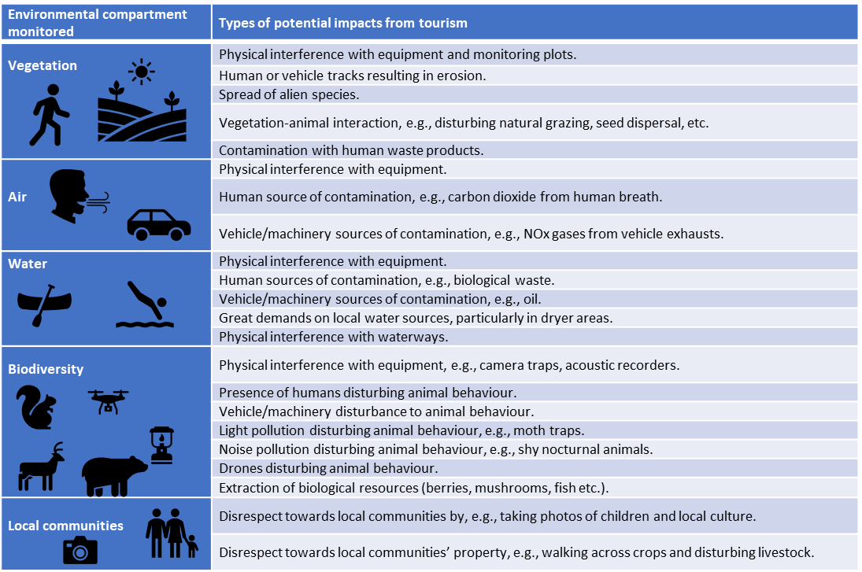
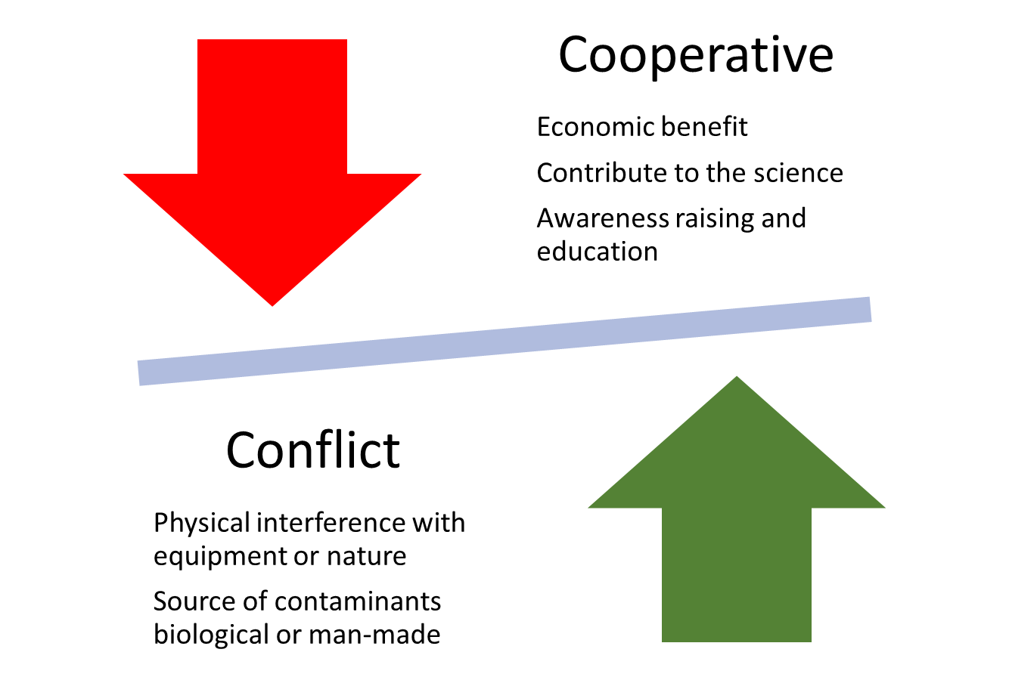
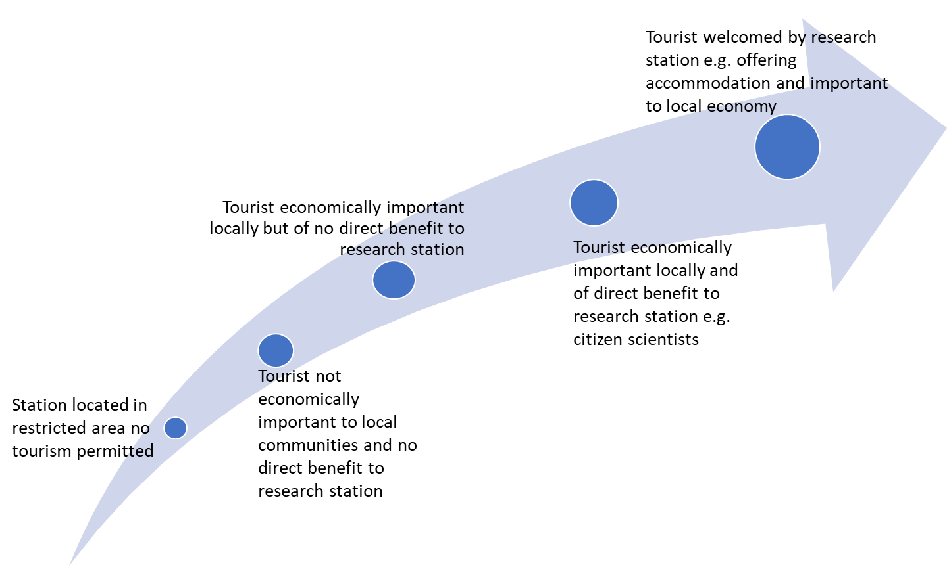
Positive themes
Negative themes
Range of relationships

Slide 5
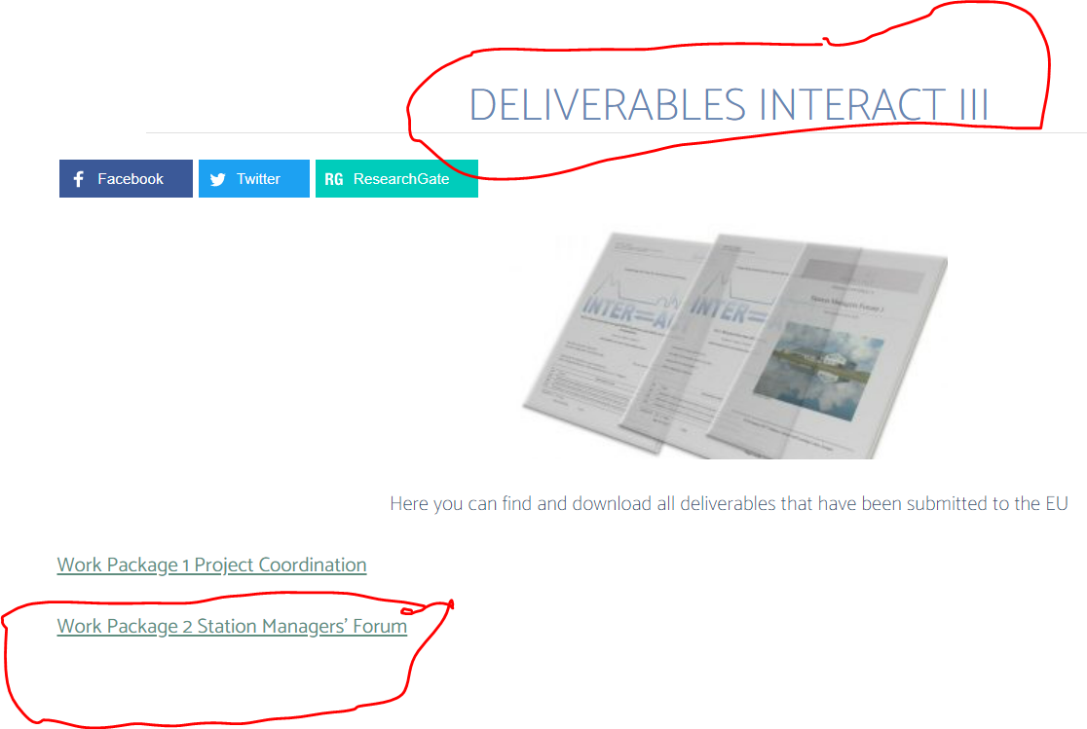
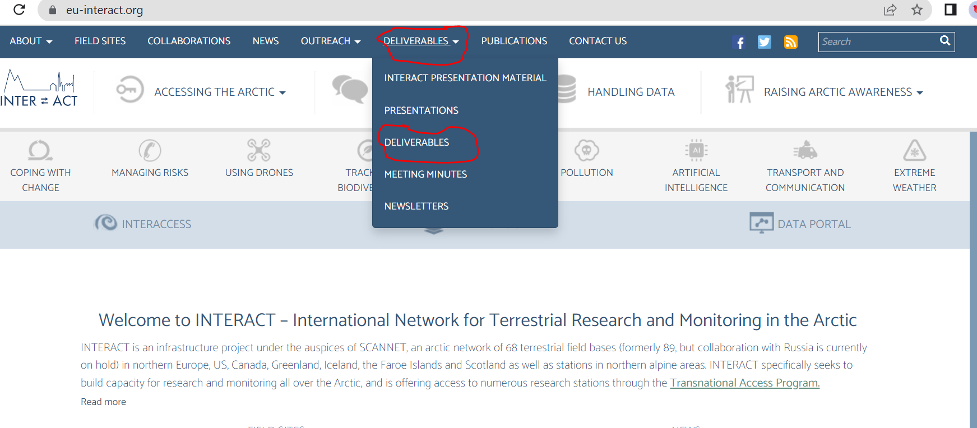
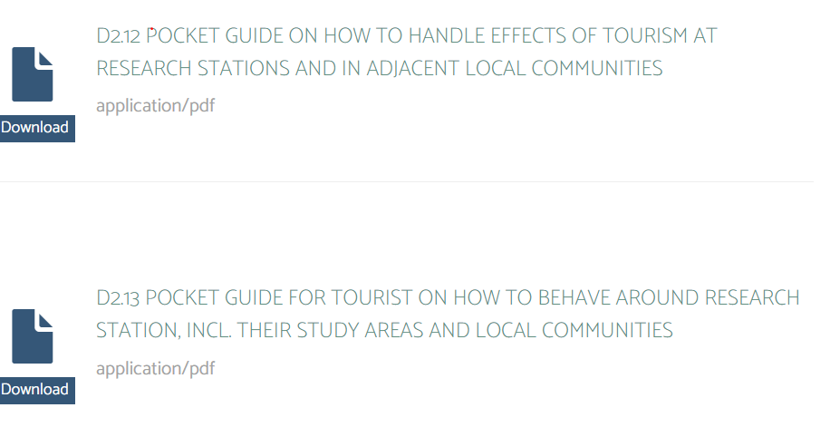
Finding the deliverables?
https://eu-interact.org/
WORK PACKAGE 2 STATION MANAGERS’ FORUM
Scroll down to D2,12 and D2,13

Slide 6
Task 2.6 The Arctic Resort (Lead: UKCEH)
Do you want to co-author a research article based on this task?
By Jan Dick, Chris Andrews, Elmer Topp-Jørgensen, Susse Wegeberg
And all those who contributed to the deliverables

Slide 7
Potential research paper: The relationship between tourists and long-term environmental research facilities in arctic and alpine environments.
Authors, Institute and address, Email
INTRODUCTION – artic melting/changing, need to monitor environment – need for INTERACT
Explain INTERACT range of stations types, range of science conducted e.g. a summary of TA topics
Tourism in arctic and alpine environments increasing – can be beneficial or can be harmful
Aim of paper to quantify within INTERACT network relationship been tourists and scientists at long-term environmental monitoring stations
METHOD - we adopt an exploratory sequential mixed methods design (qualitative followed by quantitative)
RESULTS - explain range of relationship of INTERACT stations with tourists - results of survey
Report benefits identified by station managers of tourists for their place Report actions station managers found effective and non-effective to influence positive behaviours of tourists (using awareness, nudging and regulation framework)
Report negative impact of tourists reported by station managers
Report actions station managers found effective and non-effective to avoid or reduce negative interactions with tourists
DISCUSSION - human behaviour theory, social exchange theory comparing transactional and non-transactional relationships
ACKNOWLEDGEMENTS
REFERENCES
SUPPLIMENTARY MATERIAL – this can be a data paper if anyone volunteers so we all get our names on 2 papers ☺.
Tourism Management Impact factor 10.967
Journal of Travel Research Impact factor 10.87
Annals of Tourism Research Impact factor 9.011
Other ??
Notes:
Invite people to join paper

Slide 8
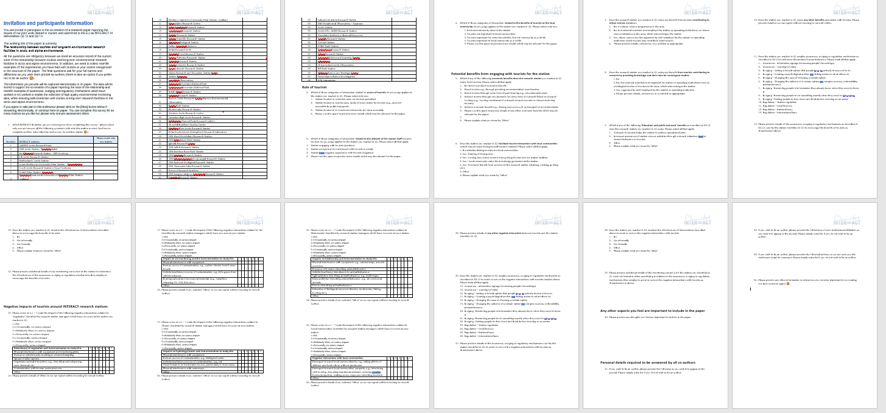
Quantitative data collection tool
Potential benefits
Role of tourism
Negative impacts
Any other aspects
Personal details required to be answered by all co-authors

