Slide 1
Introduction and progress since last meeting INTERACT III, SMF 5
Morten Rasch¹, Elmer Topp-Jørgensen²,
Marie Frost Arndal², Susse Wegeberg2
¹University of Copenhagen, Denmark, ² Aarhus University, Denmark
INTERACT III, Station Manager Forum 5,
Sudurnes Science and Learning Center, Iceland, 27-28 October 2022

Slide 2
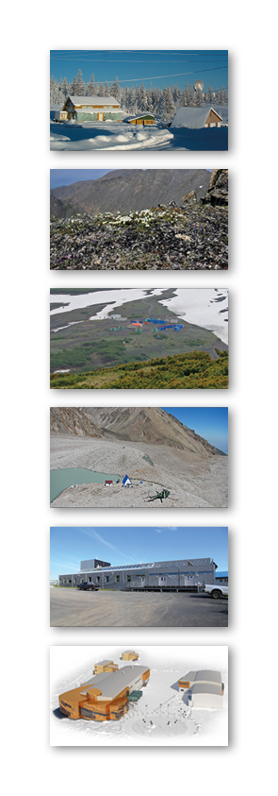
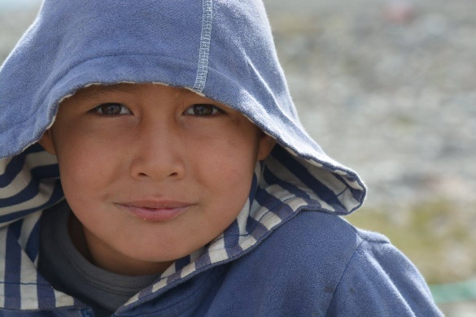
Agenda, Station Manager Forum 5, 27 October 2022
8:30 Welcome and round of introduction (Morten Rasch and Elmer Topp-Jørgensen)
8:50: Activities since last meeting (Morten Rasch and Elmer Topp-Jørgensen)
9:00: INTERACT Arctic Safety Guidebook (Morten Rasch and Elmer Topp-Jørgensen)
10:00: Coffee
10:30: INTERACT Arctic Safety Guidebook (report back in plenum)
INTERACT III, Station Manager Forum 5,
Sudurnes Science and Learning Center, Iceland, 27-28 October 2022

Slide 3
Agenda, Station Manager Forum 5, 27 October 2022
10:50: Tourism pocket guide for research stations (Jan Dick)
11:00: Comments to CAFF Extreme events and rapid biodiversity changes guidance tool (Susse Wegeberg and Elmer Topp-Jørgensen)
12:00: Lunch
13:00: Seminar on geopolitics in the Arctic (Martin Breum)
15:00: Coffee
INTERACT III, Station Manager Forum 5,
Sudurnes Science and Learning Center, Iceland, 27-28 October 2022

Slide 4
Agenda, Station Manager Forum 5, 27 October 2022
15:30: Environmental impact survey at stations (Susse Wegeberg and Marie Frost Arndal)
16:00: Repository for selected climate variables (Morten Rasch, Elmer Topp-Jørgensen and Jonas K. Rømer)
16:30: Ideas for upcoming seminar on state of the art environmental monitoring (Elmer Topp Jørgensen)
INTERACT III, Station Manager Forum 5,
Sudurnes Science and Learning Center, Iceland, 27-28 October 2022

Slide 5
Agenda, Station Manager Forum 5, 27 October 2022
16:45: INTERACT GIS (Elmer Topp-Jørgensen)
17:00: Stations to join INTERACT GIS (Elmer Topp-Jørgensen)
18:00: End of Day 1
18:00: Dinner
INTERACT III, Station Manager Forum 5,
Sudurnes Science and Learning Center, Iceland, 27-28 October 2022

Slide 6
Agenda, Station Manager Forum 5, 28 October 2022
8:30: Introduction to Day 2 (Elmer Topp-Jørgensen and Morten Rasch)
8:40: AECO Tourist guide template (WP9) (Melissa Nacke)
9:00: Course on local involvement in research and monitoring (Michael Køie Poulsen)
10:00: Coffee
10:30: INTERACT Minimum Monitoring System (Efren Lopez-Blanco)
11:00: AMAP emerging contaminant monitoring (Simon Wilson)
INTERACT III, Station Manager Forum 5,
Sudurnes Science and Learning Center, Iceland, 27-28 October 2022

Slide 7
Agenda, Station Manager Forum 5, 28 October 2022
11:30: Open floor (Elmer Topp-Jørgensen)
11:55: Round-up of Station Manager Forum 5 (Morten Rasch)
12:00: End of Station Manager Forum 5
Thursday at 19:30
New publication launch event
INTERACT III, Station Manager Forum 5,
Sudurnes Science and Learning Center, Iceland, 27-28 October 2022

Slide 8
Agenda, Station Manager Forum 5, 27 October 2022
16:45: INTERACT GIS (Elmer Topp-Jørgensen)
17:00: Stations to join INTERACT GIS (Elmer Topp-Jørgensen)
18:00: End of Day 1
18:00: Dinner
INTERACT III, Station Manager Forum 5,
Sudurnes Science and Learning Center, Iceland, 27-28 October 2022

Slide 9
Self-introduction – keep it short
INTERACT III, Station Manager Forum 5,
Sudurnes Science and Learning Center, Iceland, 27-28 October 2022

Slide 10
BBC four short online films for INTERACT
INTERACT is excited to be working with the BBC Natural History Unit to produce four short films that will feature on online digital platforms as education tools. These four films will tackle issues of, disappearing homes of indigenous communities, the effects of increasing tourism, extreme weather events and the impacts of Arctic amplification.
Sarah Titcombe from BBC is presented here at the meeting and she would like to establish contact with anyone who could support the production.
INTERACT III, Station Manager Forum 5,
Sudurnes Science and Learning Center, Iceland, 27-28 October 2022

Slide 11
BBC four short online films for INTERACT
BBC will be rely heavily on the use of supporting material from external sources and need your help. They would welcome any footage (camera or drone) or photos you may have acquired during your field seasons/research.
In particular the BBC is interested in material to support the following topics related to a warming Arctic:
First hand accounts of changes that Indigenous communities are seeing in their landscapes
Ecology and biodiversity change
Permafrost thaw monitoring
Forest and tundra fires, changes in sea ice dynamics
Effects of arctic amplification and positive feedback loops (changes in the albedo effect)
Impacts of Arctic tourism on the environment
INTERACT III, Station Manager Forum 5,
Sudurnes Science and Learning Center, Iceland, 27-28 October 2022

Slide 12
BBC four short online films for INTERACT
PLEASE FIND SARAH AT THE CONFERENCE FOR MORE DETAILS
sarah.titcombe@bbc.co.uk
+44 (0)7930916379
INTERACT III, Station Manager Forum 5,
Sudurnes Science and Learning Center, Iceland, 27-28 October 2022

Slide 13
Let’s INTERACT
INTERACT III, Station Manager Forum 5,
Sudurnes Science and Learning Center, Iceland, 27-28 October 2022

Slide 14
Progress since last meeting INTERACT III, SMF 5
Morten Rasch¹, Elmer Topp-Jørgensen²,
Marie Frost Arndal², Susse Wegeberg2
¹University of Copenhagen, Denmark, ² Aarhus University, Denmark
INTERACT III, Station Manager Forum 5,
Sudurnes Science and Learning Center, Iceland, 27-28 October 2022

Slide 15
Daily Station Manager Forum Activities
Ensure progression of tasks
Liaise with other WPs
Representing INTERACT/SMF at international meetings/workshops/conferences
Cooperation with other infrastructure networks and organisations
Operate INTERACT GIS
Circulate 360 cameras
INTERACT III, Station Manager Forum 5,
Sudurnes Science and Learning Center, Iceland, 27-28 October 2022

Slide 16
Handbook
Overall idea with all these handbooks: Making INTERACT the place to seek information concerning fieldwork in the arctic and run of arctic and northern alpine research stations
Reducing the CO2 Emissions in Arctic Science (WP5)
Status:
Published
Cooperation:
APECS and INTERACT
Authors:
Svenja Holste
Sophie Duveau
Marta Moreno Ibáñez
Deniz Vural
Rebecca Duncan
Gwenaëlle Gremion
Susana Hancock
Paul Rosenbaum
Tatiana Burmenko
Femi Anna Thomas
Morten Rasch
Editors:
Svenja Holste
Morten Rasch
Elmer Topp-Jørgensen
Pages: 98
REMEMBER THE BOOK LAUNCH Thursday at 19:30
Upcoming products:
INTERACT Reducing the Environmental Impact of Arctic Research Stations. Status: Preliminary manuscript ready for review
INTERACT Arctic Safety Manual. Status: Writing group under establishment

Slide 17
INTERACT GIS
Recent developments and plans ahead:
Restructuring of the system with focus on
- improved GIS platform (map)
- station catalogue info integration and search function
- simplicity and usability
Scientific networks and thematic maps features
Development of upload function for project metadata
Presentation by Elmer Topp-Jørgensen
16:45
If you have not already registered, please do so NOW
INTERACT III, Station Manager Forum 5,
Sudurnes Science and Learning Center, Iceland, 27-28 October 2022

Slide 18
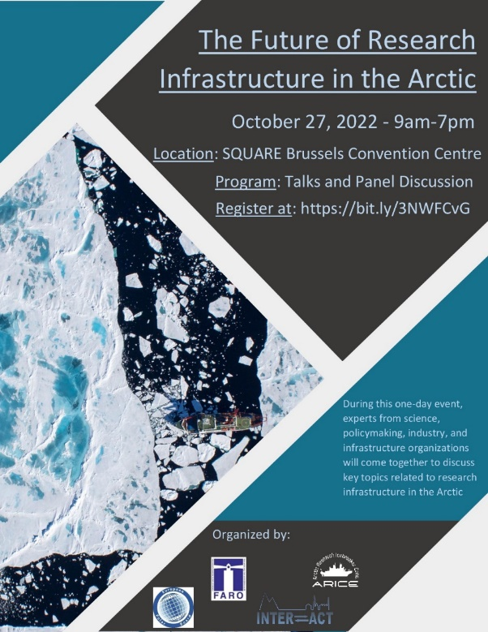
Joint FARO, INTERACT and EPB Meeting in Bruxelles
Paper in Polar Record: Kate Ruck, Marie Frost Arndal, Nicole Biebow, Justiina Dahl, Stig Flått, Mats Granskog, Svenja Holste, Josefine Lenz, Jennifer Mercer, Franziska Pausch, Anna-Maria Perttu, Morten Rasch, Maria Samuelsson, Arild Sundfjord, Femi Anna Thomas, Elmer Topp-Jørgensen and Veronica Willmott (2022). International access to research infrastructure in the Arctic. Polar Record 58.

Slide 19
Open Station events material
Three posters and three roll-up displays – to be adapted for specific purposes by stations

Slide 20
Other things
Pocket guide on how to handle tourism at INTERACT stations developed with WP9. Deliverables will be made to a brochure for tourists and a pocket guide for stations. Presentation by Jan Dick at 10.50. Respond to Jan Dicks request for information and be co-author of a scientific paper (bonus product).
Extreme events and rapid biodiversity monitoring developed with WP4 and CAFF/CBMP – presentation by Susse and Elmer at 11.00.
Survey of environmental impacts conducted developed with WP8 – results presented by Susse and Marie at 15.30.
INTERACT III, Station Manager Forum 5,
Sudurnes Science and Learning Center, Iceland, 27-28 October 2022

Slide 21
Progress, Deliverables and Milestones
Deliverables
D2.1: INTERACT GIS with new features
D2.2: Updated digital Station Catalogue integrated in INTERACT GIS
D2.6: Guide on research permit systems for all arctic countries on INTERACT website
D2.7: Pocket guide on how to reduce CO2 emissions in Arctic science
D2.12: Pocket guide on how to handle effects of tourism at research stations and in adjacent local communities
D2.13: Pocket guide for tourist on how to behave around research station, incl. their study areas and local communities
Milestones
M2.1-5: SMF Meetings
M2.6-9: Seminars on themes chosen by station managers
M2.10: Technical staff workshops
M2.11: Workshop on best practices of research infrastructure management with participation of other communities
M2.14: Session at SMF on communication and positioning systems
M2.17: Selection of photos from different stations provided to WP6
M2.18: Courses on community based monitoring of local relevance held at schools and/or high schools near four stations
M2.21: Course for station managers on improvement of communication to decision makers
Conclusion:
We have postponed a few deadlines due to COVID-19 but are otherwise
on track ☺
INTERACT III, Station Manager Forum 5,
Sudurnes Science and Learning Center, Iceland, 27-28 October 2022

Slide 22
Let’s INTERACT
INTERACT III, Station Manager Forum 5,
Sudurnes Science and Learning Center, Iceland, 27-28 October 2022

