Slide 1
INTERACT/AMAP Seminar Arctic contaminants and plastic monitoring Waste handling
INTERACT/AMAP seminar, 10 March 2021
Simon Wilson, Elmer Topp-Jørgensen, Marie Arndal, Morten Rasch

Slide 2
Programme
17:00: Opening and introduction to seminar (Morten Rasch)
Session on Arctic contaminants and plastic monitoring
17:10: AMAP Arctic contaminant and plastic monitoring programmes (Simon Wilson)
- Short into to AMAP monitoring programme in general (Simon Wilson)
- Short introduction to ‘contaminant screening’ methods (Katrin Vorkamp)
- Short introduction to practical issues, guidelines and protocols (Pernilla
Bohlin Nizzetto)
- Introduction to WP8 survey form (attached) and request for Station Managers
to complete this (Simon Wilson)

Slide 3
Programme (continued)
Session on Waste handling
18:10: Waste handling at INTERACT Stations (Elmer Topp Jørgensen)
- Waste handling system at Toolik Field Station, Alaska (Donie Bret-Harte)
- Government guidelines for waste handling at temporary field camps in
Greenland (Janne Fritt-Rasmussen/Kim Gustavson)
18:40: Designing a survey on resource use and waste handling at INTERACT stations
(Elmer Topp-Jørgensen)
18:55: New SMF products of relevance to the topic (Morten Rasch)
19:00: Closing of seminar (Morten Rasch)

Slide 4
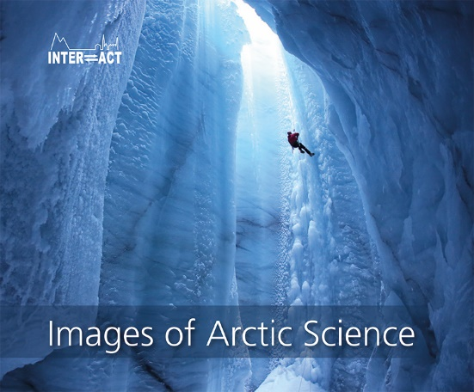
Books in pipeline or recently published
INTERACT Images of Arctic Science
INTERACT Science Stories II
INTERACT Communication and Navigation Guidebook
INTERACT Reducing the Environmental Impacts of Arctic Fieldwork
INTERACT Reducing the Environmental Impact of Arctic Research Stations

Slide 5
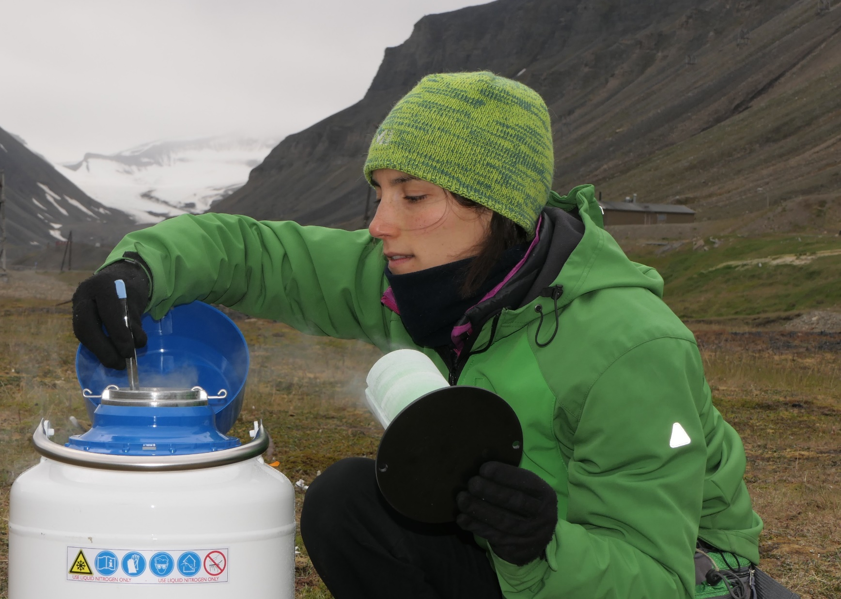
INTERACT Reducing the Environmental Impacts of Arctic Fieldwork
Content:
About this book
1 Planning your fieldwork
2 Transport
3 At the research station
4 In the field
5 After the fieldwork

Slide 6
INTERACT Reducing the Environmental Impact of Arctic Research Stations
Content:
About this book
1 Environmental management 2 Infrastructure and logistics 3 Energy 4 Water 5 Solid waste Appendices

Slide 7
Let’s INTERACT

