Slide 1
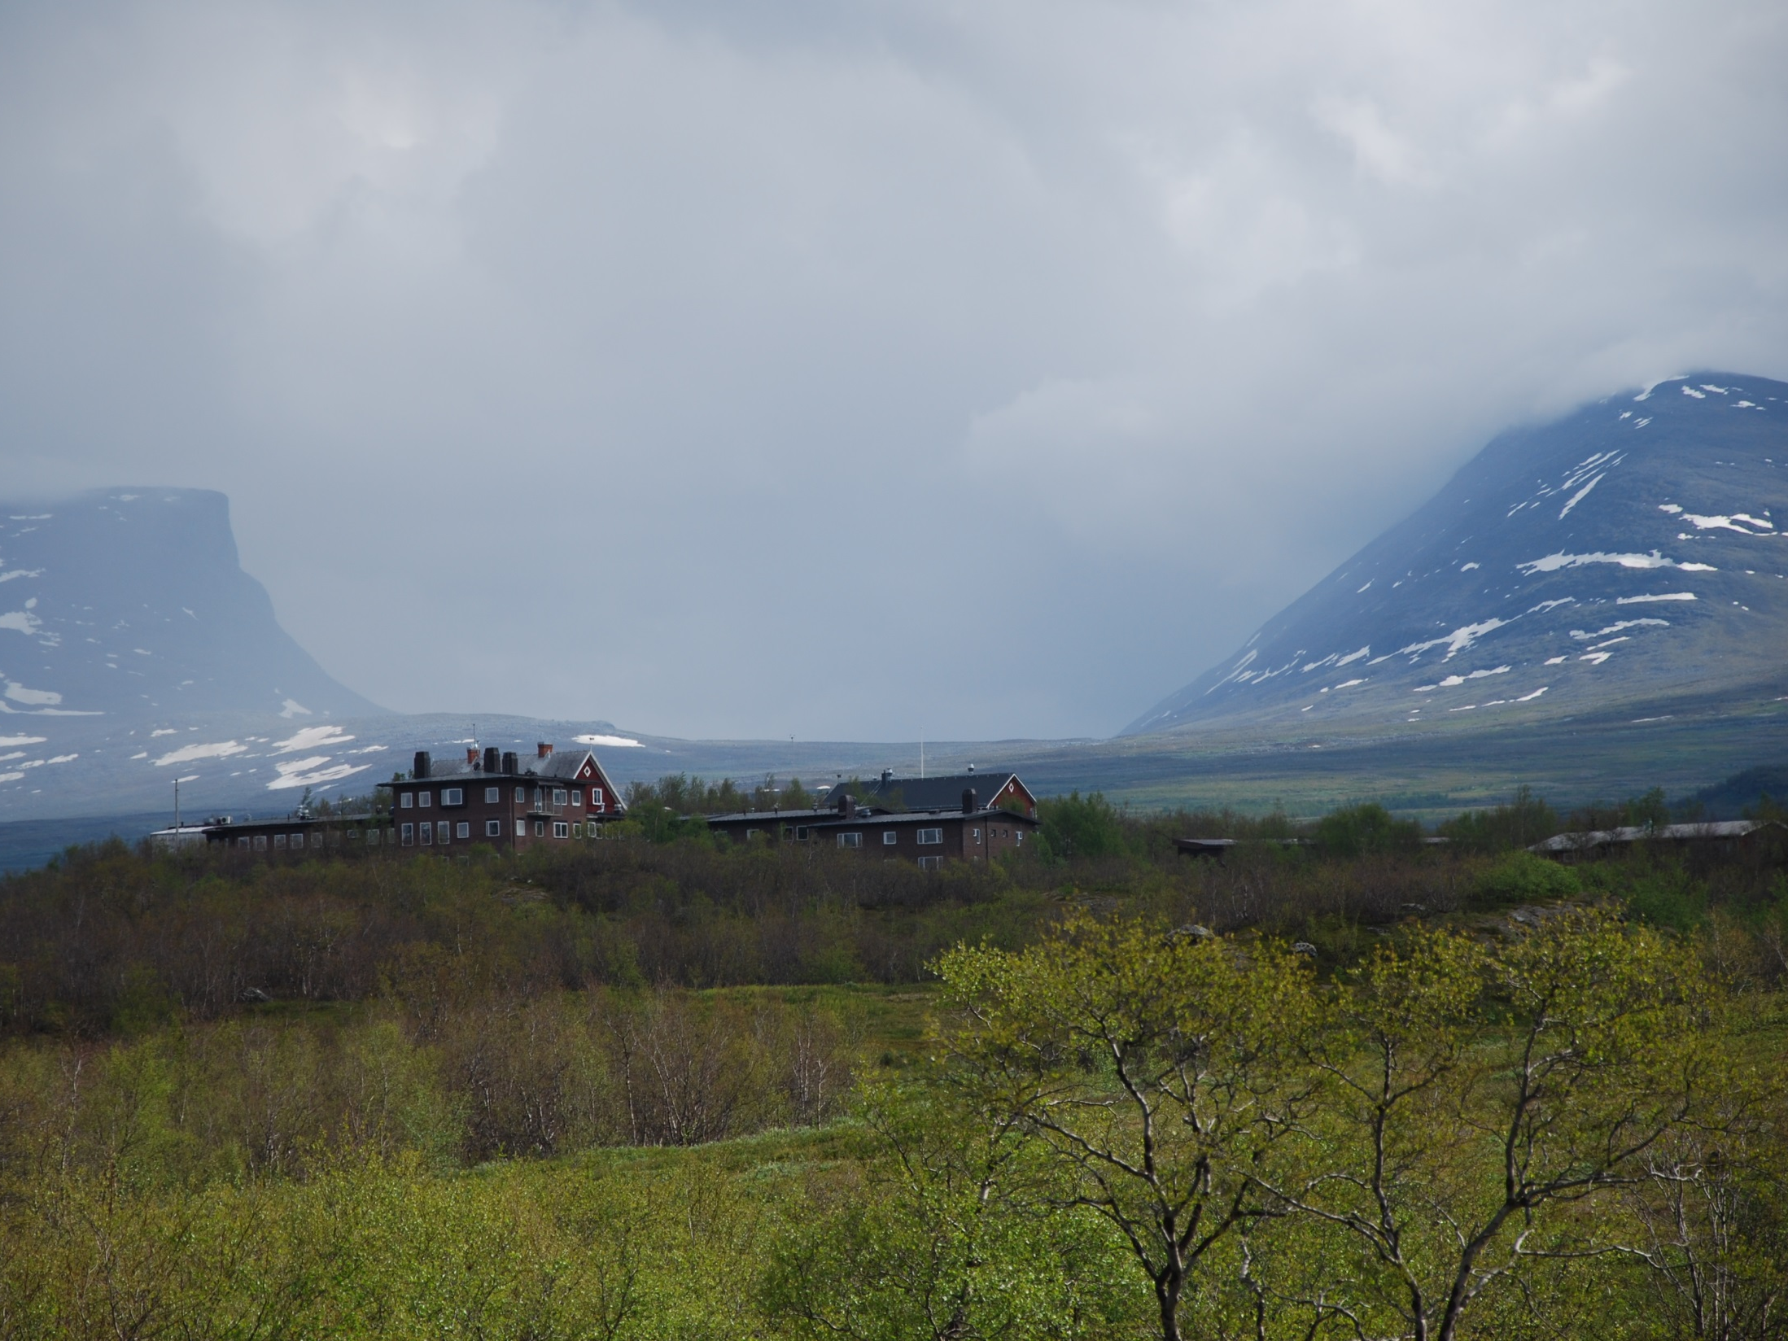
INTERACT – a Pan-arctic network of 83 terrestrial field stations
Margareta Johansson, Lund Universiy on behalf of INTERACT Friends

Slide 2
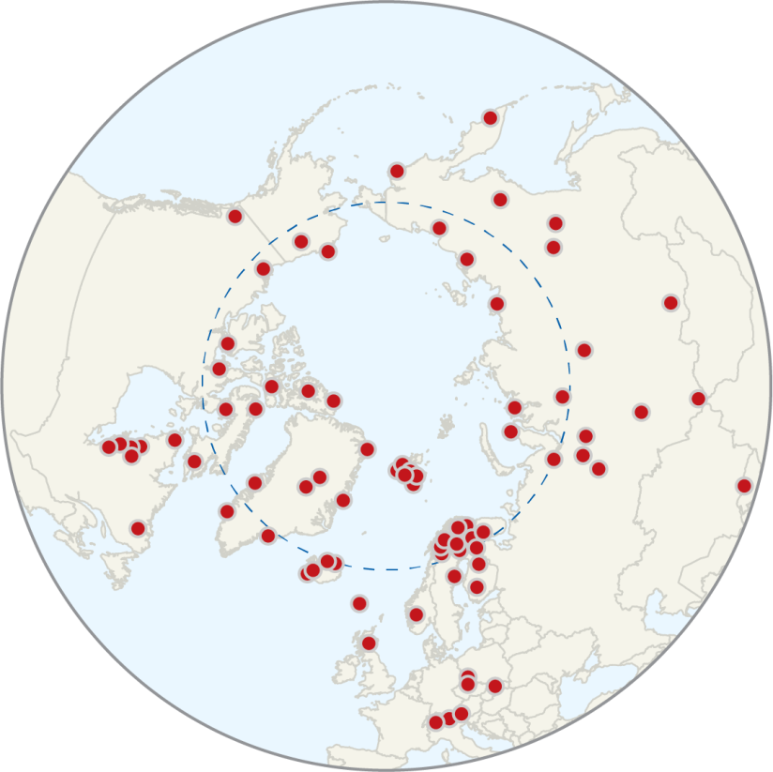
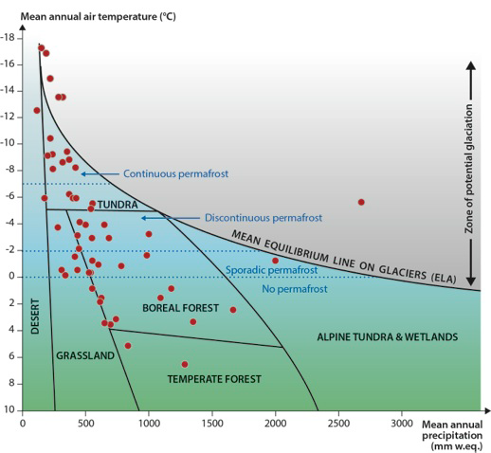
Building capacity for monitoring, research and education throughout the Arctic
84 research stations

Slide 3
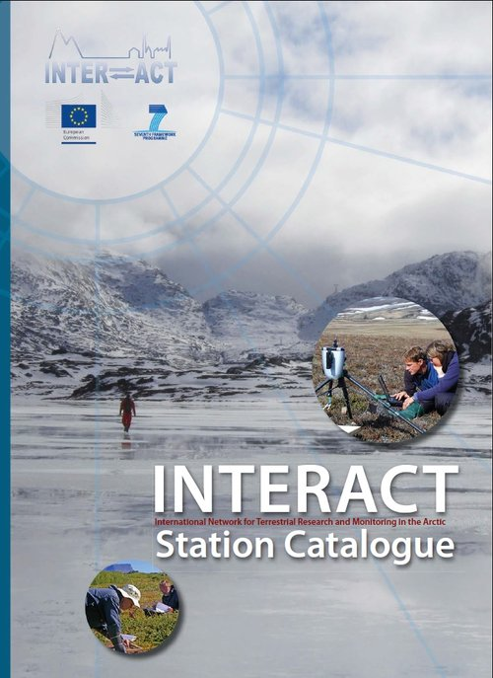
Presentation of each station…

Slide 4
2nd Phase of INTERACT – an advanced community!
In a nutshell:
4 yr project in Horizon 2020
Starting date 1 Oct 2016
47 partners from all Arctic countries
Total budget 10 million EUR

Slide 5
Transnational Access
Free access to 43 research infrastructures and installations
Max. 90 days per user group
6850 person-days in 2016-2020
Not to national infrastructures
Annual call in Sept-Oct > Decisions in Feb-March

Slide 6
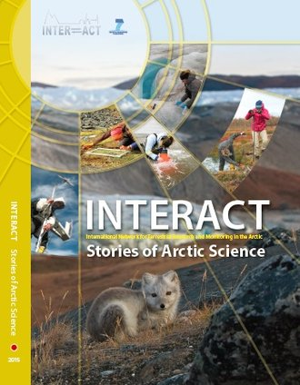
Transnational Access
Examples of Transnational Access projects funded in 2011-2015

Slide 7
Remote Access
Modality of Transnational Access
Station staff collects the samples according to the research plan
17 stations, 970 staff-days
Logistic costs reimbursed
Same application process to TA
Continuous call

Slide 8
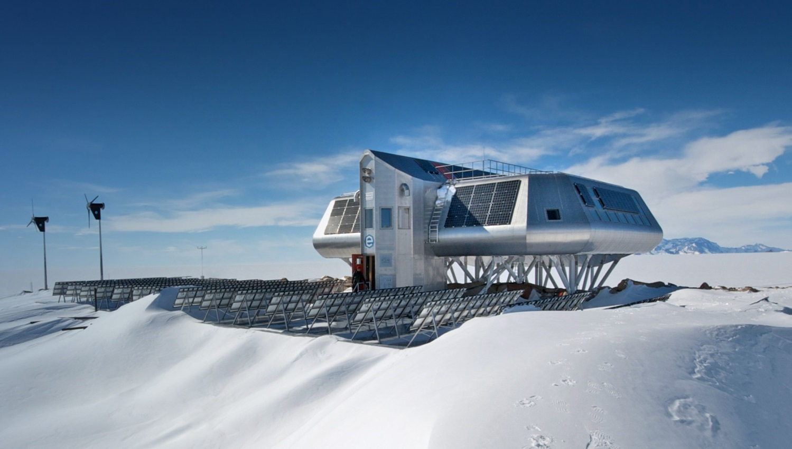
Station Managers’ Forum
Working with Safety
Zero Emission Stations
Monitoring mentoring
INTERACT GIS

Slide 9
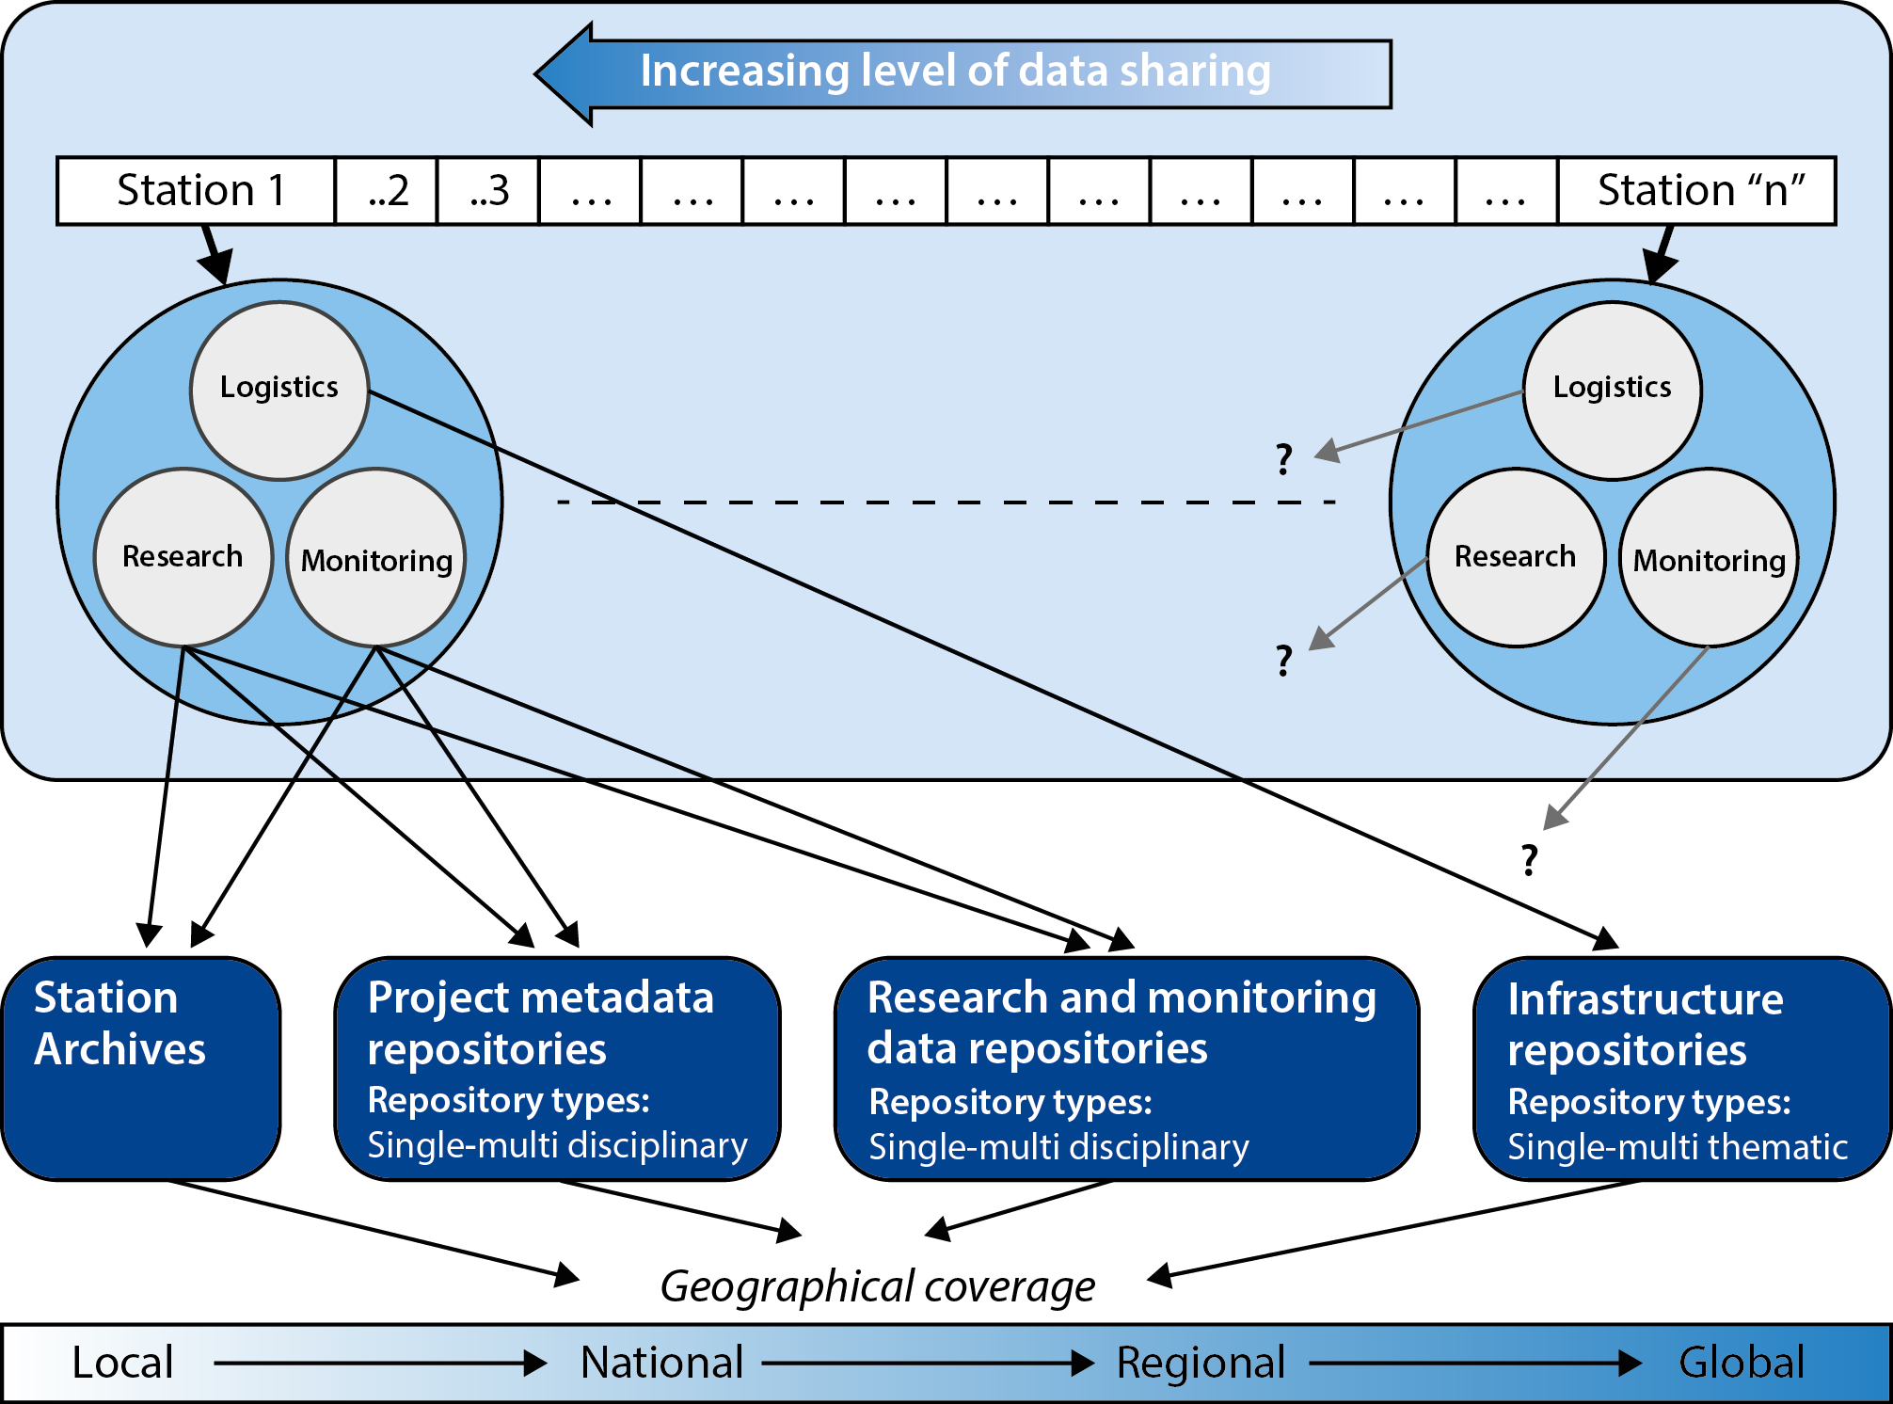
Data Forum
”Half of the INTERACT Research Stations do not have a Data Policy nor a Data Management Plan”

Slide 10
Educational material

Slide 11
Drone Development at INTERACT Stations

Slide 12
Testing biodiversity monitoring scheme at INTERACT Stations
Three test sites:
Rif Station, Iceland
CHARS, Canada
Zackenberg, Greenland

Slide 13
Local Adaptation in communities around INTERACT Stations
Fisher community in Greenland
Reindeer community in Scandinavia
Forestry community in Siberia

Slide 14
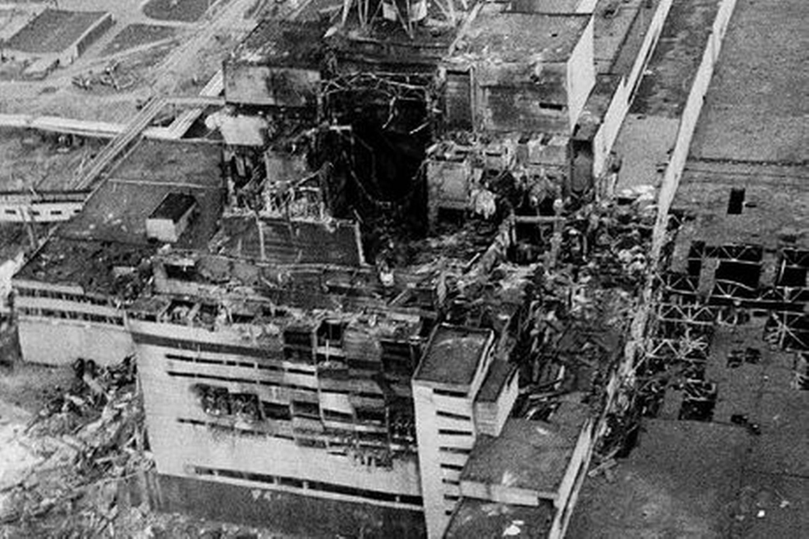
Managing Risks
Fisher community in Greenland
Reindeer community in Scandinavia
Forestry community in Siberia

Slide 15
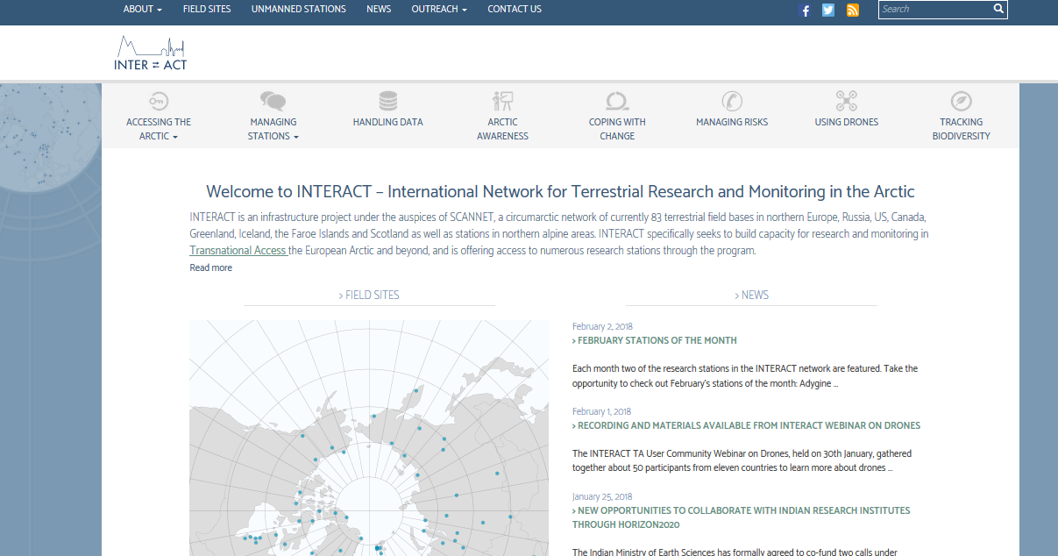
Learn more about INTERACT
https://eu-interact.org/

Slide 16
Thanks for your attention
Photo: Henrik Spanggård Munch
https://eu-interact.org/

